Slide 1


Spanish II
Spanish III
AP Spanish
Orange High School
Academic Year
2020 -2021

Slide 2
Back to School Night
Buenas noches!!
Bienvenidos !!!

Slide 3
Spanish II, Spanish III and AP Spanish
Twilight Program-Spanish I and II
Sra. Anto
Email: antomila@orange.k12.nj.us Phone #: (973) 677 – 4050; Ext. 5085

Slide 4


Slide 5
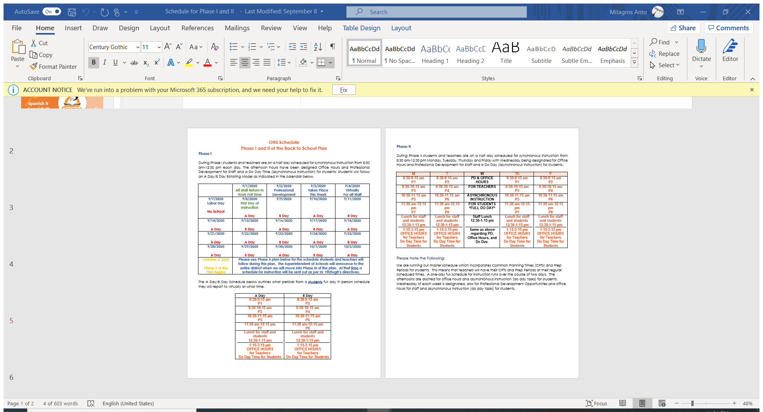

Slide 6
REMIND CODES
Spanish II -1A
@3h3dg8k
Spanish III- 2B
@a8fb7g

Slide 7
REMIND CODES
AP Spanish 4B
AP Spanish 8B
@e9b24f

Slide 8
REMIND CODES
Twilight Program
Spanish I and II
@93dgc8c

Slide 9
Back to School Night
Buenas noches!!
Bienvenidos !!!

Slide 10
Why learn Spanish? ¿Por qué aprender español ?
Video :
https://youtu.be/wk5v2WMd7tQ
WHY LEARN SPANISH VARIOUS PROFESSIONS
https://youtu.be/X-Jbo1cVXM8

Slide 11
Course Description:
Spanish I will provide the student with a general introduction to the Spanish language: sound system, pronunciation, functional vocabulary related to everyday life, cultural information and basic grammatical structures. Emphasis will be on the acquisition of four skills: listening, speaking, reading and limited writing. There are two main objectives to the course. Foremost is to give the students the ability to carry on a simple conversation. The second is to provide the students with instruction that teaches a basic understanding of Spanish culture, vocabulary, and grammatical concepts.

Slide 12
Course Description:
Spanish III - is a course that builds upon the basic communication skills mastered in the Spanish I course. The student will be studying advanced vocabulary and grammatical concepts. This course, using the Natural Approach, introduces the students to basic vocabulary and fundamental sentence structure in the present and preterit tenses. The student will be expected to use these skills in communication within situations studied. Basic aural and reading comprehension is developed and students hold simple conversations and write short compositions about present and past actions. In addition, the student will study aspects of Hispanic culture and history via a variety of media.

Slide 13
Course Description:
Spanish III -The Spanish III course has been designed to reflect the philosophy and goals found in both the national standards, Standards for Foreign Language Learning in the 21st Century (ACTFL,1999) and the New Jersey Student Learning Standards for World Languages (2014). The focus of the course is to provide students with the skills they need to create language for communication. The students continue their study of Spanish from the introduction of new material, through reinforcement, evaluation and review, presentations, exercises and activities, all of which are designed to span all four language skills. The Spanish III course delves more deeply into the nuances of the language, instills in the students an awareness of a powerful culture, discusses economic and political topics, makes a historical connection with the world, offers and analyzes selections from various literary periods and movements related to them, and encourages the students to use their critical thinking skills to make inferences and organize their learning into a coherent “big picture” of today’s world.
.

Slide 14
Course Description:
AP Spanish -The AP Spanish Language and Culture course is a rigorous course taught exclusively in Spanish that requires students to improve their proficiency across the three modes of communication: Interpretive, Interpersonal, and Presentational. The course focuses on the integration of authentic resources including online print, audio, and audiovisual resources; as well as traditional print resources that include literature, essays, and magazine and newspaper articles; and also a combination of visual/print resources such as charts, tables, and graphs; all with the goal of providing a diverse learning experience. Students communicate using rich, advanced vocabulary and linguistic structures as they build proficiency in all modes of communication toward the pre-advanced level.

Slide 15
General Guidelines
When communicating online, you should always:
• Treat your instructor and classmates with respect in email or any other communication.
• Use clear and concise language
BE A PROACTIVE CLASS CITIZEN
BE COOPERATIVE AND RESPECTFUL: Respeto. Siempre Respeto!
Follow all directions the first time given.
Take your posts seriously and review and edit your posts before sending
• Use standard fonts such as Ariel, Calibri or Times new Roman and use a size 10 or 12 pt. font
• Avoid using the caps lock feature AS IT CAN BE INTERPRETTED AS YELLING.
• Limit and possibly avoid the use of emoticons like :) or ☺.
• Be cautious when using humor or sarcasm as tone is sometimes lost in an email or discussion post and your message might be taken seriously or sound offensive.
• Be careful with personal information (both yours and other’s).
• Do not send confidential information via e-mail.

Slide 16
Academic Dishonesty Policy:
Student behavior involving any form of cheating and/or plagiarism will not be tolerated. ACADEMIC DISHONESTY. Pupils are expected to be honest in all of their academic work. To ensure the integrity of Orange High School’s educational program, a strict adherence to our district policy of academic dishonesty will be enforced.
Students are expected to be honest in order to learn and grow as responsible and ethical citizens. Any breach of this standard endangers the learning process and impugns the integrity of the entire school community. The purpose
of education is to prepare students to become lifelong learners, and dishonesty undermines and inhibits that process. No forms of personal and/or academic misrepresentation are permitted. A student, whether cheating
alone or helping another person to cheat, will be subject to the disciplinary procedure.

Slide 17
OHS ATTENDANCE POLICY
Statement of Belief
It is our belief that consistent and prompt student attendance in class is essential to achieve the maximum benefit of the educational experience. Much of what is presented in class is sequential and vital to student learning. Learning requires continuity of attendance and effort. Repeated absences from school or class impede the student’s participation in classroom activities, and thus attendance should be and will be a significant factor in the determination of a student’s grade, according to school policy.
Purpose of the Student Attendance Policy
The purpose of the Orange High School Attendance Policy is to have each student attend all classes, arriving on time and participating fully. Students and parents should familiarize themselves with the provision and procedures of the policy. It is expected that parents will support the intent of the policy and encourage students to maintain good attendance. Official school attendance is taken during the attendance period daily. Classroom attendance is taken every period

Slide 18
Maximum number of absences
Students are expected to attend every class, study hall, independent study and homeroom period. Board Policy requires each student to be present for at least 90% of class meetings in order to be eligible to receive credit. The number of absences in each class may not exceed:
18 Cumulative Absences Full Year Course
9 Cumulative Absences Semester Course
5 Cumulative Absences Quarter Course (Health)
14 Cumulative Absences Physical Education

Slide 19
Grading Policy:
Test –Unit Test -Oral and Written | 25%
QUIZZES – Oral and written | 20%
Classwork (demonstrations/ assignments) | 20%
Authentic Assessments(portfolio/projects) | 25%
Homework (including long term projects, research and nightly reading) | 10%

Slide 20
Padlet- Questions , Concerns and suggestions
https://padlet.com/manto/uxq6b1zyx8ypdh6w

