Slide 1
Cultures of the Mountains and the Sea
Chapter 5 Section 1

Slide 2
Mycenaean
The earliest Greeks, name comes from the city-state Mycenae.

Slide 3
Trojan War
War between the Early Greeks and the City of Troy about 1200 B.C. , fought over trade (& Helen of Troy).

Slide 4
Dorian
Less advanced “northern cousins” of the southern and coastal Greeks.
Moved in after the “sea peoples” destroyed the Mycenaeans – shortly after the Trojan war.
Greek “dark” age begins: no written language - rich oral story tradition develops - Homer’s epics.

Slide 5
Homer
One of the greatest of the Greek Storytellers: author of The Iliad and Odyssey.

Slide 6
Epic
A very long poem / story.

Slide 7
The Iliad
Homer’s Epic story of the Trojan War

Slide 8
Myth
Traditional stories that convey a moral idea, explains nature, or how the world works.
For the Greeks myths represented their ideas about religion (the gods of Mt. Olympus), their history (Trojan War), and the world.

Slide 9
3. What impact did nearness to the sea have on the development of Greece?
Being close to the sea made the Greeks a seafaring people, this helped them to:
Learn the best other cultures had to offer (cultural diffusion).
Ex: adopting the Phoenician alphabet from the Minoans.
  Allows them to take advantage of TRADE.

Slide 10
4. What aspects of culture did the Mycenaeans adopt from the Minoans?
The Mycenaeans adopted the alphabet and pottery as well as religious ideas and myths (the Minotaur).

Slide 11
5. Why were the epics of importance to the Greeks of the Dorian period?
The epics were important b/c the Greeks lacked writing at this time and the epics were a source of history and a common identity.

Slide 12
6. How did the physical geography of Greece cause Greek speaking peoples to develop separate, isolated communities?
The MOUNTAINS of Greece isolated each Greek settlement from each other, eventually these isolated communities would become city-states that were fiercely independent of each other but shared a common language and cultural tradition.

Slide 13
7. Other than the explanation offered in the legend, why do you think the Greeks went to war with Troy?
The Greeks went to war over TRADE b/c TRADE = $$ = POWER!
Troy was strategically located – it controlled the Hellespont, the point at which all sea travel from the Black Sea (& sea of Marmara) must pass to get to the Aegean Sea (and Mediterranean).

Slide 14
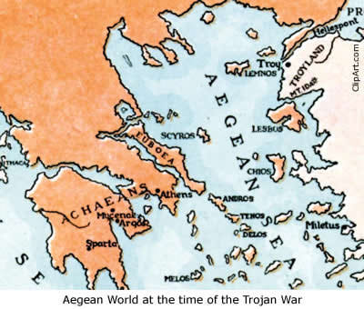
The Hellespont

