Slide 1
Daily Oral Language – February 8, 2013
Objectives
Free Reading Friday
Reading Log #3 is due today

Slide 2
Daily Oral Language – February 6, 2013
1.
1. he don’t have no reason too question the directives but he does want a explanation for this here page
Bell Work – Journaling
Objectives
Free write for five minutes on assigned journal topic
Edit and correct grammar errors
S.S.R. when you are finished
The 5 Paragraph Persuasive Essay
Huck Finn Ch. 33-35
H.W. – Outline is due tomorrow
What qualities do you admire in Derek?
Do you have someone in your life that inspires you?
Write your reaction to this video.

Slide 3

Daily Oral Language – February 5, 2013
1.
1. to ensure success they should require those in the project the ones doing the experiments too have a immediate security check
Bell Work – Journaling
Objectives
Free write for five minutes on assigned journal topic
Edit and correct grammar errors
S.S.R. when you are finished
The 5 Paragraph Persuasive Essay
Huck Finn Ch. 31-32
H.W. – Bring your thesis statement next class period

Slide 4
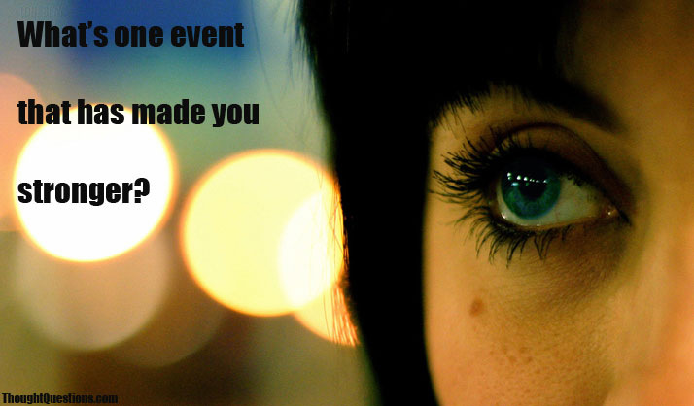
Daily Oral Language – February 4, 2013
1.
1. there are some students who are in this here class that believe no one should not have any homework
Bell Work – Journaling
Objectives
Free write for five minutes on assigned journal topic
Edit and correct grammar errors
S.S.R. when you are finished
Huck Finn through Ch. 30 Quiz

Slide 5
Daily Oral Language – February 1, 2013
Objectives
Free Reading Friday
Reading Log #2 is due today

Slide 6
Daily Oral Language – January 30, 2013
1.
1. the battle of the alamo is a Historic event of interest to many texans
Bell Work – Journaling
Objectives
Free write for five minutes on assigned journal topic
Edit and correct grammar errors
S.S.R. when you are finished
Read Ch. 26-30
Does our country need to modify its current laws and policies on gun control?
What areas need immediate attention and what areas can be addressed in the coming years?

Slide 7
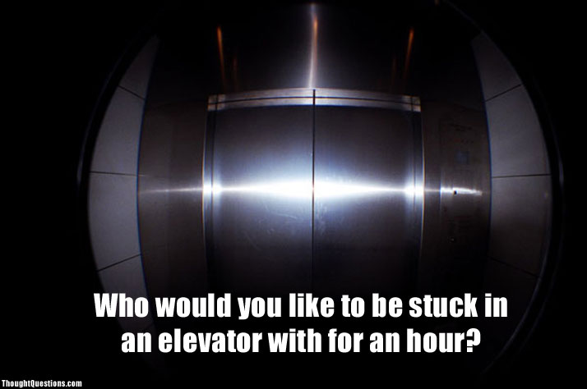
Daily Oral Language – January 29, 2013
1.
1. i think the Mountains in the east is beautiful but mom thinks the ones in the west is most beautiful
Bell Work – Journaling
Objectives
Free write for five minutes on assigned journal topic
Edit and correct grammar errors
S.S.R. when you are finished
Read Ch. 20-25

Slide 8

Daily Oral Language – January 28, 2013
1.
1. the abandoned house that no one is living in is located in the southern part of boulder colorado
Bell Work – Journaling
Objectives
Free write for five minutes on assigned journal topic
Edit and correct grammar errors
S.S.R. when you are finished
Chapter 17-19 Quiz

Slide 9
Daily Oral Language – January 25, 2013
Objectives
Free Reading Friday
Reading Log #1 is due today

Slide 10
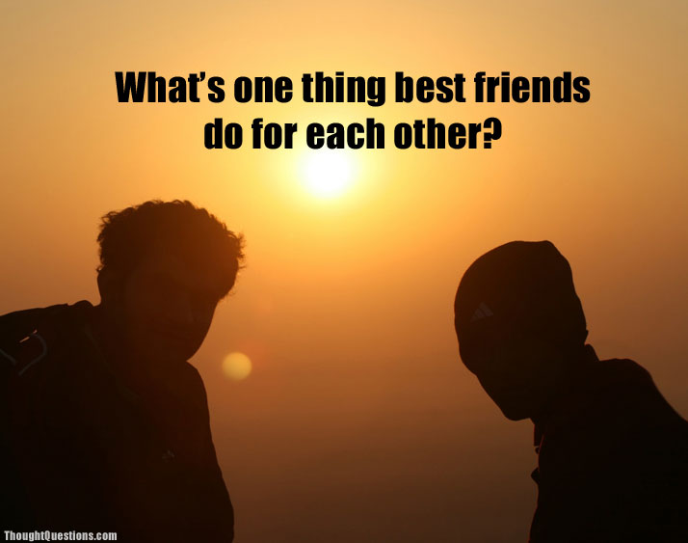
Daily Oral Language – January 23, 2013
1.
1. shes certainly doing good in her new job at the waxford tire co
Bell Work – Journaling
Objectives
Free write for five minutes on assigned journal topic
Edit and correct grammar errors
S.S.R. when you are finished
Read The Adventures of Huckleberry Finn Ch. 17-18
Homework – Finish reading Ch. 18 and read Ch. 19

Slide 11

Daily Oral Language – January 22, 2013
1.
1. on august 28 1988 we visited donna and her mother at 7213 ninth avenue seattle washington
Bell Work – Journaling
Objectives
Free write for five minutes on assigned journal topic
Edit and correct grammar errors
S.S.R. when you are finished
Read The Adventures of Huckleberry Finn Ch. 15-16

Slide 12
Daily Oral Language – January 18, 2013
Objectives
Free Reading Friday
Reading Log Calculator

Slide 13
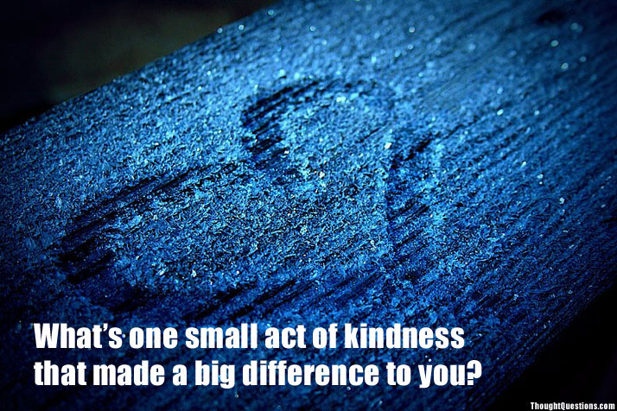
Daily Oral Language – January 16, 2013
1.
1. me and barry visited cliff st in the afternoon and then in the evening we go to the movie willow
Bell Work – Journaling
Objectives
Free write for five minutes on assigned journal topic
Edit and correct grammar errors
S.S.R. when you are finished
Read The Adventures of Huckleberry Finn Ch. 14-

Slide 14
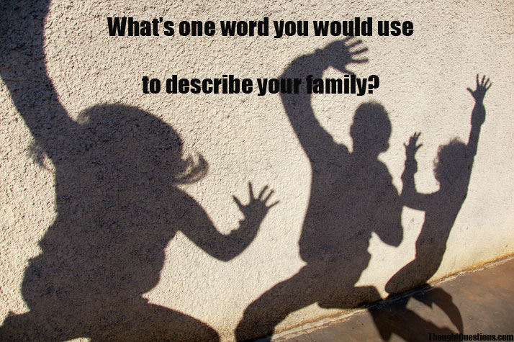
Daily Oral Language – January 15, 2013
1.
1. i would of drew the outline but i didn’t have nothing to draw with
Bell Work – Journaling
Objectives
Free write for five minutes on assigned journal topic
Edit and correct grammar errors
S.S.R. when you are finished
Mark Twain Video and 25 Quotes
Read The Adventures of Huckleberry Finn Ch. 13

Slide 15
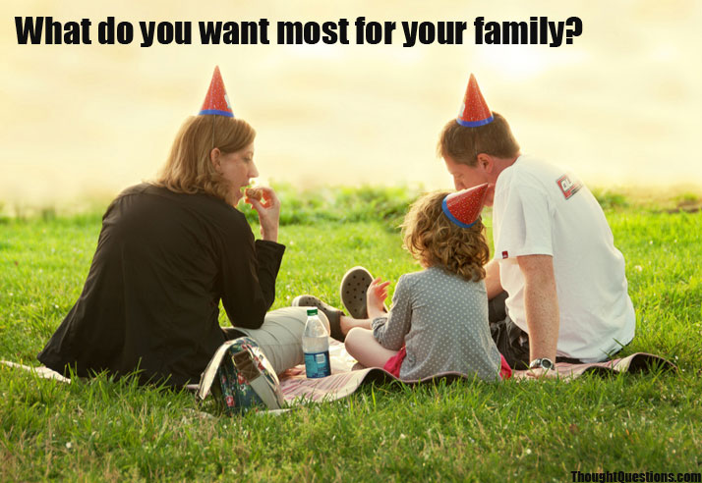
Daily Oral Language – January 9, 2013
1.
1. if you want to see an interesting Television program than watch thriller theater on thursday evenings
Bell Work – Journaling
Objectives
Free write for five minutes on assigned journal topic
Edit and correct grammar errors
S.S.R. when you are finished
Mark Twain Video and 25 Quotes
Read The Adventures of Huckleberry Finn Ch. 12

Slide 16
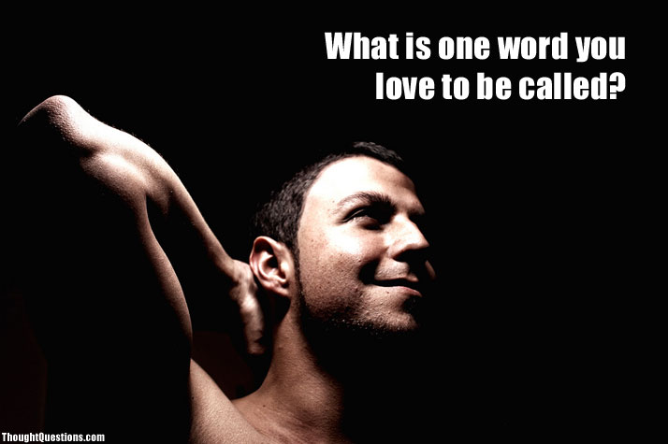
Daily Oral Language – January 8, 2013
1.
1. they haven’t never found the most valuable of the too stole paintings
Bell Work – Journaling
Objectives
Free write for five minutes on assigned journal topic
Edit and correct grammar errors
S.S.R. when you are finished
Mark Twain Video and 25 Quotes
Read The Adventures of Huckleberry Finn Ch. 11

Slide 17
Daily Oral Language – January 7, 2013
1.
1. the pipes freezed I learned because this here furnace didn’t work proper
Bell Work – Journaling
Objectives
Free write for five minutes on assigned journal topic
Edit and correct grammar errors
S.S.R. when you are finished
ABCDE Essay Notes
What was your favorite activity over the break?

