Slide 1

James Clemens
High School
Open House
Fall Semester 2021

Slide 2
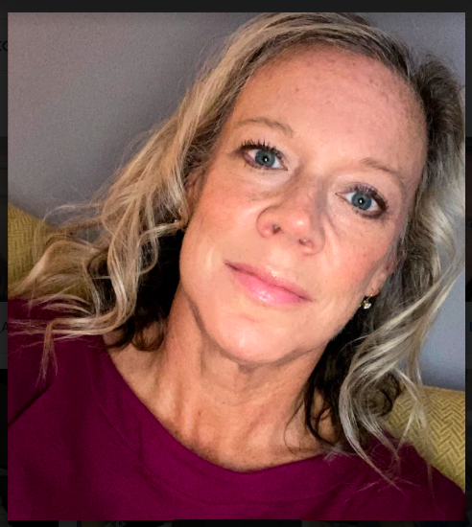
Hello
Ms. H Courtney
17 years in the classroom
Dog lover
Future Teachers of Alabama Sponsor
Junior Class/Prom Sponsor

Slide 3

Which class are YOU in?
1st - Teaching 1 & 2
2nd - Education & Training
3rd - Plan Block
4th - Child Development

Slide 4

What do you need to be successful?
Positive attitude
Intrinsic motivation
Be willing to work
Be willing to ask questions
Own your learning
Own your choices & consequences

Slide 5

What school supplies do I need?
Three ring binder
Loose leaf paper
Black/blue ink
Post Its
Electronic device/charger

Slide 6

What could you donate to our room?
Clorox wipes
Kleenex
Germ-X
Air freshener

Slide 7

Contact Information
hlcourtney@madisoncity.k12.al.us
(256) 216- 5313 EXT

