Slide 1
Welcome to
JCHS
Open House Fall 2021

Slide 2
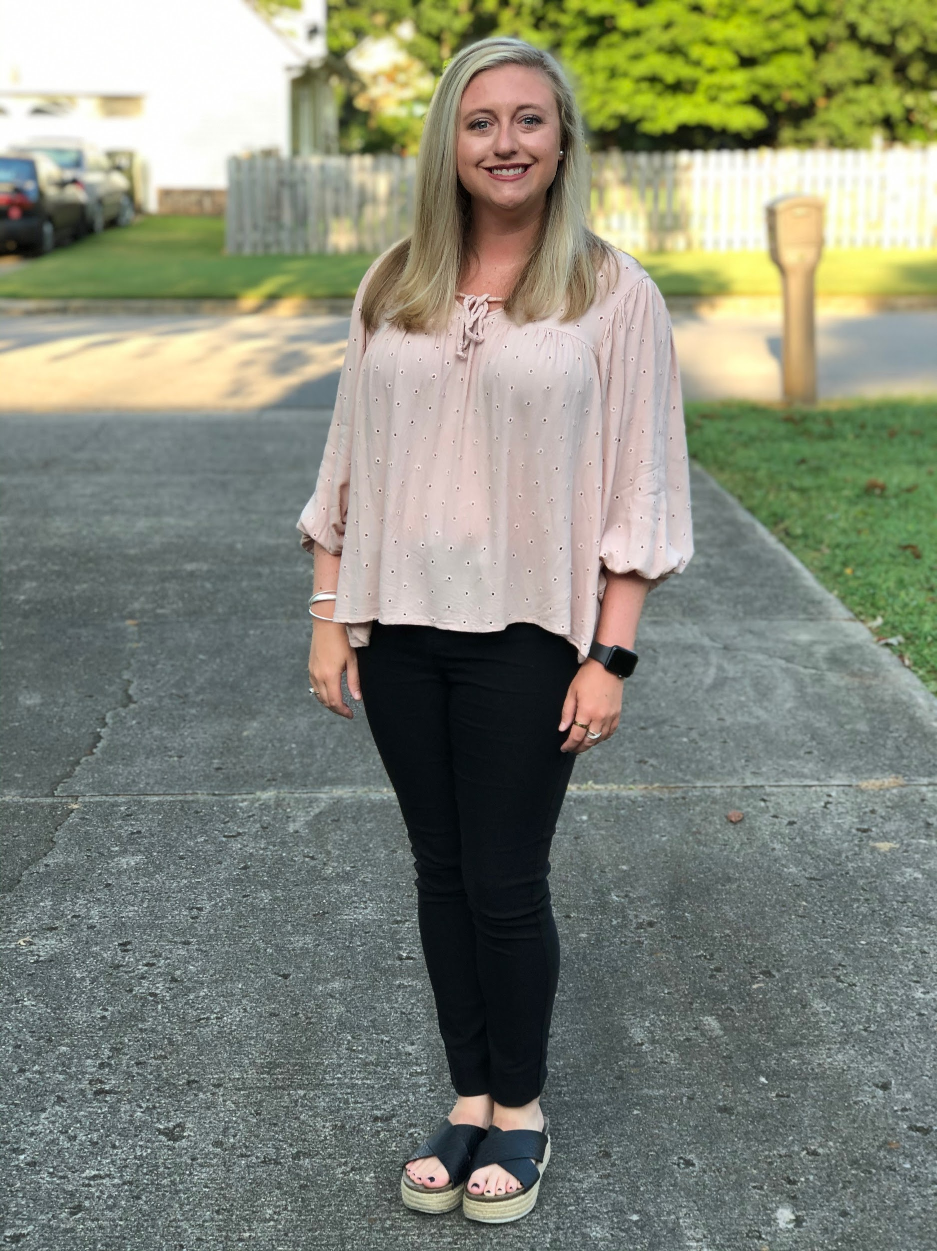
This is my 9th year teaching
I graduated from UNA and UWA.
I’m a big Alabama fan.
I am the head Blue Angels Dance Team Coach.
About Me

Slide 3
Class Schedule
1st Block: Family and Consumer Science (FACS)
2nd Block: Fashion
3rd Block: Fashion
4th Block: Blue Angels Dance Team

Slide 4

What do you need to be successful in my class?
Positive attitude
Good work-ethic
Be willing to work
Be willing to ask questions
Own your learning
Own your choices and consequences

Slide 5
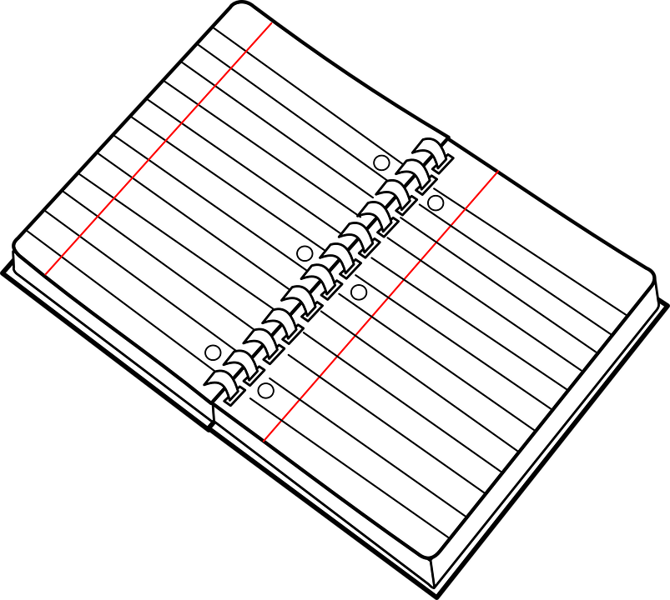
What school supplies do I need for FACS?
3-ring binder
Loose leaf paper
Pencils and Pens (Black/Blue)
Electronic Device

Slide 6
What school supplies do I need for Fashion?
3-ring binder
Loose leaf paper
Pencils and Pens (Black/Blue)
Electronic Device
Sketch Book
Hand Sewing Kit

Slide 7

What could you donate to our room?
Clorox wipes
Kleenex
Germ-X
Leftover fabrics/thread

Slide 8
Contact Information
rscourtney@madisoncity.k12.al.us
(256) 216- 5313 EXT 95053

