Slide 1
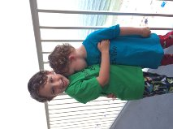
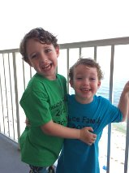
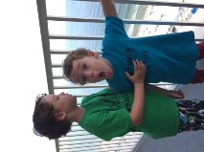
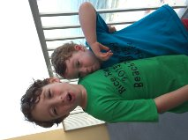
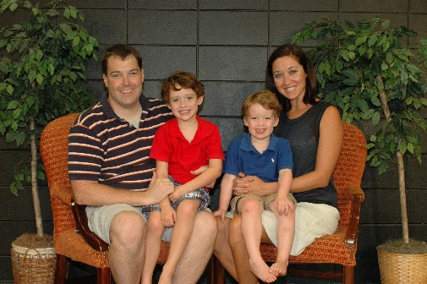
8th Grade Ancient and Medieval World History
Leslie Carlson
*National Board Certified since 2009
*13th year at MBJH
*Married to Nathan, a history teacher at Homewood High
*We have two little boys, Gabriel and Gideon.

Slide 2
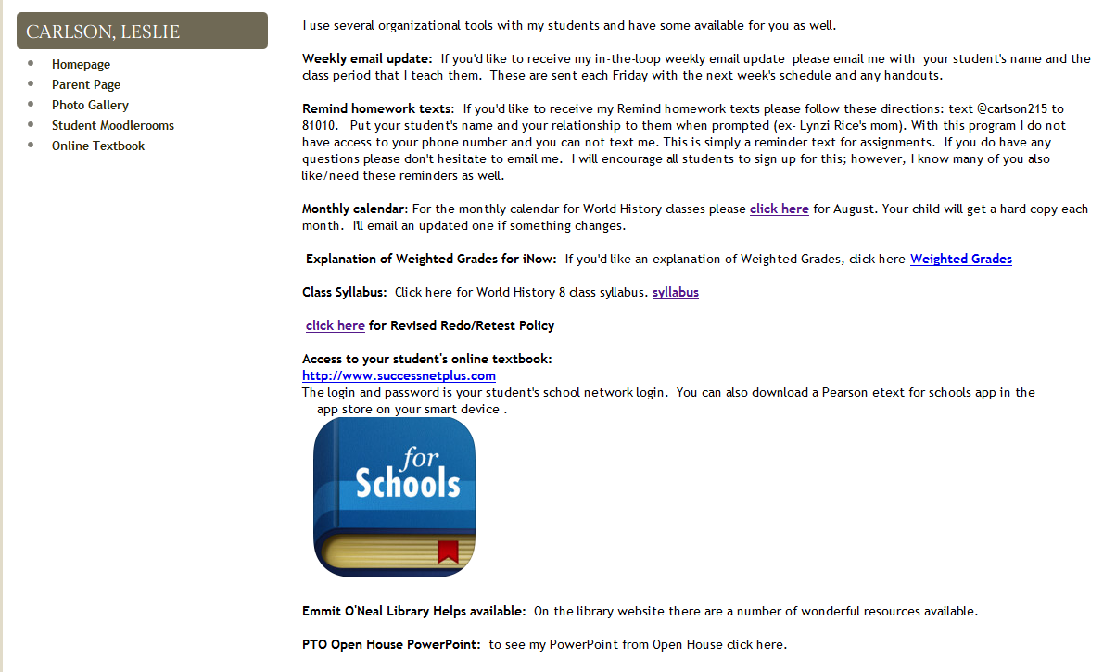

Slide 3
Skills we work on this year:
Writing
Notes from text and from videos – in binder, use Learning Targets/Guided Targets to guide text notes
For study: standard based Guided Targets for each unit, using Learning Style for study tools and to organize study groups
Learning Style
know it and work from areas of strength
Independence/Responsibility
Email teacher when absent, use before school or AO time with teacher as needed, self-reflection after each test, managing short and long term assignments using the monthly calendar and Remindtexts, using Moodleroom for review
Higher Level Thinking skills
Document Based Questions on Tests with comparisons, sequencing, evaluation and analysis

Slide 4
Tools I provide for the students
Xeroxed copies: guided targets of each unit, monthly calendar, project instructions, reflection/goals
Moodleroom: Resources for the year, all items handed out in class are also here, PowerPoints of each section after I teach it, in class readings, extra helps like charts for a difficult section of notes
Remind: a text or email service for students with a daily reminder of what is on my white board and on the calendar for Homework.
My time: I arrive at school by 7:15 am every morning and am available to meet with students or with a pass during AO.
Chromebooks! Students are welcome to come before school or during AO and obviously during class if its an appropriate time.

Slide 5
Course Description: The 8th grade course is a survey of world history and geography from prehistory to the Renaissance/Reformation/Scientific Revolution (around 1500). Our extended studies will include: the 4 river valley civilizations, Ancient Greece, Ancient Rome, Europe in the Middle Ages and Renaissance. This study of the world will be continued in the 9th grade with a modern world history and geography course.
We start with the caveman in the Paleolithic Age at 10,000 BC and then fast forward through to cover 5,000 years of “civilized” history. The way our curriculum lines up, we end up going around the world twice.

Slide 6

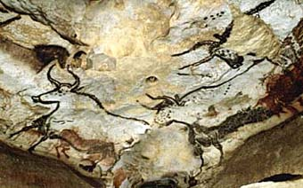
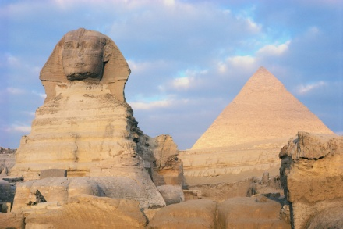
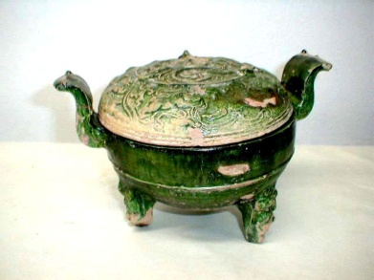
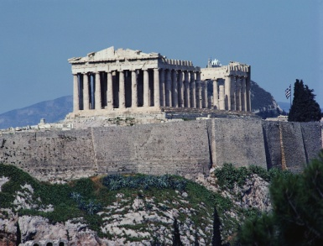
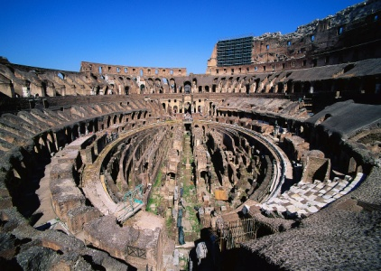
1st Semester Topics: Ancient World
Prehistory: first people, technology, calendars
Egypt: Kingdoms, advancements, Pharaohs, pyramids
Mesopotamia: different civilizations, Hammurabi, Judaism
China: dynasties, Confucianism, Legalism, Daoism
India: different empires, Hinduism, Buddhism
Greece: types of gov’t, wars, advancements, Hellenistic civilizations
Rome: Republic, Empire, Christianity, decline

Slide 7
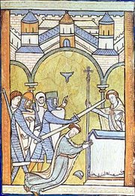
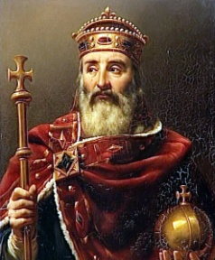
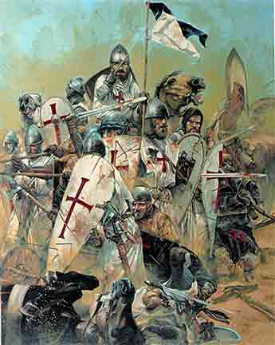
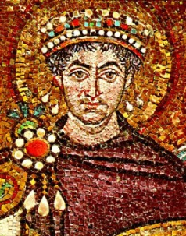
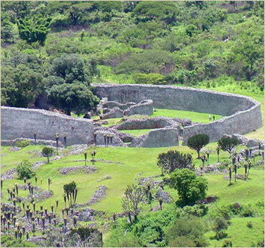
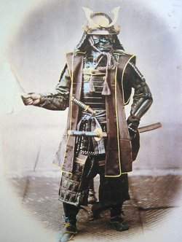
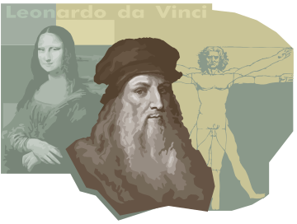
2nd Semester Topics: Medieval World
Muslim World: beginning of Islam, spread, contributions
Rise of Europe: feudalism, Church, economic changes
High Middle Ages: England, France, Holy Roman Empire, Advancements, Crisis
Byzantine Empire and Russia: Eastern Europe
Africa: West and East, traditions
East Asia: dynasties, Korea, Japan
Renaissance: Italy, Europe, Scientific Revolution
Civilizations of the Americas: Mayas, Aztecs, Incas, Mound Builders, Anasazi, Iroquois

Slide 8
Absences: There is no way that a student can completely make up a missed class (some days I may cover over 500 years of history). Work that has been assigned for one week or more is due on the due date. If there is no way they or you can bring it to school, they can email it to me or send it with a friend.
If possible, when a student is absent please please please have them email me. I’ll happily pass along any information we’re going over and attach any handouts they’ll need. They also have the monthly calendar glued into their notebook and it’s on my webpage so they stay caught up. Handouts can also be sent out via the Remind texts or through Moodlerooms.

Slide 9
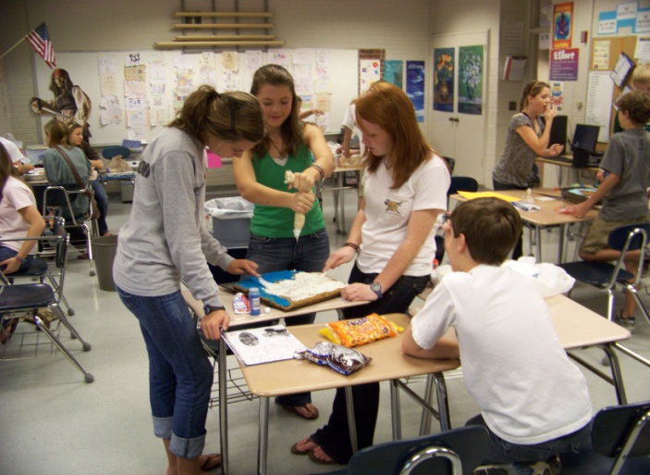
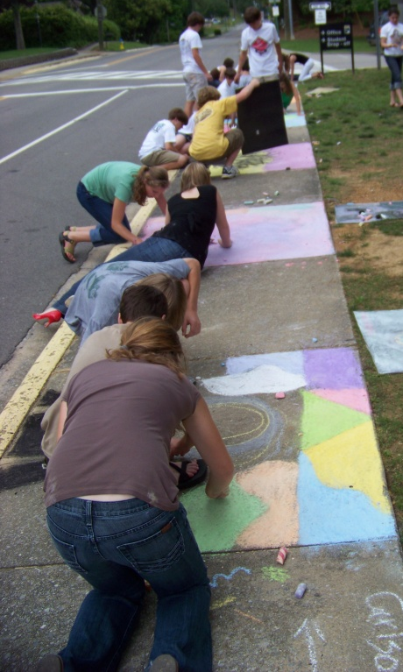
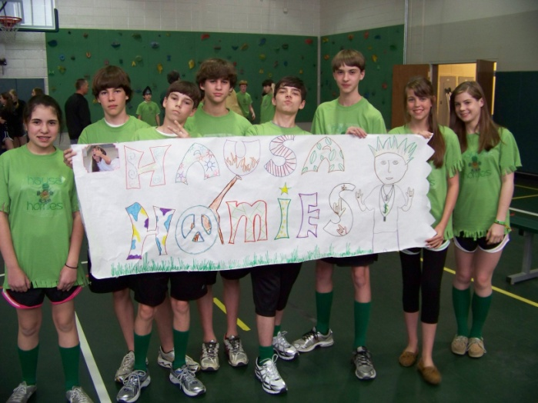
Activities that Help Us Learn
Hittite/Egyptian spy journals
Edible topics from the classical world
Power Points/Glogs/voicethread/Prezi/
Google Docs/Portal and Webpages on
Greek and Roman concepts
Virtual tour of a Mosque
Medieval Day
African Survivor
Renaissance Bio-in-a-Bag
Sidewalk Art
Cooperative Teaching on
Native Americans

Slide 10
LEARNING TARGETS
1. I can explain how artifacts and other archaeological findings are used to explain the characteristics of prehistoric groups including their migration patterns.
2. I can articulate the causes and effects of the Agricultural Revolution.
3. I can describe the civilizations of the ancient world using GSPRITE.
4. I can compare the development of early world religions, philosophies, and their key tenets: Judaism, Hinduism, Confucianism, Taoism, Christianity, Buddhism, Islam, Greece and Rome.
5. I can describe the transformation of civilizations during the Middle Ages using GSPRITE.
6. I have mastery in Alabama College and Career Readiness Anchor Standards for reading and writing in a history classroom.
GSPRITE= Geography, Social, Political, Religion, Intellectual, Technology and Economics

Slide 11
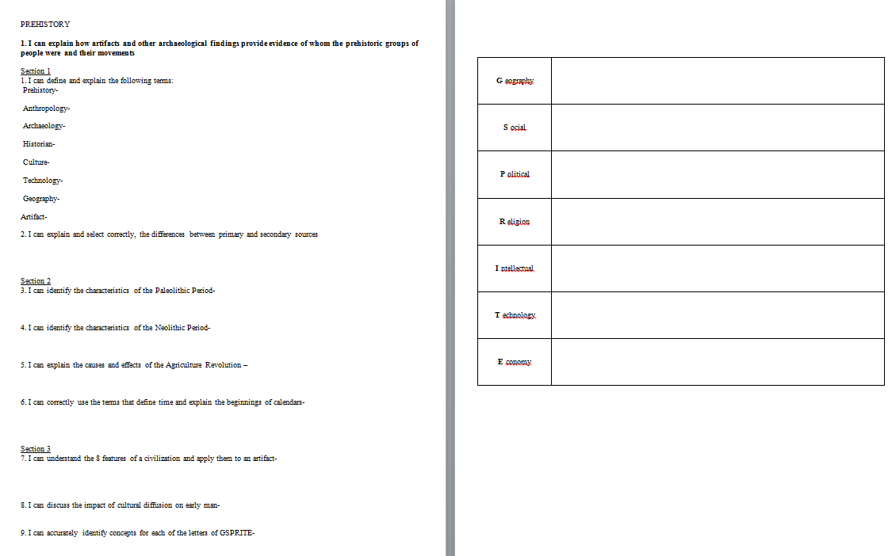

Slide 12
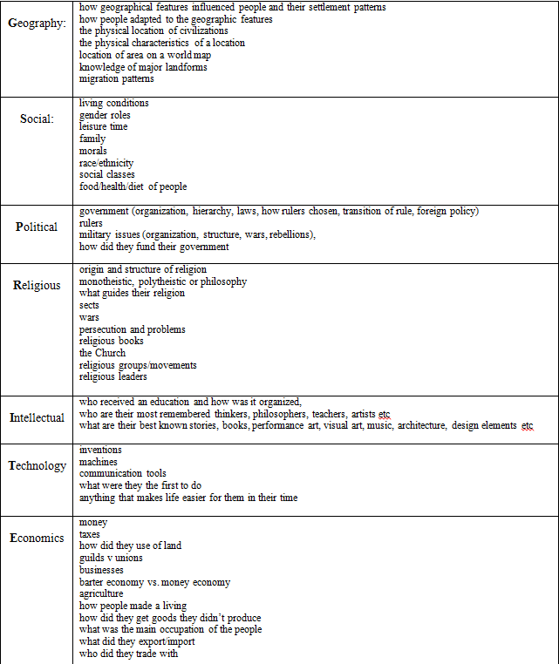
GSPRITE!

Slide 13
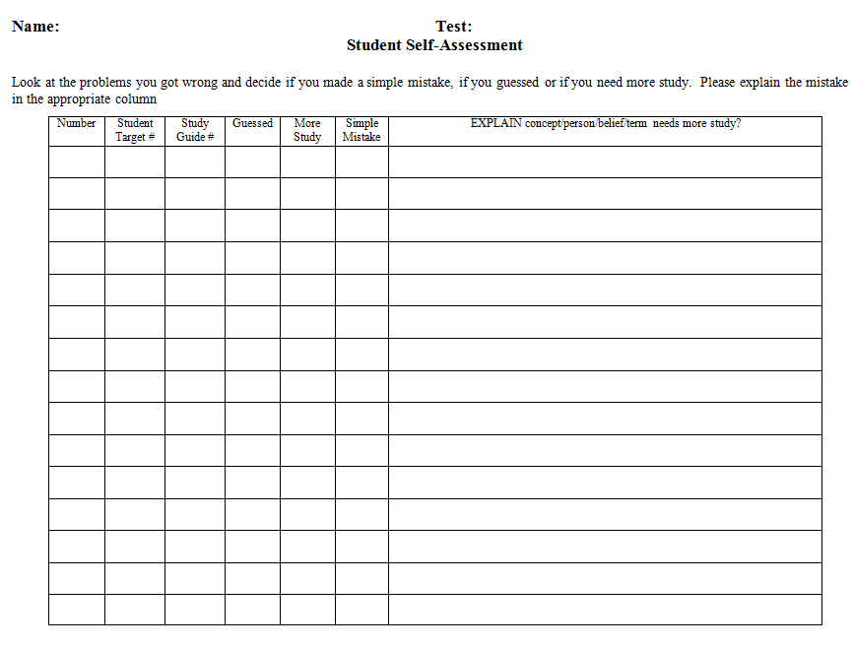

Slide 14
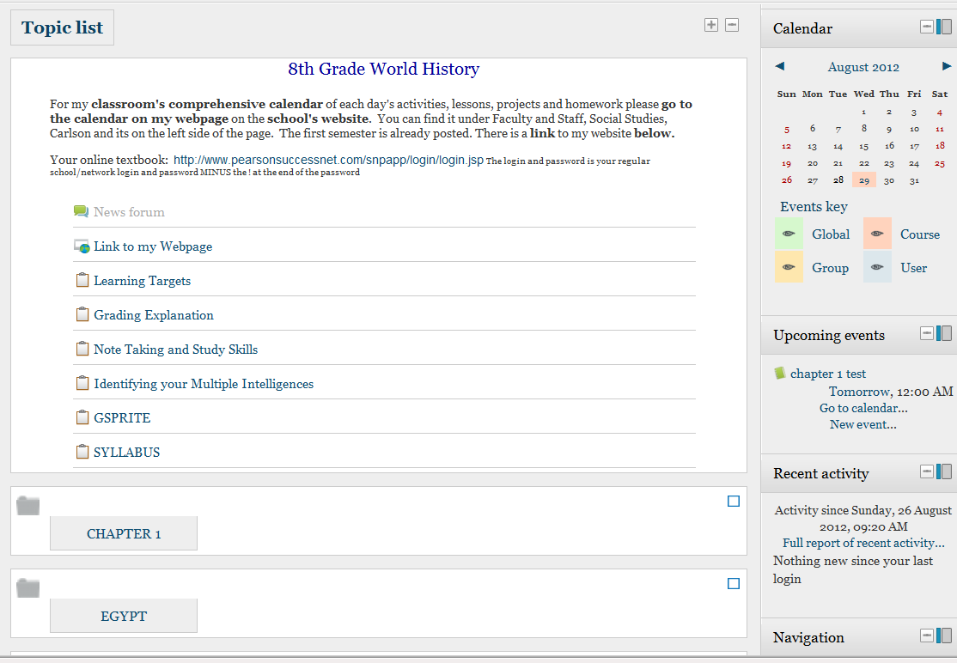
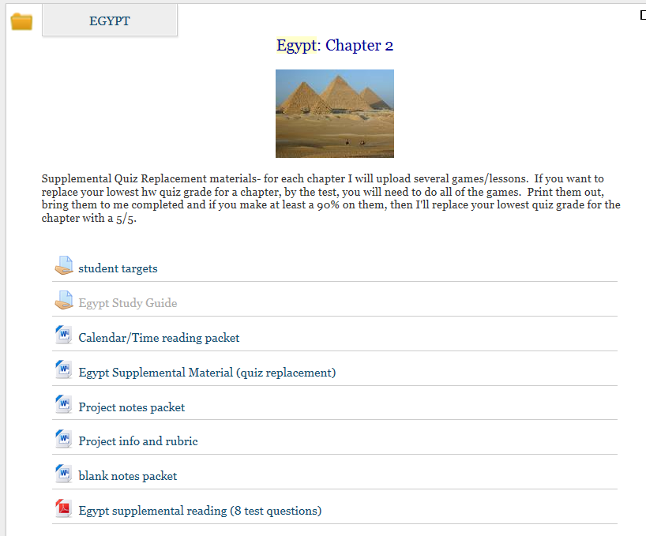
What my Moodle homepage looks like…

Slide 15

Online Textbook….soon??
Pearson does have a free app that has the textbook on it. Students use their regular login/password and their book should show up.

Slide 16

!!!! The TEENAGE BRAIN !!!!
This is hugely important!!!!!!!!!
Click the brain : )

