Slide 1
NUTRITION
Freshman Health

Slide 2

What Is Nutrition?
-The process by which the body takes in and uses food.

Slide 3
What is a Nutrient?
A nutrient is a chemical substance in food that helps maintain the body.
Some provide energy.
All help build cells and tissues, and regulate bodily processes such as breathing.
No single food supplies all the nutrients the body needs to function.

Slide 4
The Six Essential Nutrients
Carbohydrates
Proteins
Fats
Vitamins
Minerals
Water

Slide 5
Carbohydrates
WHAT IT DOES | EXAMPLES OF SOURCES
Your body converts carbohydrates to glucose (a simple sugar that is your body’s main source of energy) Your body uses energy from carbohydrates to do every task 4 calories per gram There are simple and complex carbohydrates | Simple Carbohydrates - fruit, milk, sugar cane Complex Carbohydrates - whole grains, nuts, potatoes, seeds Fiber - fruit, vegetables, oatmeal, brown rice
EXTRA NOTES: Simple Carbohydrates - sugars Complex Carbohydrates - starches Fiber is an indigestible complex carbohydrates and is used to move waste through the digestive system (20-35g each day)

Slide 6
Proteins
WHAT IT DOES | EXAMPLES OF SOURCES
Help build, maintain, and repair body cells and tissues Used to make enzymes, hormones, and antibodies Provide energy Made up of amino acids 4 calories per gram | Complete Protein - fish, meat, poultry, eggs, milk, cheese, yogurt Incomplete Protein - beans, peas, nuts, whole grains
EXTRA NOTES: The body cannot produce 9 of 20 amino acids needed so a person must get the 9 (essential amino acids) from food sources Complete Proteins - contain enough amounts of all 9 essential amino acids Incomplete Proteins - lack on or more of the essential amino acids

Slide 7
Fats
WHAT IT DOES | EXAMPLES OF SOURCES
Type of lipid (fatty substance that does not dissolve in water) Source of energy Made up of fatty acids Transports Vitamins A, D, E, and K in blood Source of Linoleic acid (needed for growth and healthy skin) 9 calories per gram | Saturated fats - animal fats, beef, pork, dairy are higher than chicken and fish Unsaturated fats - olive oil, canola oil, corn oil
EXTRA NOTES: Unsaturated fats are better for you than saturated fats

Slide 8
Vitamins
WHAT IT DOES | EXAMPLES OF SOURCES
Help regulate many vital body processes, which includes digestion, absorption, and metabolism of other nutrients There are water-soluble and fat-soluble vitamins | Vitamin C - citrus fruits, broccoli, cantaloupe, tomatoes, potatoes B Vitamins - whole grain cereals, milk, cheese, liver, fish, meat, eggs, vegetables Vitamin A - milk, carrots, green vegetables
EXTRA NOTES: pg 119-figure 5.1, pg120-figure 5.2 Water-Soluble Vitamins - dissolve in water and pass easily into the blood during digestion - they need to be replenished regularly by eating the certain food sources Fat-Soluble Vitamins - absorbed, stored, and transported in fat - too much of these vitamins can be toxic

Slide 9
Minerals
WHAT IT DOES | EXAMPLES OF SOURCES
Help form healthy bones and teeth and regulate many vital body processes The body cannot manufacture these nutrients | Calcium - dairy, leafy vegetables Phosphorus - milk, peas, fish, eggs Magnesium - whole grains, dark green leafy vegetables, nuts Iron - meat, shellfish, poultry, peanuts
EXTRA NOTES: pg121 - Figure 5.3

Slide 10
Water
WHAT IT DOES | EXAMPLES OF SOURCES
Vital to every body function Transports other nutrients to and carries wastes from your cells Lubricates joints and mucous membranes Enables swallowing and digestion Helps maintain normal body temperature through perspiration | Plain Water Milk Juice Fruits Vegetables
EXTRA NOTES: Drink at least 8 cups of water every day to maintain health

Slide 11
Nutrients That Have Calories:
Proteins
Carbohydrates
Fats

Slide 12
Calories Per Gram:
Protein 1 Gram = 4
calories
Carbohydrates 1 Gram = 4
calories
Fat 1 Gram = 9
calories

Slide 13
Definition of a Calorie:
A unit of heat that measures the energy used by the body and the energy that foods supply to body

Slide 14






Variables which affect the need for nutrients:
Age
2. Gender
3. Activity Level
4. Climate
5. Health
6. State of Nutrition

Slide 15
The U.S. Dietary Guidelines:
3 BROAD AREAS
A: Aim For Fitness
B: Build A Healthy Base
C: Choose Sensibly

Slide 16



AIM FOR FITNESS
1. Aim For A Healthy Weight
2. Be Physically Active Each Day (60 min.)

Slide 17


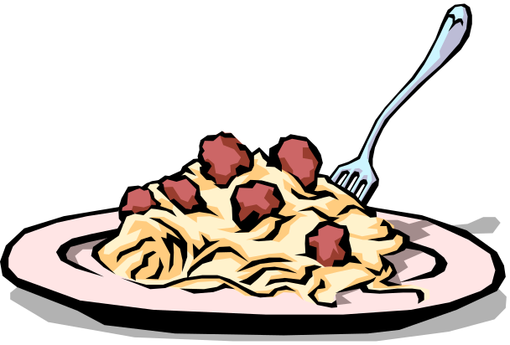


BUILD A HEALTHY BASE
3. Make your food choices carefully
4. Choose a variety of grains products, especially whole grains
5. Choose a variety of fruits and vegetables daily
6. Keep food safe to eat

Slide 18



CHOOSE SENSIBLY
7. Choose a diet that is low in saturated fat and cholesterol and moderate in total fat
8. Choose beverages and foods to moderate your intake of sugars
9. Choose and prepare food with less salt

Slide 19
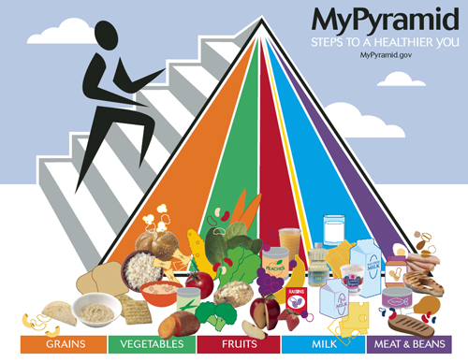
FOOD GUIDE PYRAMID VIDEO
Building a Healthy Base is Possible By Using the Food Guide Pyramid

Slide 20


Slide 21
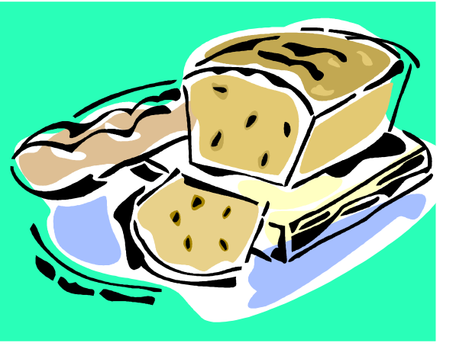
Grains
- Servings Daily: 3-10 ounces
- Major Nutrient: Carbohydrates, Fiber
Serving: 1 oz = 1 slice bread – 1 cup dry cereal = ½ cup pasta or rice
- Tips: eat at least 3 oz
of whole grains each day

Slide 22

Vegetables
Servings Daily: 1-4 cups
Major Nutrient: Vitamins, Fiber
Serving: Eat a variety of colors
Tips: Eat more dark green and orange vegetables

Slide 23

Fruits
Servings Daily 1-2 ½ cups
Major Nutrient: Vitamins, Fiber
Serving: 1 medium/small piece of fruit = 1 cup
Tips: eat a variety of fruit,
go easy on juices

Slide 24

Milk
Servings Daily 2-3 cups
Major Nutrient: Minerals, Protein
Serving 1 ½ oz cheese – 1 cup milk/yogurt
Tips: go low-fat or
fat free, if you can’t
consume milk, choose
other calcium sources

Slide 25

Meat and Beans
Servings Daily: 2-7 ounces
Major Nutrient: Protein
Serving: 1 oz meat = 1 egg = 1 T peanut butter = ¼ cup cooked beans = ½ oz nuts or seeds
Tips: choose low fat or lean meats, bake, broil or grill. Vary protein.

Slide 26

Oils
Servings Daily: 3-11 teaspoons
Major Nutrient: Fat
Serving: Watch for it in foods such as nuts, olives, mayonnaise, salad
dressing
Tips: Use canola, olive, peanut, soybean, corn safflower or
sunflower oil.

Slide 27
Fats and Oils
Fats are solid at room temperature and oils are liquid.
Consume less than 10% of calories from saturated fatty acids and less than 300 mg of cholesterol. Keep trans fatty acid consumption as low as possible.
Choose meat and dairy products that are low in fat.

Slide 28

Sugar
Keep sugar within the discretionary calorie allowance.
Choose water or fat free milk
to drink.
Limit sweet snacks and
desserts.
Select unsweetened cereals.

Slide 29

Discretionary Calorie Allowance
The calories remaining after accounting for the calories needed for all the food groups. These can be used up with poor food choices in the pyramid or saved for a real treat!

Slide 30
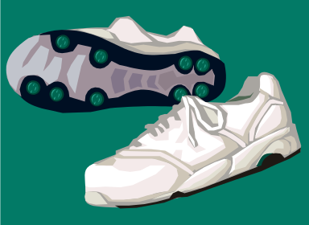
Physical Exercise
Be physically active for at least 30 minutes a day.
About 60 minutes a day of physical activity may be needed to prevent weight gain.
For sustained weight loss at least
60-90 minutes of physical activity
is needed.
Children and teenagers should
be physically active for 60 minutes
every day!

Slide 31
**PROJECT**
Get into group of no more than 3 people
Choose on of the following projects….
Create a poster of the food guide pyramid. It must include all sections, at least 5 pictures of food sources for each food group, and at least 3 dietary guidelines somewhere on the poster.
OR
Create a poem or a rap about the food guide pyramid and nutrition. It must include at least 25 lines, 3 dietary guidelines, all food pyramid groups, and 5 healthy food choices.

Slide 32
References
Glencoe Health Textbook - 2004 edition
www.mypyramid.gov

