Slide 2
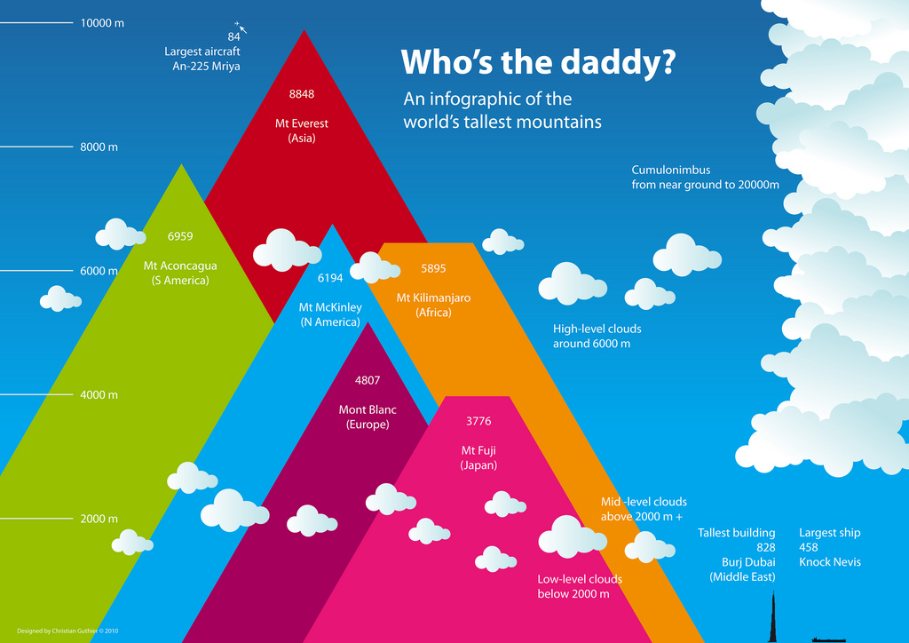

Slide 3
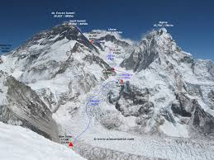
HIGHEST
Mount Everest
Mountain in Asia
Mount Everest, also known in Nepal as Sagarmāthā and in Tibet as Chomolungma, is Earth's highest mountain. It is located in the Mahalangur section of the Himalayas. Its peak is 8,848 meters above sea level.
Elevation: 29,029 feet
First ascent: May 29, 1953
Prominence: 29,029'
First ascenders: Tenzing Norgay, Edmund Hillary
Mountain range: Himalayas, Mahalangur Himal

Slide 4
LOWEST
The Mariana Trench is a crescent-shaped trench in the Western Pacific, just east of the Mariana Islands near Guam. The region surrounding the trench is noteworthy for many unique environments. The Mariana Trench contains the deepest known points on Earth, vents bubbling up liquid sulfur and carbon dioxide, active mud volcanoes and marine life adapted to pressures 1,000 times that at sea level.
The Challenger Deep, in the southern end of the Mariana Trench (sometimes called the Marianas Trench), is the deepest spot in the ocean. Its depth is difficult to measure from the surface, but modern estimates vary by less than 1,000 feet (305 meters).
In 2010, the Challenger Deep was pegged at 36,070 feet (10,994 m), as measured with sounds pulses sent through the ocean during a 2010 survey by the National Oceanic and Atmospheric Administration (NOAA).

Slide 5
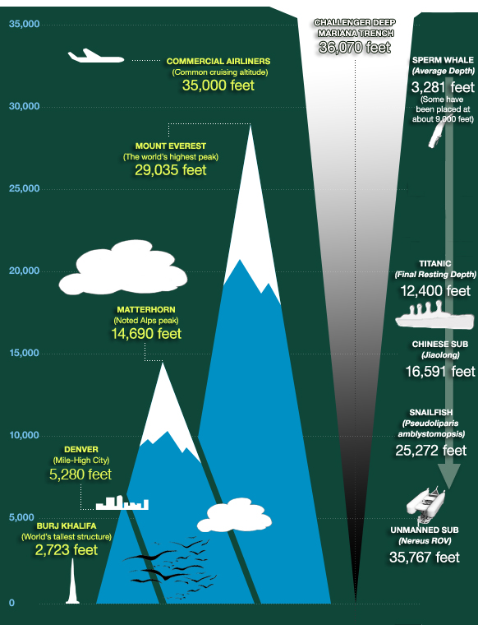

Slide 6
Hottest and Coldest
Click here!
http://www.accuweather.com/en/weather-news/death-valley-marks-anniversary/50027254
Click here!
http://news.nationalgeographic.com/news/2013/12/131210-coldest-place-on-earth-antarctica-science/

