Slide 1
Station 1: Planet Earth – Size, Distance and Location

Slide 2
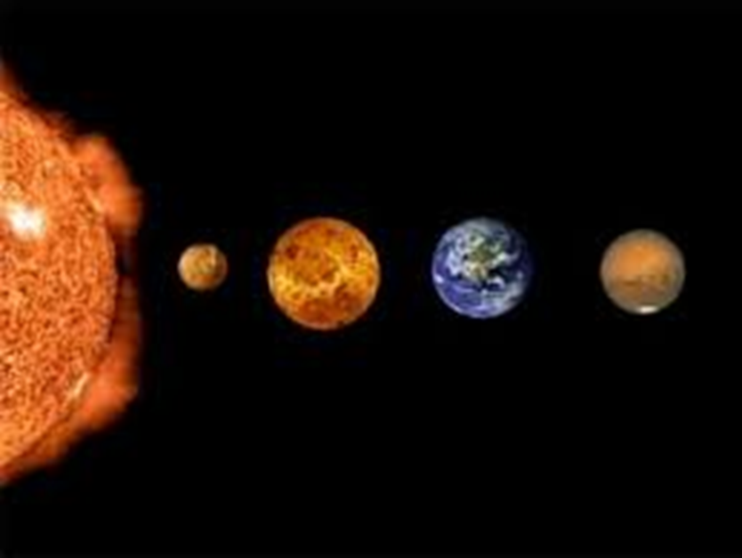
Question 1: How many planets away from the Sun is our planet, Earth?
Here’s the order of the eight larger planets, starting nearest the sun and working outward through the solar system: Mercury, Venus, Earth, Mars, Jupiter, Saturn, Uranus, Neptune.

Slide 3
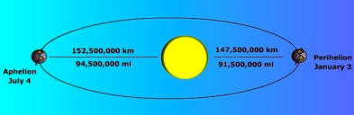
Question 2: What is the distance in miles from the Sun to Earth?
The Sun is at an average distance of about 93,000,000 miles (150 million kilometers) away from Earth. It is so far away that light from the Sun, traveling at a speed of 186,000 miles (300,000 kilometers) per second, takes about 8 minutes to reach us.
Like all of the other planets in our Solar System, Earth does not travel around the Sun in a perfect circle. Instead its orbit is elliptical, like a stretched circle, with the Sun just off the center of the orbit. This means that the distance between Earth and the Sun changes during a year. At its closest, the Sun is 91.4 million miles (147.1 million km) away from us. At its farthest, the Sun is 94.5 million miles (152.1 million km) away. The Earth is closest to the Sun during winter in the northern hemisphere.

Slide 4
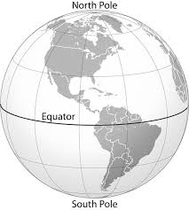
Question 3: What is the size of the diameter of Earth at the equator?
Earth's equatorial diameter is 7,926 miles

Slide 5
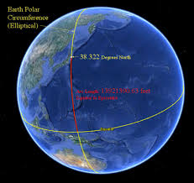
Question 4: What is the size of the circumference of Earth at the equator?
The circumference of Earth at the equator is about 24,902 miles.

Slide 6
Question 5: What is the distance of the diameter from the North Pole to South Pole?
From pole to pole, the diameter is 7,900 miles.

Slide 7
Question 6: What is the distance of the circumference from the North Pole, to the South Pole, and back to the North Pole?
From pole-to-pole — the meridional circumference — Earth is only 24,860 miles (40,008 km) around.

