Slide 1
Unit 4 Section 3 Notes
Properties of Matter

Slide 2
Chemical Properties
Chemical Properties: how a substance changes into a new substance by combining with something or breaking into a new substance.
  Only observable in a chemical reaction
  Describes how a substance acts when it changes (either combines with another substance or breaks apart into a new substance)

Slide 3
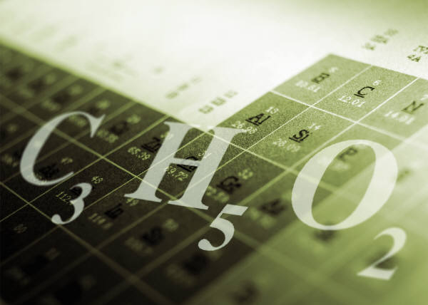
Chemical Properties
Each element & compound has its own chemical properties
  Steel and plastic have their own chemical properties

Slide 4
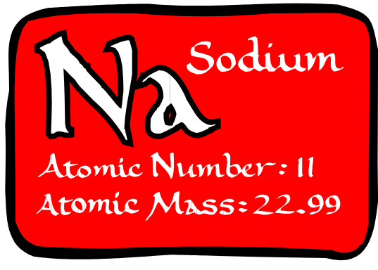
Reactivity
Reactivity: the ability of a substance to chemically combine with another substance
  Example: Sodium (Na) & Magnesium (Mg) are very reactive with other elements & compounds

Slide 5
Chemical Properties Include:
Burning
Rusting (reaction of oxygen & iron)
Tarnishing
Corrosion
Reactivity
Flammability: describes whether substances will react with oxygen and burn when exposed to a flame

Slide 6
Physical Properties
Physical Properties: a characteristic that can be observed or measured without a change in composition

Slide 7
Physical Properties Include:
Shape
Color
Odor
Texture
Strength
Hardness
Ability to conduct heat, electricity, and/or magnetism
State of matter (changes of state)
Density
Viscosity
Dissolving
Durable
Flexible
Ductile/malleable
Melting point: temp. at which a solid becomes a liquid. For water: 0˚ C, 32˚ F
Boiling point: temp. at which a liquid becomes a gas. For water: 100˚ C, 212˚ F

Slide 8
Density
Density: mass per unit volume of a substance
  Here’s how to remember the equation: In DenCity, the mountains are over the valleys. D = m/v
  Units for density: any unit for mass / any unit for volume
    Examples: g/cm³ or g/mL

Slide 9
Density
Density of water: 1.0 g/cm³
Low density: low mass per volume Example: wood
High density: high mass per volume Example: lead
Knowing density tells you if a substance sinks or floats:
  Density greater than 1.0 g/cm³ – sink
  Density less than 1.0 g/cm³ - float

Slide 10
Sample Problem
10.0 cm³ of ice has a mass of 9.17 g. What is the density of ice?
  D = m/v
  9.17g/10.0 cm³ = 0.917 g/cm³
  Ahha! That’s why ice floats!

Slide 11

Buoyancy
Buoyancy: tendency of a less dense substance, like ice, to float in a more dense liquid, like water
  Water pushes ice up.

Slide 12
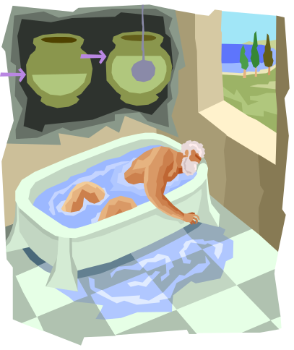
Archimedes Principle
Archimedes Principle: buoyant force on an object in a fluid (gas or liquid) equals weight of fluid that is displaced by object
  This explains why bath water rises when you get in.
  Discovered by Archimedes thousands of years ago!

Slide 13
Chemical Change
Chemical Change: occurs when 1 or more substances change into NEW substances with completely different properties
  A chemical change is a change in composition; it CANNOT be reversed by physical changes.

Slide 14

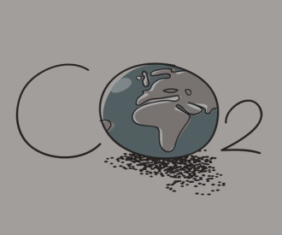
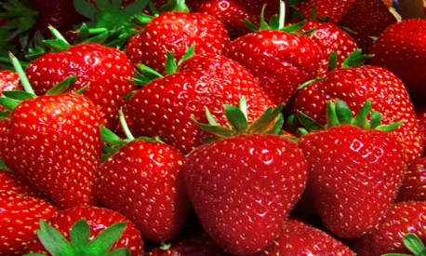
Examples of Chemical Changes:
Dead battery: chemicals inside battery have been changed
Oxygen you breathe in comes out as carbon dioxide
Fruits & vegetables ripen

Slide 15

Chemical Changes
The law of conservation of mass is still upheld
  Think of a burning match
Signs that a chemical reaction has taken place:
  Change in color or odor
  Fizzing or foaming
  Production of heat, light, sound (energy)

Slide 16
Physical Change
Physical Change: change in physical form or properties
  Not a change in composition
  Substance may look different (ice vs. water), but the atoms that make up the substances are NOT changed or rearranged

Slide 17
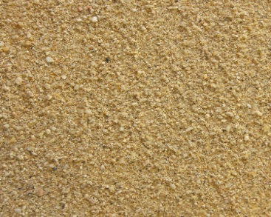



Examples of Physical Changes:
Sugar dissolving to make lemonade
Grinding peanuts into peanut butter
Making gold ring out of nugget
Grinding quartz into sand

Slide 18
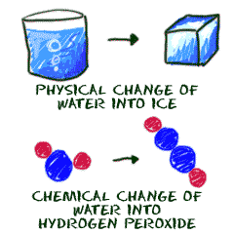
Physical Changes
Dissolving of any type is a PHYSICAL CHANGE!!!!!
Melting, freezing, and evaporating are all PHYSICAL CHANGES!!!!!

Slide 19
Physical and Chemical Properties Video
https://www.youtube.com/watch?v=C4pQQQNwy30
https://www.youtube.com/watch?v=wg_dcSEZrt4

Slide 20
Gas Laws
Use the following variables:
  T : Temperature
  P : Pressure
  V : Volume

Slide 21

Charles Law
Charles Law: states that if you increase temperature, you increase volume, and if you decrease temperature, you decrease volume
  ↑ T ↑ V; ↓ T ↓ V
  Example:
    Hot air balloon has air heated in it

Slide 22

Boyle’s Law
Boyle’s Law: states that if you increase pressure, you decrease volume, and if you decrease pressure, you increase volume.
  ↑ P ↓ V; ↓ P ↑ V
  Example:
    Cartesian Diver

Slide 23
To Find Iron in Breakfast Cereal:
https://www.stevespanglerscience.com/lab/videos/iron-breakfast-sick-science-123/?utm_source=bm23&utm_medium=email&utm_term=Watch+the+Video&utm_content=SICK+Science+Friday+-+Iron+for+Breakfast&utm_campaign=01/13/2017&_bta_tid=422156456876000226530629920428796567386084208282268329901557485780818542466278520369158

