Slide 1
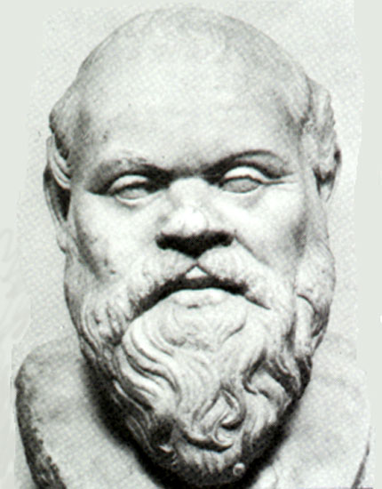
SOCRATIC SEMINAR
There is only one good, knowledge, and one evil, ignorance. - Socrates

Slide 2
Expectations for Socratic Seminar

Slide 3

Be prepared to participate.

Slide 4

Don’t raise hands.

Slide 5

Invite others into the discussion.

Slide 6

Refer to the text.

Slide 7

Comments must be appropriate, respectful, and focused.

Slide 8

Listen to and build on one another’s comments.

Slide 9

Use your speaking time fairly (contribute but do not control).

Slide 10
Socratic Seminar is a dialogue, not a debate.

Slide 11
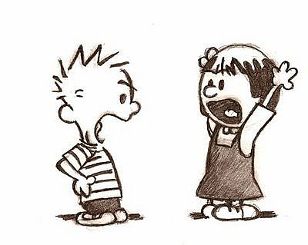

What is the difference between dialogue and debate?
VS.

Slide 12
Dialogue is collaborative: multiple sides work toward shared understanding.
Debate is oppositional: two opposing sides try to prove each other wrong.

Slide 13
In dialogue, one listens to understand, to make meaning, and to find common ground.
In debate, one listens to find flaws, to spot differences, and to counter arguments.

Slide 14
Dialogue enlarges and possibly changes a participant's point of view.
Debate defends assumptions as truth.

Slide 15
Dialogue creates an open-minded attitude: an openness to being wrong and an openness to change.
Debate creates a close-minded attitude, a determination to be right.

Slide 16
How does Socratic Seminar work?
Students sit in an inner and outer circle.
Students in the inner circle discuss a question that the teacher asks.
Students in the inner circle earn points for participation. Goal = 3 points

Slide 17
Students in the outer circle take notes on the discussion on the provided note taking sheet.
Students in the outer circle keep track of their inner circle partner’s points.

Slide 18
After a period of time, the inner and outer circles switch.
Throughout the seminar, the teacher monitors participation, preparedness, and the quality of students’ comments.

Slide 19
In Socratic Seminar, students talk to one another, not just the teacher.

Slide 20
How is seminar evaluated?
When I am evaluating your Socratic Seminar participation, I ask the following questions about participants. Did they….
-Speak loudly and clearly?
-Cite reasons and evidence for their statements?
-Use the text to find support?
-Listen to others respectfully?
-Stick with the subject?

Slide 21
-Talk to each other, not just to the leader?
-Paraphrase accurately?
-Ask for help to clear up confusion?
-Support each other?
-Avoid hostile exchanges?
-Question others in a civil manner?
-Seem prepared?

Slide 22
4 | 3 | 2 | 1
-I offer enough solid analysis, without prompting, to move the conversation forward. -I demonstrate a deep knowledge of the text and the question. -I come to the seminar prepared, with notes and a marked or annotated text. | -I offer solid analysis without prompting. -I demonstrate a good knowledge of the text and the question. -I come to the seminar prepared, with notes and a marked or annotated text. | -I offer some analysis but need prompting from the seminar leader. -I demonstrate a general knowledge of the text and question. -I am somewhat unprepared, with few notes and no marked or annotated text. | -I offer little commentary. -I come to the seminar ill-prepared with little understanding of the text and question.

Slide 23
4 | 3 | 2 | 1
-I show active listening. -I offer clarification and/or follow-up that extends the conversation. -I make comments that refer to specific parts of the text. | -I show active listening, and offer clarification and/or follow-up. -I rely on the text to drive my comments. | -I actively listen, but do not offer clarification and/or follow-up to others’ comments. -I rely more upon my opinion and less on the text to drive my comments. | -I do not listen to others and offer no commentary to further the discussion.

Slide 24

Enjoy the discussion!

Slide 25
In your group, discuss the following questions. Be prepared to share your answers with the class.

Slide 26
Overall, what went well during the seminar?
What could have been better?
What did you learn about the text during the seminar?
What did you learn about discussion skills during the seminar?
What should we do next time to make the seminar more effective?
What would be good topics for future Socratic Seminars?

