Slide 1
Notes on WWI from 3/4

Slide 2
World War I: 1914 - 1918

Slide 3

Notes: US Enters the War (April 1917)
Zimmerman Telegram
Sinking of the Lusitania
Unrestricted Submarine Warfare
Joins the Allies
U.S. President: Woodrow Wilson

Slide 4
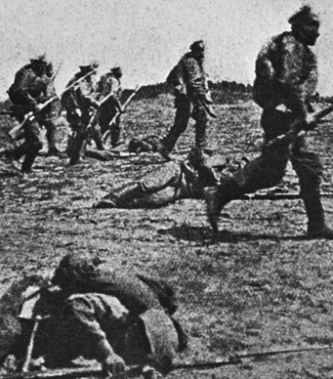
(Notes) Russia Exits WWI
Disastrous results on the front for Russia
Russian Revolutions (1917)
New gov’t in Russia ➔ Civil War➔ Communism
Russia Exits WWI and signs a separate treaty with Germany 1917
  (Treaty of Brest-Litovsk)

Slide 5
Wilson’s 14 Points (excerpts)
Write the main idea under each point listed
What are the important points here?
1. Right to self-determination (nations have a right to decide how they will govern themselves)
2. League of Nations is proposed

Slide 6
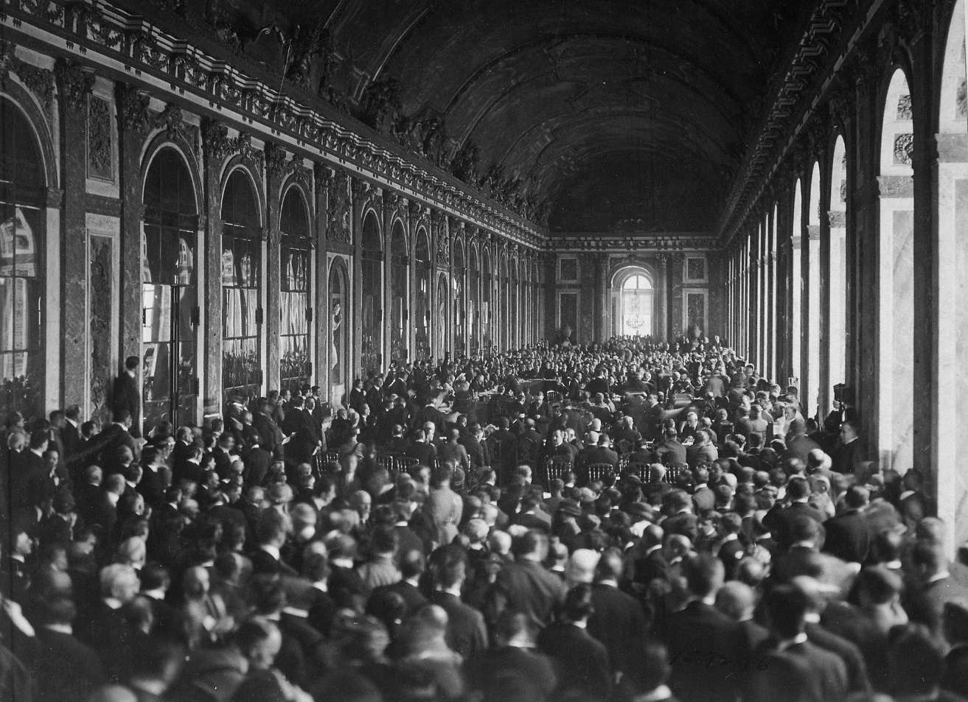

Notes: Treaty of Versailles (1919)
Meet in France (Versailles)

