Slide 1

Learning the notes of your instrument!

Slide 2
To review your notes:
Click to go to the next page
Click on the smiley face go to your instrument
When you are at the next page you will only see a blank staff – click and a note will appear. Guess the note name and click again and the note name will appear.
You can review other instruments notes as well.

Slide 3
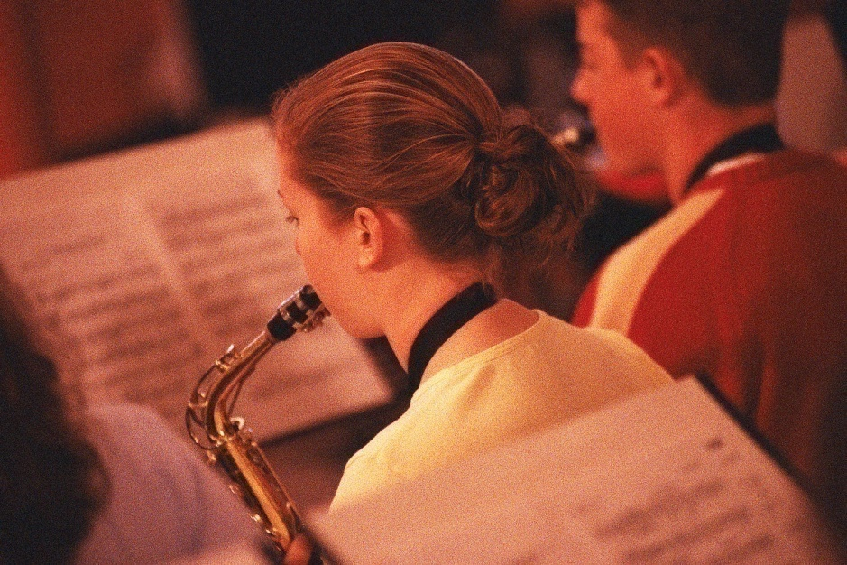
Click on your instrument below and it will take you to your first notes.
Flute/Oboe
Clarinet/Bass Clarinet
Alto Sax
Trumpet
Trombone/Baritone
Tuba
Make up your own song

Slide 4
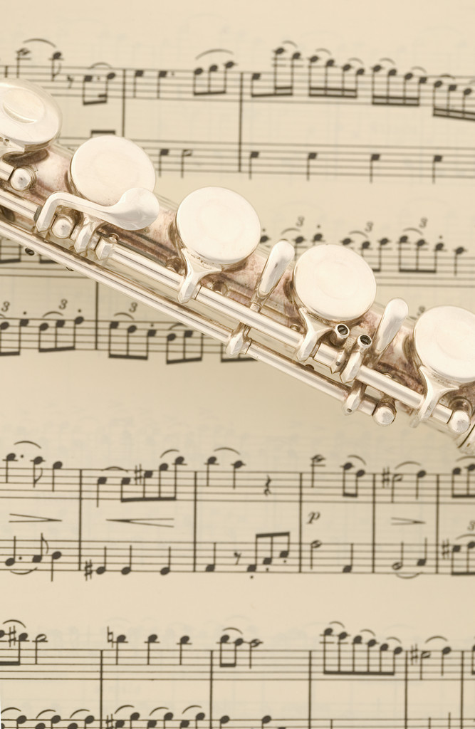
Flute/Oboe
What are these notes? Click to reveal the note and then the note name.
b
V
b
Bb
C
D
Eb
F

Slide 5
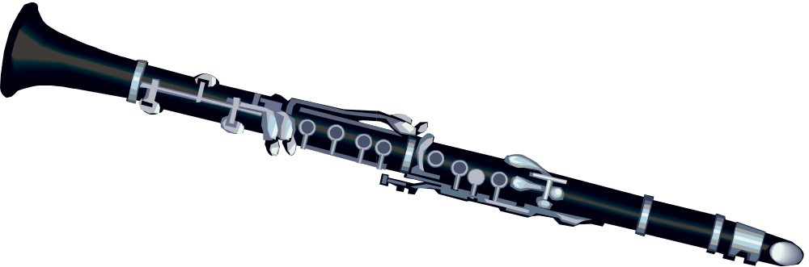
Clarinet and Bass Clarinet
What are these notes? Click to reveal the note and then the note name.
V
G
F
E
D
C

Slide 6
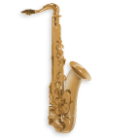
Alto Sax
What are these notes? Click to reveal the note and then the note name.
V
C
D
G
A
B

Slide 7
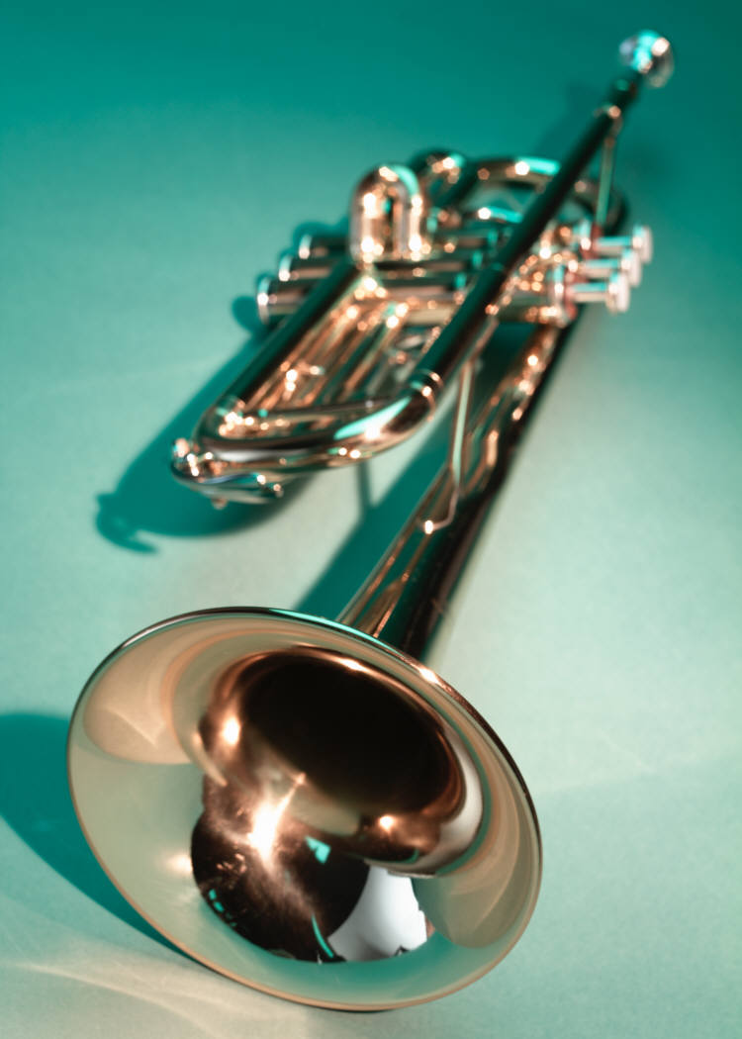
Trumpet
What are these notes? Click to reveal the note and then the note name.
V
G
E
F
D
C

Slide 8
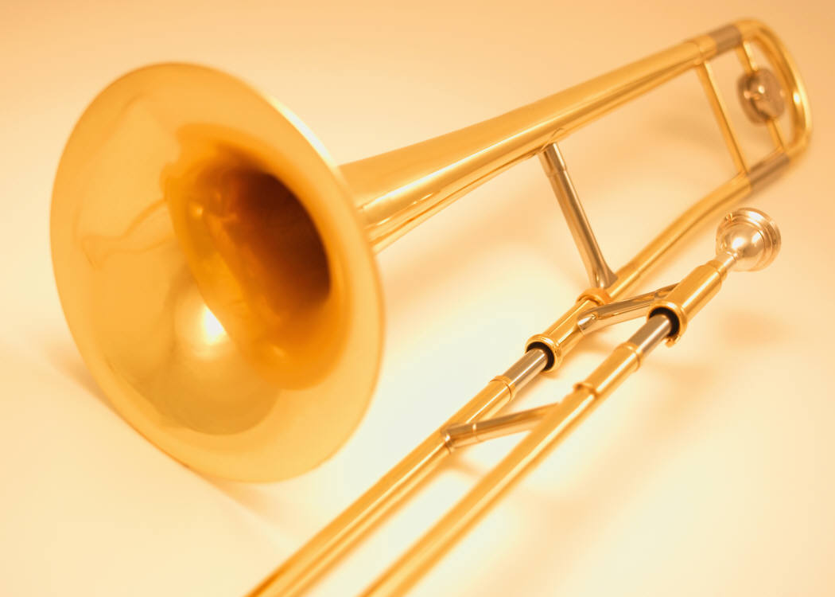
Trombone/Baritone
What are these notes? Click to reveal the note and then the note name.
t
b
b
C
D
Eb
F
Bb

Slide 9
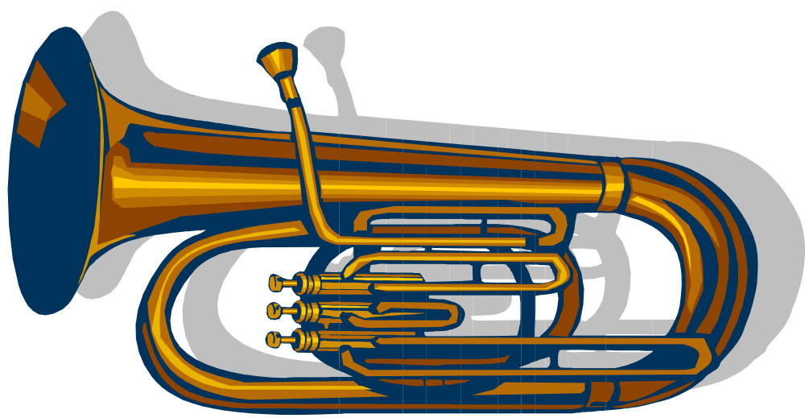
Tuba
What are these notes? Click to reveal the note and then the note name.
t
b
b
F
Eb
D
Bb
C

Slide 10
Make up your own song for your instrument.

