Slide 1
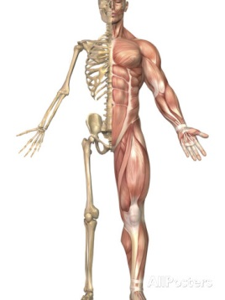
The Skeletal and Muscular Systems
http://goo.gl/eK19bQ

Slide 2
The Skeletal and Muscular System
By working together, your muscular and skeletal systems allow you to do many things such as stand up, sit down, type a note, or run a race.
So let’s take a closer look at these systems to see how they help us function in our everyday lives.

Slide 3
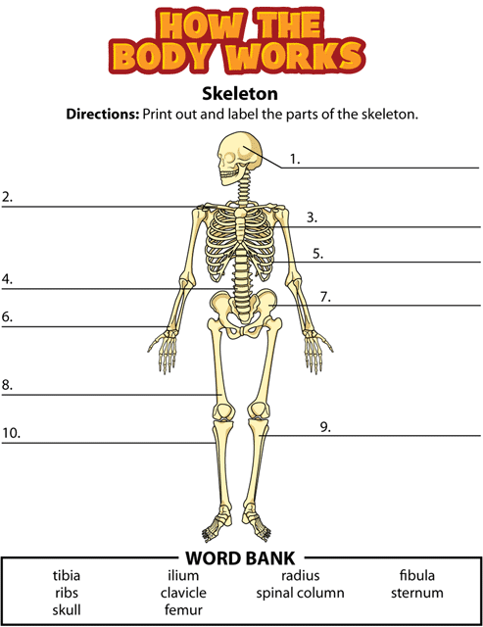
The Skeletal System

Slide 4
Functions of the Skeletal System
What do you think of when you hear the word skeleton?
Is it dry, white bones from a science class?
Your skeletal system is more than that, it is full of life!
The skeletal system is the organ system that supports and protects the body and allows it to move.

Slide 5
Functions of the Skeletal System
Support
Bones provide support for your body and make it possible for you to sit or stand upright.
Without bones, we would be a mass of soft tissue, like a slug.
Unlike a slug however, we would not be able to move around
BONES ARE A VITAL PART TO OUR MOVEMENT!

Slide 6
Functions of the Skeletal System
Other jobs of the skeletal system include storing minerals and producing red blood cells.
The human skeleton is inside the body, so it also has the name endoskeleton.

Slide 7
Functions of the Skeletal System
Storage
The hard outer layer of bone, compact storage, stores important minerals.
Ex: Calcium
These minerals are necessary for nerves and muscles to work properly.

Slide 8
Functions of the Skeletal System
Protection
Bones provide protection to organs.
Our ribs protect our heart and lungs.
The vertebrae protects our spinal cord.
The skull protects our brain.

Slide 9
Functions of the Skeletal System
Blood Cell Production
At the center of bones is soft tissue called marrow.
Red marrow is a type of marrow that makes blood cells.

Slide 10
Functions of the Skeletal System
Movement
Bones are important to movement as they provide a place for muscles to attach.
Without bones, muscles couldn’t do their job of moving the body.

Slide 11
What are the parts of the skeletal system?
Your skeletal system is made up of:
Bones
Ligaments
Cartilage

Slide 12
What are the parts of the skeletal system?
Bones
Bones are alive! They have blood vessels which supply nutrients and nerves.
Fact: the body of a newborn baby has about 300 bones, but the average adult has only 206 bones.
This is because as a child grows, some bones fuse together.

Slide 13
What are the parts of the skeletal system?
Ligaments
Ligaments are tough, flexible strands of connective tissue that holds bones together.
They allow for movement, and are found at the end of bones

Slide 14
What are the parts of the skeletal system?
Cartilage
Cartilage is strong, flexible, and smooth.
It is found at the end of bones and allows bones to move smoothly across each other.
Where do we have cartilage at?

Slide 15
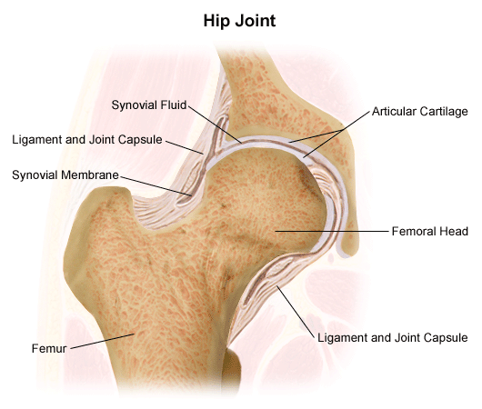
How are bones connected?
The place where two or more bones connect is called a joint.
Some joints allow movement of body parts.
Other joints often stop or limit the movement of our bodies.
http://goo.gl/cDZCaZ

Slide 16
https://human.biodigital.com/index.html

Slide 17
Injuries/disorders of the skeletal system
Fractures
Bones may be fractured, or broken by a high-force impact like a fall from a bike.
Sprains
A sprain is an injury to a ligament that is caused by stretching of a joint too far.
Sprains are very common sports injuries

Slide 18
Injuries/disorders of the skeletal system
Osteoporosis
Is a disease that causes bone tissue to become thin. The bones become weak and break more easily.
Arthritis
This is a disease that causes joints to swell, stiffen, and become painful. It can also cause the joint to become misshapen.

Slide 19
http://www.brainpop.com/health/bodysystems/skeleton/preview.weml
http://www.brainpop.com/health/bodysystems/joints/preview.weml
http://www.youtube.com/watch?v=uzxmKAWiN_U

Slide 20
Discussion Questions
How do bones act as a support system?
  They provide the structure that the rest of the soft tissues and organs are housed in, on, and around.
What are the major functions of the skeletal system?
  The main functions of the skeletal system are support, protection, storage of nutrients, and movement.
What is the difference between red bone marrow and yellow bone marrow?
  Red marrow is where red blood cells are made; yellow marrow is where fat is stored.

Slide 21
Discussion Questions
How do ligaments and cartilage help the skeletal system function?
  Ligaments connect bones to other bones. Cartilage covers the end of bones and reduces friction so bones move more easily at joints.

Slide 22
Discussion Questions-Challenge
Does bone development occur from the outside in or from the inside out?
  from the inside out
How does the skeletal system help the body maintain homeostasis?
  The skeletal system provides calcium for nerves, muscles, and heart; bones store fat and make blood cells.

Slide 23
The Muscular System

Slide 24
Main functions of the muscular system
The muscular system is mostly made of the muscles that allow your body to move and be flexible.
Muscles do many things, including:
  Pumping blood though your body
  Enabling you to breathe
  Hold you upright
  Allow you to move.

Slide 25
What are the three types of muscles?
Your body has three kinds of muscle tissue:
  Skeletal muscle
  Smooth muscle
  Cardiac muscle

Slide 26
Smooth Muscle
Is found in internal organs and blood vessels.
Helps move materials through the body.
Are also found in arteries and veins to help control blood flow through the blood vessel.
Is a type of involuntary muscle, meaning it is not under your control.

Slide 27
Skeletal Muscle
Is called voluntary muscle because you are able to control the movement of it.
Are attached to bones and allows you to move
Ex: bringing your arm up to your mouth to take a bite from an apple.
The tough strand of tissue that connects a muscle to a bone is called a tendon.

Slide 28
Cardiac Muscle
This is the tissue that makes up the heart.
It never stops moving over your entire lifetime!
Contractions of cardiac muscle push blood out of the heart and pump it around the body.
Is also a type of involuntary muscle, meaning it is not under your control.

Slide 29
https://human.biodigital.com/index.html

Slide 30
Injuries/disorders of the muscular system
Like our other body systems, the muscular system can suffer injury or disease.
These include:
Muscle strains and tears
  This occurs when a muscle is overstretched or torn.
  Happens when they are not stretched out properly or overworked.
Muscular Dystrophy
  A hereditary disease that causes muscle to become weaker over time
  A person with this has poor balance and difficulty walking
Tendinitis
  Can become inflamed when muscles are overused
  Painful and needs rest in order to heal properly.

Slide 31
http://www.youtube.com/watch?v=vvBWnQJHGBs

Slide 32
Discussion Questions
What is one major function of the muscular system?
  Most responses will involve movement.
How are tendons different from ligaments? How are they similar?
  Tendons connect muscles to bones, while ligaments connect bones to other bones. Both tendons and ligaments hold together and stabilize joint connections.
What are the three types of muscles?
  skeletal, cardiac, and smooth

Slide 33
Discussion Questions-Challenge
Why must skeletal muscles work in pairs?
  Muscles can only pull on bones and not push them. Therefore, muscles must work in pairs to move bones in one direction, then back again..
How do muscles help maintain homeostasis in the body?
  Muscles help maintain homeostasis by helping to maintain body temperature. They also help the body move to avoid unpleasant or dangerous stimuli. Cardiac muscle enables the heart to supply oxygen to the body when you exercise, and other involuntary muscle works to maintain the digestive system and other body functions involving movement.

