Slide 1
Muscular System
Notes

Slide 2
Muscle Facts
The tongue is the strongest muscle in the body (relative to size)
There are about 640 skeletal muscles in the human body
It takes twice as long to lose new muscle if you stop working out than it did to gain it.
You use 200 muscles to take one step

Slide 3
Important vocabulary
Contraction- the activation of muscle fibers to move our skeleton
Muscle strain- occurs when the muscle is over stretched or torn.
Muscle cramp- an involuntary contraction of our skeletal muscles. Can also be caused by putting too much stress on a muscle

Slide 4
Involuntary vs Voluntary Muscles
Involuntary muscle- a muscle that is not under conscious control.
  Involuntary muscles control processes like digesting food and making our heart beat.
Voluntary muscle- A muscle that is under our conscious control.
  We use these muscles to move our skeleton. We control when these muscles contract and relax.

Slide 5
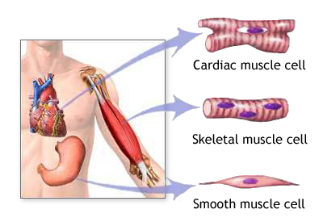
Types of Muscles
We have three different types of muscles in our bodies
  Cardiac muscle
  Skeletal Muscle
  Smooth muscle
Each muscle type has a specific job in the body

Slide 6
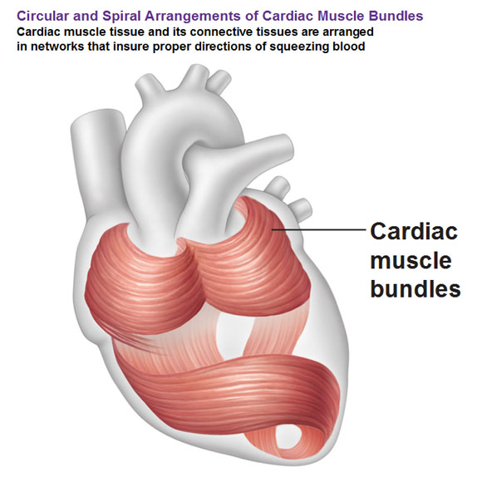
Cardiac Muscle
This muscle type is only found in the heart
It is involuntary, meaning we cannot control its actions
Luckily, cardiac muscle does not get tired. It will contract about 115,000 times per day.

Slide 7
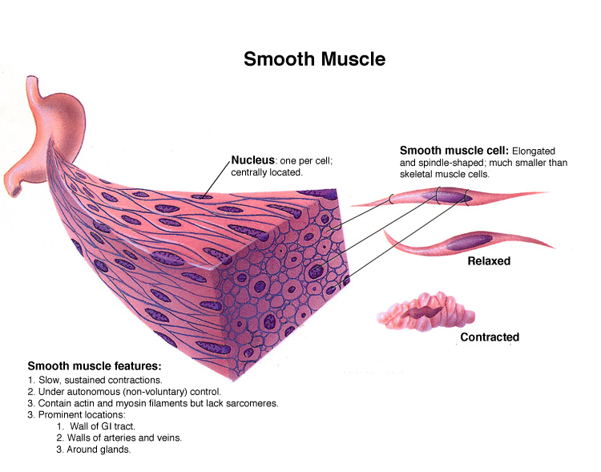
Smooth muscle
Reacts and tires slowly. Continuously contracts, but at a much slower rate than cardiac or skeletal muscle
Involuntary muscle. We can not control how fast we digest food, compress blood vessels, etc…
Built to have a smooth surface, unlike skeletal or cardiac muscles.

Slide 8
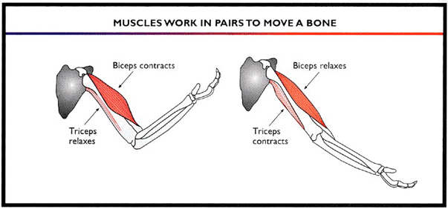
Skeletal muscle
Voluntary muscles. We use these muscles to move our skeleton.
Reacts quickly, but also tires quickly. Will fire rapidly to move our skeleton, but this leads to the muscles tiring much easier than cardiac or smooth.
Always work in pairs. When one muscle contracts, another must relax to allow the movement to happen.

Slide 9
Type 1 vs Type 2 muscles
Skeletal muscle fibers can be type 1 (slow twitch) or type 2 (fast twitch).
Type 1 are used for long distance activities (cross country). They contract slower, but can be used for hours if trained properly.
Type 2 are used for short bursts (sprints/jumping). They contract at a rapid rate, but tire in under a minute.

Slide 10
Keeping muscles healthy
Regular exercise is important to keep strength and flexibility
Muscle cells get small tears in them during exercise. Growth occurs while the muscles heal.
Stretching and warming up are important before exercising. A cool down after exercise can help with soreness.

Slide 11
