Slide 1
Intermolecular Forces Notes

Slide 2
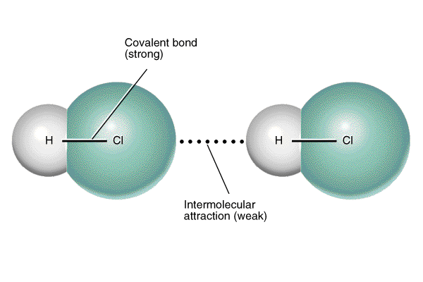
Intermolecular Forces
Intermolecular Forces: attraction between molecules
Much weaker than chemical bonds

Slide 3
Strength of Forces
STRONGEST
Covalent Bonds (400 kcal)
Hydrogen Bonding (12-16 kcal)
Dipole-Dipole Interactions (0.5-2 kcal)
London Dispersion Forces (<1 kcal)
WEAKEST
kcal = kilocalorie (unit of energy stored in chemical bonds)

Slide 4
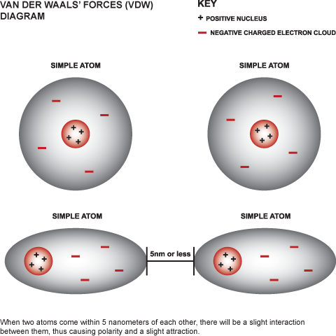
London/Van der Waals
London Dispersion Forces:
  Attraction due to the constant motion of electrons
    Will cause temporary concentration of charge on one side of an atom/molecule
  Exist between ALL molecules

Slide 5
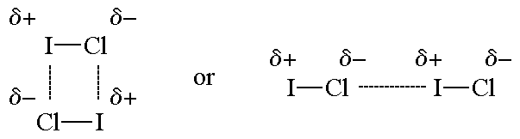
Dipole
Dipole-dipole:
  Attraction between polar molecules
The squiggly symbol means a partial charge.

Slide 6

An Analogy
Dipole-dipole attraction
- - - - - - -
The two couples are very happy with each other, but the guy is attracted to the other girl.

Slide 7
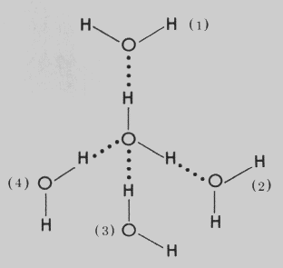
Hydrogen
Hydrogen Bonding:
  Stronger type of dipole-dipole interaction
  Occurs only between molecules with lone pairs on center atom AND hydrogen bonded to F, O, or N
    Hydrogen bonding is FON!

Slide 8
Intermolecular Forces
Is the molecule polar?
Yes
No
Does the molecule have lone pairs on the center atom, with H bonded to F, O, or N?
London Dispersion Forces
Yes
No
London Dispersion Forces
Dipole-dipole
Hydrogen bonding
London Dispersion Forces
Dipole-dipole

Slide 9
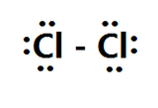
Intermolecular Forces Examples
Cl₂
The molecule is nonpolar.
This molecule has London Dispersion Forces.

Slide 10
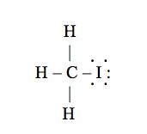
Intermolecular Forces Examples
CH₃I
The molecule is polar.
The central atom does not have lone pairs, and H is not bonded to F, O, or N.
The molecule has London and Dipole-dipole forces.

Slide 11

Intermolecular Forces Examples
CH₂O
The molecule is polar.
The central atom does not have lone pairs, and H is not bonded to F, O, or N.
The molecule has London and Dipole-dipole forces.

Slide 12
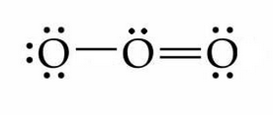
Intermolecular Forces Examples
O₃
The molecule is polar.
The central atom has a lone pair, but does not have H bonded to F, O, or N.
The molecule has London and Dipole-dipole forces.

Slide 13
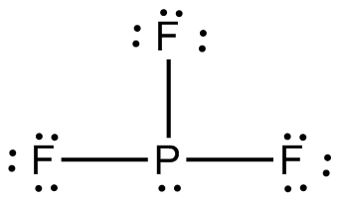
Intermolecular Forces Examples
PF₃
The molecule is polar.
The central atom has a lone pair, but does not have H bonded to F, O, or N.
The molecule has London and Dipole-dipole forces.

Slide 14
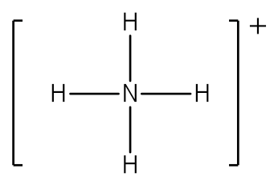
Intermolecular Forces Examples
NH₄⁺
The molecule is nonpolar…
So even though H is bonded to N…
This molecule has only London Dispersion forces.

Slide 15
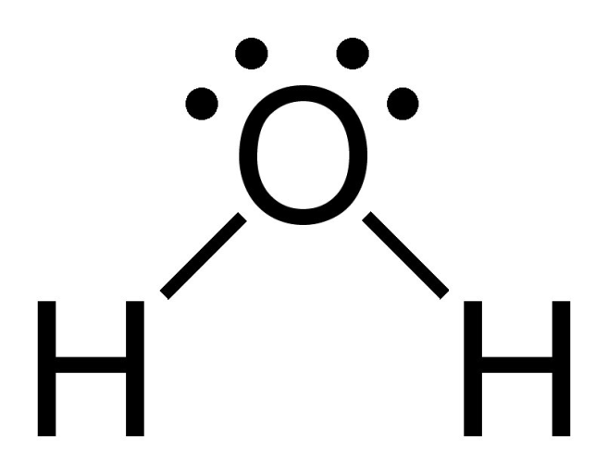
Intermolecular Forces Examples EXTRA
H₂O
The molecule is polar.
There is a lone pair.
Hydrogen is bonded to F, O, or N.
This molecule has London, Dipole-Dipole forces AND hydrogen bonding.

