Slide 1
Spanish 2A
Review for the final exam trimester 1 2017-2018

Slide 2
The following is the format of the 2A final exam
Oral Final Exam: Each teacher will provide class specific details for the oral
Essay Final Exam: Each teacher will provide class specific details for the essay
Multiple Choice: 100 questions. Listening, reading, vocabulary, grammar, and culture.

Slide 3
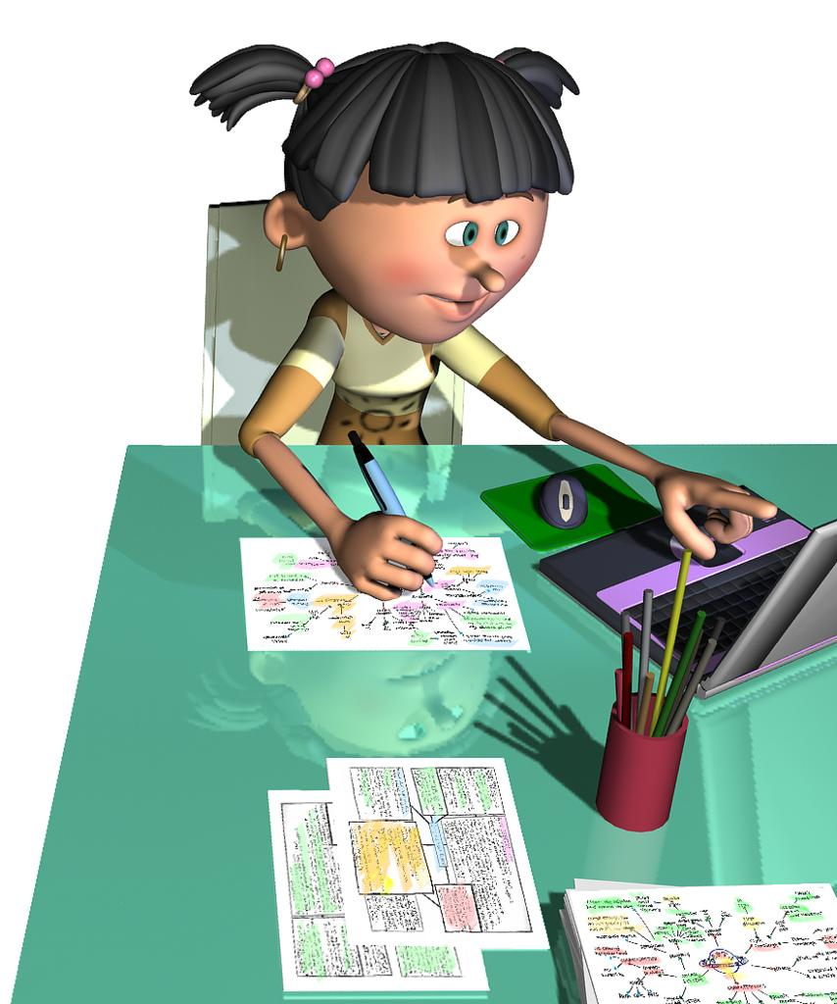
Tips:
Review old tests and quizzes
Look back at handouts from the trimester
Look back at your Vistas work
Google a topic for more information (for example: Google- Preterite verb conjugations for extra practice)
Color code your notes
Study individually sometimes
Study with a partner or group sometimes
Relax

Slide 4
Lesson 6 topics: Click on the topic for a review.
Vocabulary: Page 224; clothing, shopping, adjectives, colors, words associated with the preterite tense. Práctica
Saber y Conocer: Pages 200-201; Práctica
Indirect Object Pronouns: Pages 202-203; práctica
Preterite Tense of regular verbs: Pages 206-207; Video, Notes; Practice
-Car, -Gar, Zar verbs; Notes; práctica
Spell changes of Leer, creer, oír in preterite (ACCENTS AND Y in 3rd PERSON); práctica
Demonstrative adjectives and pronouns: Pages 210-211: Video, Video 2; Notes; practice

Slide 5
Lesson 7 topics: Click on the topic for a review.
Vocabulary: Page 260; Reflexive verbs, sequence words, affirmative and negative words, verbs like gustar, bathroom and daily routine vocabulary. Práctica
Reflexive Verbs: Pages 236-237. Notes; Práctica
Indefinite (affirmative) and Negative Words: Pages 240-241. Know meanings and opposites.
Preterite of SER and IR: Pages 244-245. Práctica
Verbs like gustar: Pages 246-247. Video, Video 2; Video 3 Notes; Práctica

Slide 6
Cultura...Do you know?
¿Dónde puedes regatear en países hispanos?
¿Quién es una diseñadora famosa de Venezuela?
¿Qué es la capital de Cuba?
La exportación de ______ es muy importante a Cuba.
El descanso entre 1:00-3:00por la tarde en países hispanos es ________
Una bebida tradicional en Argentina, Uruguay y Paraguay es ______
La capital de Perú es _______________
_______ son los animales más importantes en Perú.

