Slide 1
Unit 4 Solar System
Chapter 7 Notes
These notes are outlined from the 8th grade integrated science book chapter 7. Refer to the book for support.

Slide 2
Objectives:
Be able to describe the role of gravity in the formation of our solar system
Be able to differentiate between the Heliocentric and Geocentric models of the solar system.
  Be able to describe the contributions of Copernicus, Galileo and Kepler to the acceptance of the heliocentric model.

Slide 3
1. The Formation of the Solar System
  Gravity is the force responsible for forming the solar system.
  About five billion years ago a solar nebula condensed to form our star, the sun.
  Next, chunks of rock, dust and ice called planetesimals began to form in the outer nebula.
  Planetesimals collided and began to form the planets.

Slide 4
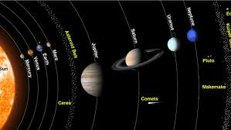
1. The Formation of the Solar System
    FIRST – The terrestrial planets (Mercury, Venus, Earth, Mars) formed from the heavier material.
    NEXT – the gas giants (Jupiter, Saturn, Uranus, Neptune) formed with most of the escaped gases.
    Beyond the planets, a huge disk of ice and other substances formed. Pluto also formed in this region.

Slide 5
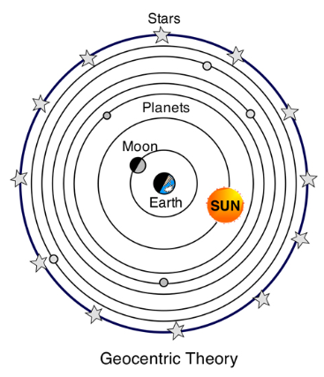
2. Models of the Solar System
  Geocentric model – Geo meaning ‘Earth’. In this model, Earth is at the center and planets and stars revolve around it.
Most early Greek astronomers believed in a geocentric model.
Ptolemy was an ancient Greek astronomer who created a model that explained this and most people believed him until the 1500s.

Slide 6
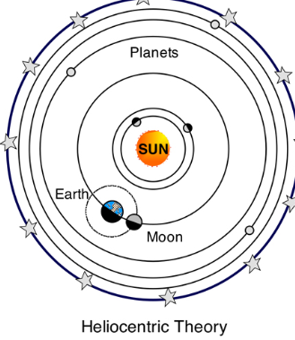
2. Models of the Solar System
  b. Heliocentric model – Helios meaning ‘Sun’. In this model, Earth and the other planets revolve around the sun.
      This model was developed by Nicolaus Copernicus, and was not well received. Over time, the following contributors helped people to accept this model.
        Nicolaus Copernicus (1543) created a heliocentric model with proper placement of planets moving around the sun, but flawed since orbits were circles.

Slide 7
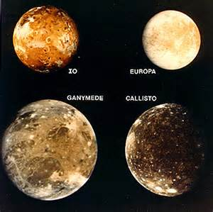
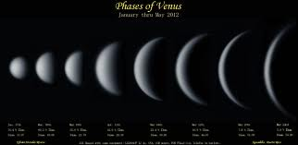
2. Models of the Solar System
      2. Galileo (1600s) used the newly invented telescope to make discoveries that supported Copernicus’s heliocentric model, including:
            Jupiter had four moons that revolved around it.
            Venus has similar phases to Earth’s moon, proving that it must circle something other than Earth.

Slide 8
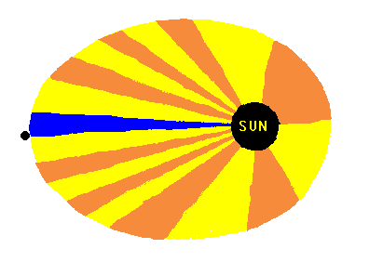
2. Models of the Solar System
Johannes Kepler (1600s) found that the orbit, or path of each planet, is an ellipse. An ellipse is an oval shape, which may be elongated or nearly circular.
    Kepler used evidence gathered by Tycho Brahe, who he was an apprentice for. Their mathematical evidence disproved that planets moved in perfect circles.

Slide 9
3. Modern Astronomy
  Astronomers have since discovered much more about our solar system and the universe its part of.
  We now know that the solar system consists of the following:
      Eight planets
      Asteroids found in the Asteroid Belt between Mars and Jupiter
      Comets found beyond the gas giants in the Kuiper Belt and Oort Cloud
      Meteors
      Dwarf planets, and
      Satellites (moons)

