Slide 1
Character Notes
9th English

Slide 2
12/3 Character Notes
1) Direct Characterization—Writers tell us directly what characters are like or what their motives are.
Oh, but he was a tightfisted hand at the grindstone, Scrooge! a squeezing, wrenching, grasping, scraping, clutching, covetous old sinner!
from A Christmas Carol by Charles Dickens
2) Indirect Characterization—Writers show us characters (through STEAL: Speech, Thoughts, Effects on others, Actions, Looks/Appearance) but allow us to decide what characters are like.

Slide 3
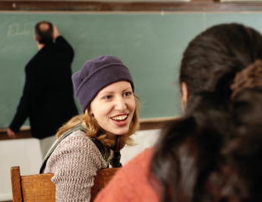


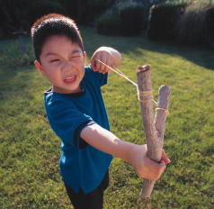
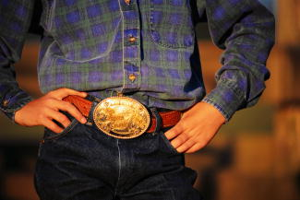
Indirect Character Development: (STEAL)
Writers build characters by revealing
Speech
Effect on others
Thoughts
Actions
Looks/appearance

Slide 4
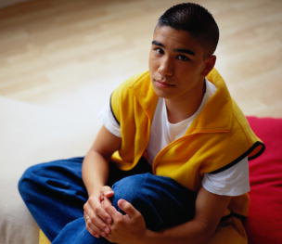
Speech
First-person narrators reveal their personal traits as they
  tell their own stories (using pronouns like I, me, and we)
  tell us what they think and feel
Be aware that some first-person narrators mislead or lie to the audience.

Slide 5
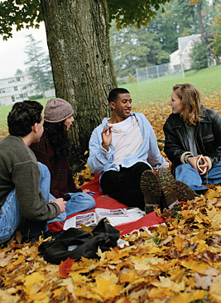
Speech
Dialogue can reveal a lot about characters and their relationships with each other. Pay attention to
  what characters say and don’t say
  how characters respond to each other
Dialect – way of speaking that is characteristic of a particular region or a particular group of people

Slide 6



Thoughts
Writers can take us into the characters’ minds to reveal their thoughts and feelings.
As you read, note whether the characters’ thoughts and feelings match their speech and actions.

Slide 7
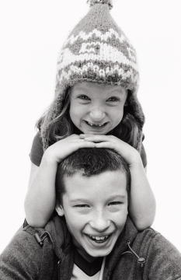
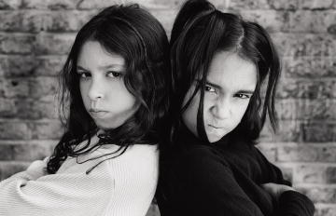
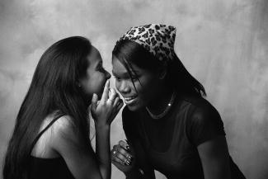
Effect on Others
Watch how other characters in the story react to the character. Note
  how the others feel about the character
  what the others say about the character

Slide 8

Actions
What characters do and how they treat each other often reveal the most about them.
Observe characters’ actions to determine
  what their personality is like
  what motivates them
  how they deal with conflict

Slide 9
Looks / Appearance
Pay attention to language the writer uses to describe the characters’ looks, clothes, and demeanor.
The cold within him froze his old features, nipped his pointed nose, shriveled his cheek, stiffened his gait; made his eyes red, his thin lips blue. . . .
from A Christmas Carol by Charles Dickens
  Does the description give you a positive or negative impression of the character?
  Which words contribute to this impression?

Slide 10

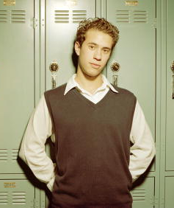
Main Characters
Protagonist—the main character of a story.
  The action of the story revolves around the protagonist and the conflict he or she faces.
Antagonist—the character or force the protagonist struggles against and must overcome.

Slide 11

Subordinate Characters
Subordinate characters
add depth and complication
to the plot.
Main character
Friends

Slide 12
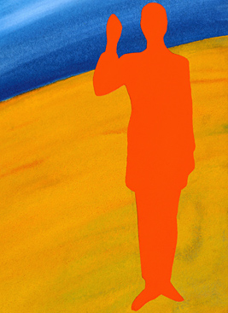
Flat Characters vs. Round Characters
Flat characters
  have only one or two character traits that can be described in a few words
  have no depth, like a piece of cardboard

Slide 13


Flat Characters vs. Round Characters
Round characters
  have many different character traits that sometimes contradict each other
  are much like real people, with several sides to their personality

Slide 14
Dynamic Characters vs. Static Characters
Dynamic characters
  change or grow as a result of the story’s actions
  learn something about themselves, other people, or the world as they struggle to resolve their conflicts
The changes that a dynamic character undergoes contribute to the meaning of the story.

Slide 15
Dynamic Characters vs. Static Characters
Static characters
  do not change or grow
  are the same at the end of a story as they were in the beginning
Subordinate characters are often static characters.

Slide 16
Character Motivation
Motivation—what drives a character’s actions. It
  explains behaviors
  reveals personality
  is often based on character’s fears, conflicts, needs
Motivation can be inferred by observing characters’ behavior, speech, actions.

