Slide 1
Basic Music Theory
MUSH 261
Prof. Slaton

Slide 2
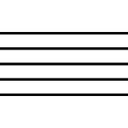
Music Staff
Music is written on a STAFF of five lines and four spaces between

Slide 3

Music Notes
Oval-shaped symbols that are placed on the lines and in the spaces.
They represent musical sounds, called Pitches

Slide 4
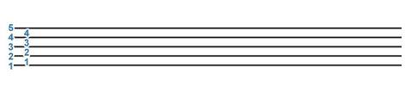
Numbering the Staff
The lines and spaces of the staff are numbered from bottom to top

Slide 5
Higher or Lower?
The higher the note is on the staff, the higher the pitch.
The Lower the note is on the staff, the lower the pitch

Slide 6
The Musical Alphabet
Music notes are named after the first seven letters of the alphabet, from A to G.
The musical alphabet repeats, so after G comes A.
ABCDEFGABCDEFGABCDEFGA…

Slide 7
Clef Signs
Clef signs help to organize the staff so notes can easily be read.

Slide 8
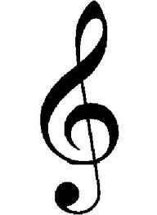
Treble Clef
The Treble Clef is used for notes in the higher pitch ranges.
The treble (or G) clef has evolved from a stylized letter G

Slide 9
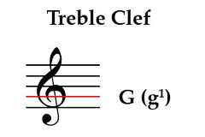
Treble Clef Cont.
The curl of the treble clef circles the line on which the note G is placed.
This G is above MIDDLE C

Slide 10


Treble Notes
Lines
Spaces
In the treble staff, the names of the notes on the lines from bottom to top are E, G, B, D, F
Every Good Boy Does Fine
The names of the notes in the spaces from bottom to top spell FACE.
…FACE

Slide 11

Bass Clef
The Bass clef (base) is used for notes in the lower pitch ranges.
The Bass or (F) clef has evolved from a stylized letter F

Slide 12
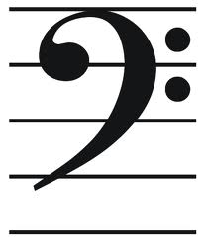
Bass Clef Cont.
The two dots of the bass clef surround the line on which the note F is placed.
This F is below middle C

Slide 13
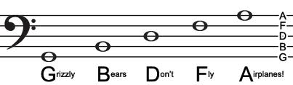

Bass Notes
Lines
Spaces
In the bass staff, the names of the notes on the lines from bottom to top are G, B, D, F, A
Good Boys Do Fine Always
The names of the notes in the spaces from bottom to top are A, C, E, G
All Cows Eat Grass

Slide 14
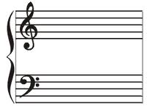
The Grand Staff
When the bass and treble staffs are connected by a brace and a line, they combine to form the GRAND STAFF

Slide 15
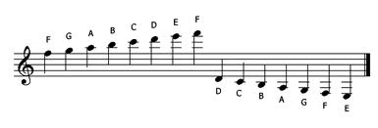
Ledger Lines
Ledger lines are short lines which are added to extend the range of the staff when the notes are too low or too high to be written on the staff.

Slide 16
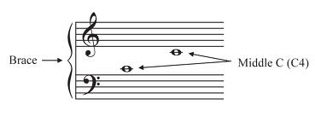
Middle C
Middle C is the “middle” of both clefs

