Slide 1
Olfaction Notes
Maddie Cline, Kelly Piper, Meg Mori, Emma Ivanauskas

Slide 2
Olfaction
5 Special Senses
Olfaction
Gustation
Vision
Equilibrium
Hearing

Slide 3
Olfaction
Olfaction – the sense of smell
Our sense of smell does not compare to with dogs, cats, or fish
Provided by paired olfactory organs
Organs are located in the nasal cavity on either side of the nasal septum

Slide 4
Olfaction
Organs made up of two layers:
Olfactory epithelium
Lamina propria

Slide 5
Olfaction
Olfactory epithelium made up of:
Olfactory receptor cells
Supporting cells
Regenerative basal cells (stem cells)

Slide 6
Olfaction
Lamina propria contains:
Areolar tissue
Numerous blood vessels
Nerves
Olfactory glands (Bowman’s glands)
  secretions absorb water and form a thick pigmented mucus

Slide 7
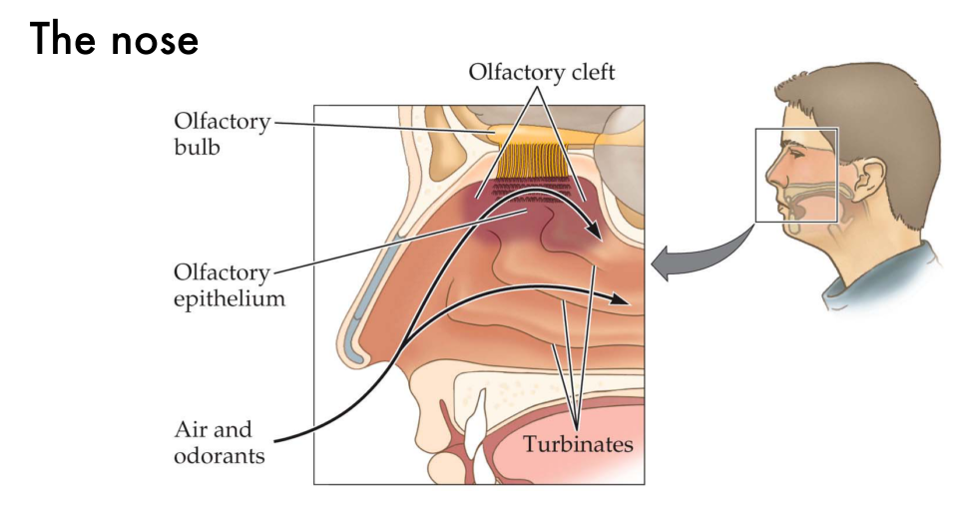

Slide 8
Olfaction
Normal inhalation:
2% of inhaled air to olfactory organs
Sniffing increases flow of air across the olfactory epithelium and intensifies the stimulation of the olfactory receptors

Slide 9
Olfactory Receptors
  Olfactory receptor-Highly modified neuron
  Larger olfactory receptor surface= better sense of smell
  Contains up to 20 cilia
exposed to inhaled compounds
site of reception (smell)
contain odorant-binding proteins

Slide 10
Olfactory Receptors
Odorants
Chemicals that stimulate olfactory receptors
Small organic molecules
Notes:
http://homepage.psy.utexas.edu/homepage/faculty/pillow/courses/perception09/slides/Lec23_Olfaction.pdf

Slide 11
Olfactory Receptors
Receptors are G proteins
Receptor binds to odorant and activates adenylate cyclase
    Converts ATP to cyclic-AMP (cAMP)
cAMP opens sodium channels in membrane… results in a localized depolarization
Action potential is triggered in the axon and smell information goes to the central nervous system (CNS)

Slide 12
Olfactory Pathways
Olfactory system is very sensitive
Stimulus does not always reach the olfactory cortex
Persistent stimulus- olfactory receptors adapt very little which causes lost awareness of a new smell

Slide 13
Olfactory Pathways
Axons go from
olfactory epithelium cribriform plate
olfactory bulbs
Olfactory bulbs- where first synapse occurs
Axons leaving the olfactory bulbs go from olfactory tract to olfactory cortex (the hypothalamus)

Slide 14
Olfactory Discrimination
Olfactory system can differentiate between 2000-4000 stimuli (smells)
At least 50 primary smells are known
Impossible to describe these sensory impressions

Slide 15
Aging and Olfactory Sensitivity
New olfactory receptor cells are produced by division of basal cells in the epithelium
Total number of receptors declines with age
Receptors become less sensitive
Elderly have hard time detecting smells of low concentrations

Slide 16
Occupations associated
with Olfaction
Smell research technician- test products to see if they smell bad or good
Otorhinolaryngologist- a doctor who specializes in diseases of the ear, nose, and throat

Slide 17
Diseases/ Conditions associated with olfaction
Deviated septum- displacement of the nasal septum or a bend causing nasal blockage on one side, post-nasal drip and trouble breathing
Choanal Atresia- nasal blockage occurring in infants affecting one side of the nose and chest retractions causing sinking of the chest
Sinus infection- inflammation, or swelling, of the tissue lining the sinuses

Slide 18
http://www.careersearch.com/smell-research-technician/

