Slide 1


Stuart Little
By E.B.White
Book report by Lliam Aguilar
Read this book and you will be speechless
when you see Stuart and his adventures on sea and land.
By Lliam Aguilar
Wow!

Slide 2
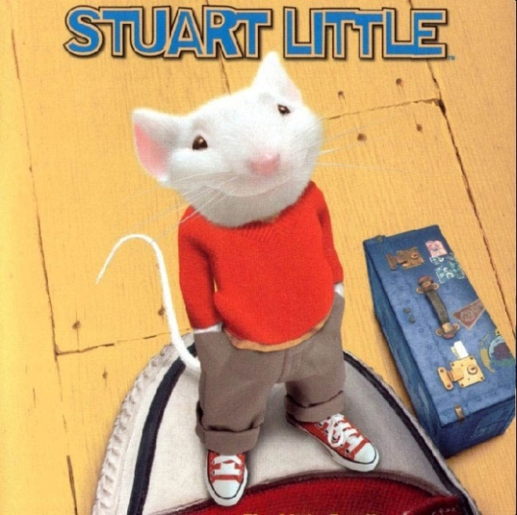
Genre
The setting in this story is fiction because there is no such thing as talking mice or birds or any animal for that matter. I also noticed in this story that they mentioned that Stuart has a tiny automobile that is invisible. There is no such thing as that either so that makes it part fiction. Fiction can involve real places and real people but some parts in the story
Like I said involve made up things.

Slide 3
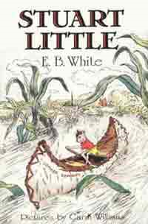
Setting
This story takes place in New York City in a house across the street from Central Park. Later in the story the setting is also at Ames Crossing, a school yard, a pipe drain and a lake in Central Park. At one point even on a garbage truck and a ship.

Slide 4
Stuart Little summarize
This story takes place in New York City in a house across the street from Central Park. The main characters are Stuart Little, who is a mouse, and his adoptive family the Little’s, their son George, the Little’s cat Snowbell and Stuart’s friend Margalo who is a bird. This book is about the fun adventures of Stuart and these characters.
Cat and mice are naturally enemies and one time Snowbell pretended Stuart went into his mouse hole and left the family. The family was really sad and tried finding him with the help of a friendly exterminator. But they didn’t find him. George, Stuart’s brother, finally found him tangled in the curtains and saved him. Another time, Stuart was taking a walk when he fell into the garbage. When the garbage truck came and picked him up it drove to the waiting harbor dump ship. The ship was getting ready to dump Stuart in the ocean! Just then Margalo swooped down and caught Stuart bringing him home safely. Also, Stuart has a hobby, not just any kind of hobby but the coolest of them all, he gets too drive a model boat. Remember Stuart can’t drive a real one because he is a mouse.
Stuart was offered a job to run the boat and keep it ship shape for races and every time Stuart won a race the owner, Tom would pay Stuart money. During the spring time Snowbell was made fun of by the other cats because he was living with a bird. He hired cat bounty hunters to kill Margalo. While Snowbell was talking to the bounty hunters a pigeon heard the whole story so the pigeon wrote a note to Margalo that she was going to get killed. In the morning Margalo woke up and read the note she was scared out of her mind so she left the house and headed up north where she knows she will be safe from the cats. When Stuart woke up he was devastated that Margalo ran away so he ran away in search of Margalo. Stuart stopped Tom’s house to see if he has anything Stuart can use to find Margalo.
Tom builds miniature working gas models of cars for a hobby. Stuart bought one and it was just what he needed to find Margalo. On a gloomy night heading up north to find Magalo, how does Stuart know well he knows that Margolo is a winter bird. Just then Stuart comes to the town of Ames Crossing what happens next read the book and find out.

Slide 5
Evaluation
I like this book very much I would rate it with five stars because of all the excitement that Stuart has on his adventures with friends. Some big and some small. I also think the story line is very interesting because it shows his life and all of the other characters lives and there adventures too with no Stuart sometimes. Any- one would like this book if they like adventures and very silly things like invisible cars and mice riding model boats.

