Slide 1

Planning and Building Services
PRE-APPLICATION CONFERENCE TRAINING
November 24, 2019

Slide 2
What we’ll cover this evening:
What are pre-application conferences and why do we have them?
What kinds of projects will we see?
What is a typical meeting like?
How can I be most effective in representing my neighborhood?
Notes:
Today we want to help you:
Understand the purpose of a pre-application conference and its role in development review.
Learn what a typical meeting is like, and address your questions about what will be discussed, and
Offer some advice about how you can be most effective in collecting information for your association and sharing neighborhood information with the applicant to make their proposal better.

Slide 3
What Is the Purpose?
City Code
LOC 50.07.003(1)(e)
The purpose of the pre-application conference is to discuss the proposal, the applicable criteria and the requirements for completing an application.
Notes:
Here is what the City’s Community Development Code says about pre-apps: ( Is anyone not familiar with what CDC is?)
A pre-application conference is required for minor and major development permit applications (and some ADUs), and must be scheduled by the applicant prior to submitting an application for development.
Exception: Exterior paint color review on non-historic buildings, mods where there is no increase in intensity and no Building Permit required, City projects for some non-habitable buildings, minor variance to fence standards when part of code enforcement action.
iii. The purpose of the pre-application conference is to discuss the proposal, the applicable criteria and the requirements for completing an application. A copy of an adopted neighborhood plan shall is provided to the applicant, regardless whether its provisions constitute criteria for the proposed development or not.
An applicant may request one or more additional pre-application conferences in order to discuss any changes in the applicable criteria and application requirements that may occur between the date of the pre-application conference and the filing of the development permit application.
iv. The development permit application must be filed within one year from the date of the pre-application conference; if the development permit application is not filed within one year, a new pre-application conference is required unless the applicant requests and the City Manager approves a waiver of the additional pre-application conference.

Slide 4
What Is the Purpose?
For the Applicant
The applicant pays a fee (sometimes waived) for staff to explain what will be expected of them during the City’s development review process.
It allows the applicant one-on-one time with the assigned staff to ask questions & learn about the codes which will affect their property.
It’s generally the rough draft stage, but this varies.
Notes:
Click the mouse again to reveal…
The pre-application conference has been developed to:
-- Thoroughly familiarize an applicant with City development codes, other applicable codes, and the procedures to complete land use/development applications.
-- Review applicant's preliminary site inventory and proposal and to provide specific zoning and development information to the applicant as it relates to site limitations and the proposal.
In other words, the purpose of a pre-development conference is to give an applicant an explanation of what will be expected of them during the City’s development review process. It allows them one-on-one time with the assigned planner to ask questions and learn about the codes which will affect their property. The applicant pays a fee for this service.
Generally, the applicant has a rough ideas of what he or she is proposing, but the amount of detail the applicant has varies. For instance, some times people are considering buy a piece of property and want to know what they could do with. Others come in with plans drawn by an architect.

Slide 5
What is the purpose?
For the Neighborhood
Learn about new development that might be happening in the neighborhood.
Share neighborhood information with the applicant.
Build a relationship with the applicant.
Take information back to the neighborhood.
Notes:
We’ll talk more about your role at the meeting a little later.

Slide 6
Neighborhood Representation at
Pre-Application Conferences
Neighbors attending pre-apps is unique to Lake Oswego.
Planning Department began inviting citizens many years ago.
Lake Oswego is committed to citizen involvement.
Notes:
Neighborhood association representatives have not always been invited to attend pre-application conferences and we’re not aware of other jurisdictions that have this practice.
Because applicants pay a fee for a service the primary goal of the meeting is to explain the development review process. Staff has a lot of information to share with the applicant and has a responsibility to stay on track.
Since 2003, the City has invited up to two trained neighborhood representatives to attend pre-apps in order to keep folks informed about potential development in their neighborhoods and possibly influence the outcome.

Slide 7

When Is It Required?
Required: for all minor and major developments, and ADUs that add floor area to the site.
Optional: for all other
development applications.
Notes:
Required: for all minor and major developments and ADUs that add floor area to the site
Optional: for all other development applications. May be scheduled by the applicant or requested in special cases by the City Manager.
You’re next question might be, “so what is a minor development and what is a major development?” Let’s talk, then, about the types of development permits we deal with in the planning department…

Slide 8


Land Use Decisions
Clear and Objective
Ministerial Development
Building permits, lot line adjustments, ADUs
Discretionary
Minor Development Partitions, minor variances, RID
Discretionary
Major Development
Conditional use permits, major variances, subdivisions, zone changes
Notes:
Decisions fall on a continuum between those that require no discretion to those that require considerable discretion. As the level of discretion increases, so do the levels of public notice and opportunity for participation.
Clear and Objective (single family or duplex construction/building permits, lot line adjustments, ADUs), a.k.a ministerial decisions: Applications are reviewed against a checklist of measurable criteria from the City Code. If an applicant meets the requirement of the applicable code, he or she will be issued a permit.
* There is no notice provided to neighbors for this type of permit, nor opportunity for “land use “ appeal.
Discretionary (Minor Development permits such as partitions, minor variances, RID) a.k.a. administrative decisions: Staff makes these types of decisions. But because some discretion is involved, public notices are provided and public input invited. There is opportunity for a hearing on appeal.
Discretionary (conditional use permits, subdivisions, major variances; new commercial, MF or institutional construction) a.k.a quasi-judicial decisions: Decisions are made on the use or development of individual properties based on facts and evidence presented in a public hearing similar to judicial hearings in a courtroom. A public hearing is a part of this type of decision.
Policy decisions (neighborhood plans, Comprehensive Plan changes, Community Development Code changes) a.k.a. legislative decisions: Decisions are made by the City Council on proposals that have broad implications for the whole community, involving the creation of new laws or policies. (Planning Commission provides a recommendation to Council)

Slide 9
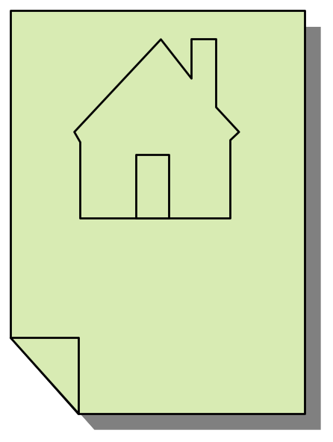
When Does the Pre-App Meeting Happen?
The pre-application conference occurs before the applicant has submitted a formal application for their project.
Notes:
The pre-application conference occurs before the applicant has submitted a formal application for their project.
It is possible that they will never file a formal application or that they may not complete the application process once they start. Some applicants come in for multiple pre-application conferences before ever submitting a formal application.
An applicant may request one or more additional pre-application conferences in order to discuss any changes in the applicable criteria and application requirements that may occur between the date of the pre-application conference and the filing of the development permit application.
The development permit application must be filed within one year from the date of the pre-application conference; if the development permit application is not filed within one year, a new pre-application conference is required unless the applicant requests and the City Manager approves a waiver of the additional pre-application conference.

Slide 10
Opportunities for Neighborhood Input
Pre-Application Conference
Neighborhood Meeting with Applicant
Written Comments to Staff
Public Testimony at Hearing
Notes:
Pre-application Conference.
First opportunity to give neighborhood input is at the pre-app.
Neighborhood Meeting
City Code requires that applicants for partitions, subdivisions, and major development hold a meeting for adjacent neighbors (within 300 feet/or 50 owners whichever is greater), neighborhood association and adjacent neighborhood associations. The meeting is held to inform the community about the proposed project and take comments and questions. Meeting minutes must be submitted with the application, and a copy provided to the neighborhood association for review within 14 days of the meeting. The neighborhood association may submit their own version of meeting minutes to the City planner in charge of reviewing the application. Specific requirements for the neighborhood meeting can be found in the City Code under LOC 50.07.003(1)(f).
Opportunities to Respond in Writing to Staff
For all minor development applications, there is a 14-day public comment period between the time at which the public is given notice of the complete application, and when the staff report is written. For major development decisions, notice of the public hearing is mailed 20 days before the hearing. Neighborhood associations may provide their comments to be considered in the staff report/ decision or recommendation and become part of the official record.
Opportunities to Give Public Testimony
Your neighborhood association may select representatives to give comments to the public body (Development Review Commission, Planning Commission, or City Council) during the public hearing. Recognized associations are given up to 10 minutes to testify. Remember to state the level of support for your testimony, i.e. the neighborhood association held a board meeting and voted 8-2 to support this position. Both majority and minority reports are required by the Citizen Involvement Guidelines.

Slide 11

Format of a Typical Conference Before the Meeting
Scheduled two weeks after receiving application materials
Staff will seek input from other departments
Staff makes a site visit*
Staff drafts pre-app comments
  *Note: only staff is authorized to make a site visit.
Notes:
When applications for a pre-application conference are received at the Planning desk, staff schedules the conference at least two weeks out.
Once a date and time are selected, city staff will notify the designated NA representative of the upcoming meeting.
Please provide the email address (and phone number) you would like the planners to use before you leave tonight. It is your responsibility to RSVP with information about who will attend from your association. Please keep in mind that attendance is limited to two neighborhood people. A packet will be sent to you via e-mail which contains the application materials submitted by the applicant.
Prior to the meeting, the planning support staff sends a request to staff who would likely review this project once a formal application had been received. These staff members are asked to review the materials that the applicant submitted for the pre-app and make comments in writing.
*Neighborhood reps and other interested persons are not authorized to enter a site subject to a pre-app conference, land use app, or tree permit. Only City staff or members of a hearing body are authorized to enter the property and City staff cannot grant permission for other persons to visit the site. If you would like to make a site visit, you must contact the property owner for permission.

Slide 12

Format of a Typical Conference Schedule
Meetings occur on Thursdays at these allotted times:
  1:15 pm
  2:30 pm
  3:45pm
Notes:
Meetings occur on Thursdays at these allotted times:
1:15 pm,
2:30 pm, or
3:45 pm

Slide 13
Format of a Typical Conference
Who is there?
The Applicant
Assigned Planner
Engineering
Neighborhood Reps
Leslie
Johanna
Debra
Debra
Jessica
Russ
Jessica
Todd
Amanda
Andrea
Jonna
Notes:
What you can expect when you arrive at your first pre-application conference.
Who will be there?
1 and 2. One or more people representing the property owner or developer.
(Keep in mind, you will likely see a variety of types of applicants. Some are professionals who do this all the time, others are property owners who’ve never come in for a permit.)
3. The planner assigned to the case (if this becomes an actual application, this will most often be the person who continues as the assigned planner).
4. A representative from Engineering (usually Todd Knepper).
5. Sometimes you will see a representative from the Fire Department, but most often the Fire Marshal will submit a written report that will be shared during the meeting.
6. If there are sensitive lands involved, you might see the City’s Natural Resources consultant, or notes from him/her

Slide 14

Format of a Typical Conference Discussion
Submittal requirements for a land use application
  Applicable criteria from the City’s Community Development Code (CDC) and other applicable codes.
Notes:
So, what is discussed at a typical meeting?
Most meetings will center around the applicable criteria for the proposed project. This means, what is allowed by the City’s code.
The City’s Community Development Code (CDC) has applicable criteria for the various types of proposals that come in. The applicable criteria will vary by the location and type of proposal. They are the criteria that staff will use to make an administrative decision and the criteria DRC, Planning Commissioners and City Council will use in a quasi-judicial or legislative decision. Just like in a court of law, the decisions staff, Commission or Council makes about an application must be clearly based on the criteria laid out in the City code. This is how decisions are made fair and impartial.
If your association presents information to the DRC, PC or CC down the road, it will be most influential if it speaks to the criteria also. Otherwise you may be asking staff, Planning Commission or City Council to make a decision that the law simply won’t allow them to make. During the conference, keep your ears open to the applicable criteria presented by the assigned planner.
Note: If your association wishes to change the applicable criteria for projects that occur in your neighborhood, it would require a separate process. The project currently under consideration is only responsible for the rules in place when they applied. If you’d like to talk about making changes to the City Code or the Comprehensive Plan, please contact planning staff, the Planning Manager or the Community Development Director.

Slide 15
Format of a Typical Conference Discussion
The assigned staff will facilitate.
Staff comments compiled before the meeting will be presented.
Staff with comments that require explanation
will attend the meeting.
  You will be given a copy to take with you.
You will be given time at the end to provide
comments from your association.
Notes:
The assigned planner will lead the meeting.
The planner has prepared notes that contain comments which the owner or developer will take with them after the meeting.
Those staff people who have additional questions for the applicant, or who might need to explain their comments, will be at the conference.
If a staff person who made comments cannot attend the conference, they usually make themselves available at a later date if the applicant has additional questions.

Slide 16

How to be Most Effective at the Meeting?
GOALS:
Provide Information
Build a Relationship
Take Information Back
Notes:
Now that you know more about what a meeting is like, let’s talk about how you can be most effective as a representative of your neighborhood.
There are three common goals:
1. Provide information
2. Build a cooperative relationship
3. Take information back

Slide 17

Your Role
#1: Provide Information
You are a resource for the applicant.
You can help them produce a better application and a better development.
Speak as a representative of your neighborhood.
Notes:
You know the dynamics of your neighborhood and are attending the conference as a representative of the neighborhood.
Think of yourself as a resource for this applicant, you are here to provide information. Be sure to focus on NEIGHBORHOOD concerns and try to steer clear of personal opinions.

Slide 18

Your Role
#2: Build Cooperation
Good relationship are built on mutual respect
Don’t alienate
Share information
Be constructive
Notes:
This is an opportunity for the neighborhood to learn about a proposal very early on and to share with the applicant ideas and questions that should be considered before the applicant takes the proposal to the community or submits an application.
The process may not result in a perfect project, but your early involvement might make it a better project than it might have been without your participation.
Remember this is probably your first contact with the applicant and vice versa. So this is everyone’s first opportunity to share information and forge a cooperative, working relationship. This conference is the time for an open discussion where everyone involved should be allowed to explore and try out ideas. The your first opportunity to build an open relationship
Don’t alienate the applicant even if you know that your neighbors will not support what they are proposing. Relationships built on mutual respect have a much higher likelihood of being successful for both parties over the long haul.
Be constructive by acknowledging the positive aspects of the project and then share concerns you think the neighborhood will have about specific aspects of the proposal. Try saying, “I appreciate that you would like to have a successful business and the neighborhood supports local businesses, but the neighbors may have some concerns about where your customers will park, so you may want to be prepared to talk about parking when you come to the community meeting.
Just as you are hearing about the applicant’s ideas for the first time, the applicant might be learning for the first time about the limitations to developing the property, which could be frustrating. The staff who attend these meetings know not to let this frustration rub off. You should do the same. Don’t forget Goal #2, to build a positive working relationship with this applicant.

Slide 19
Your Role
#2: Build Cooperation
What to do if:
You don’t agree with staff’s interpretation
You don’t like the way the code is written
Don’t understand something
Notes:
So, if you don’t like what is being proposed, the approach here suggests that you give the applicant the benefit of the doubt and a chance to make improvements before filing a final application. But what if you don’t like what the code allows? Or what if you don’t agree with the interpretation of the assigned planner or other city staff?
If there are aspects of the City Code that you are not happy with, the pre-application conference is not the best forum to voice that concern. The reason: No one in the room can change the code. Write down your thoughts and make an appointment to talk to me or another planner about this issue. I can help you understand the process of changing the City code.
If you do not like the planner’s interpretation of the City’s code, write that down in your notes and talk to them outside the meeting. Inside the meeting is not the most professional place to question their decisions. Additionally, the ideas you record can form the basis for letters or testimony the association might choose to submit on the land use application.
This is not meant to dissuade you. You have the right to disagree with anything you wish. It is simply meant to direct you toward the appropriate forum for making the changes you desire.
Last, if there are questions which arise during the meeting, write them down too and ask at the end. OR ask your questions after the meeting with the assigned planner.

Slide 20
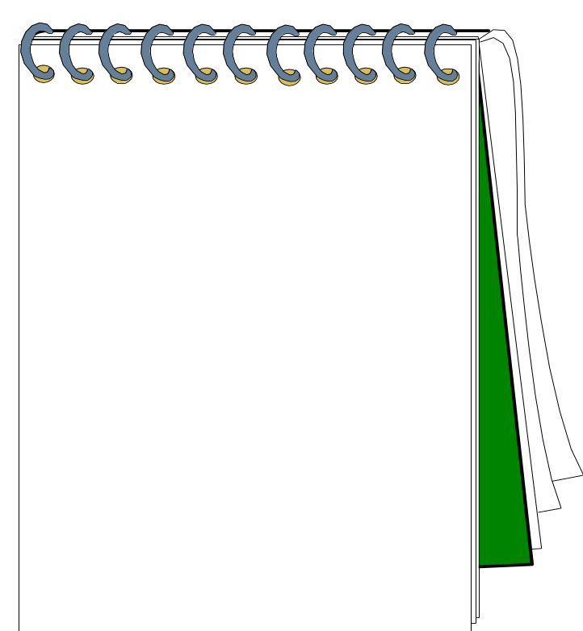
Your Role #3: Take Information Back to the Association
Take notes.
  Project details
  First impressions
  Controversial items
Find out what happens next.
  Request notice of a complete application from applicant.
Ask questions
Notes:
Two flag lots,
sidewalks
Notes:
Take comprehensive notes. Share the information with your association members at the next board meeting or report it in the next newsletter.
You can ask the applicant to include you in the mailing list they provide to the City. This will provide you notice if this project ever becomes an application. Note: your association chair is already on this list. Another way to find out is to ask them to keep track of this address and inform you if it becomes an application.
Before you leave the meeting you may want to ask about the schedule so you know what will happen next and when you can expect to hear more about the application.

Slide 21
Sharing the Information
In writing prior to the meeting
  To assigned planner
  By Wednesday before the meeting
In writing after the meeting
  To assigned planner
Notes:
Presenting concerns in writing
You are invited to share your concerns about the project in writing prior to the meeting just like staff does. These comments are due the Wednesday before the meeting. Written comments are an excellent way to present your ideas in a clear and succinct manner that the applicant can refer to later. Try to keep your comments short and to the point that you are sure to be understood.
If you were not able to provide written comments before the meeting, you may want to send a copy of your notes to the assigned planner.

Slide 22

Sharing Information
The neighborhood meeting
GOALS:
1. Clear up confusion about the project
2. Share concerns
3. Provide ideas for improvement
Notes:
Here are a few things to keep in mind for the Neighborhood Meeting (must take place after the pre-app)
Goals:
To clear up areas of confusion ask questions.
Share concerns about the proposal.
Provide ideas about how to improve the project.
Required for:
• A partition, subdivision, Major variance, Conditional Use Permit, or Any other development permit if the City Manager deems neighborhood contact to be beneficial.
i. Purpose
The purpose of neighborhood contact is to identify potential issues or conflicts regarding a proposed application so that they may be addressed prior to filing. This contact is intended to result in a better application and to expedite and lessen the expense of the review process by avoiding needless delays, appeals, remands or denials. The City expects an applicant to take the reasonable concerns and recommendations of the neighborhood into consideration when preparing an application. The City expects the neighborhood association to work with the applicant to provide such input.
The City recognizes that potential impacts of development, such as stormwater runoff, traffic, noise or impacts on natural resources, may affect not only the area immediately surrounding the site of the proposed development, but the neighborhood in which the site is located, and adjacent neighborhoods.

Slide 23
Training Follow-Up
Make sure your neighborhood association’s pre-application contact person knows that you have been trained, so they can invite you to attend.
  Thank You!

