Slide 1
Alternate Assessment
1% State-level Participation Cap

Slide 2
Learning Objectives
Participants will become aware of the requirements in the Every Student Succeeds Act (ESSA) pertaining to alternate assessment (AA-AAAS) and the State-level cap on 1% participation.
Participants will examine the provisions in ESSA for requesting a waiver of the State-level 1% cap.
Participants will be provided strategies and suggestions for meeting the State-level 1% cap.

Slide 3
Evolution of the 1% cap from ESEA to ESSA
The 2003 Elementary and Secondary Education Act (ESEA) regulations placed a 1% cap on the percentage of the total tested student population that could count as proficient on the alternate assessment. This was not a cap on participation in the assessment.
Data collected before 2003 enactment of the accountability regulation indicated that participation in the alternate assessment was less than 1% of total tested population in nearly every state.
Alternate assessment participation rates have increased steadily since that time.

Slide 4
Then …
Every Student Succeeds Act (ESSA) reaffirmed that the alternate assessment is an appropriate assessment for students with the most significant cognitive disabilities to demonstrate their knowledge and skills, but rather than placing a cap on accountability ESSA places a 1% cap on participation in the assessment.

Slide 5
What does this mean?
This shift in policy means that states, districts, schools and IEP teams need to think carefully about which students should be included in the alternate assessment.
ESSA indicates that the alternate assessment is for students with the most significant cognitive disabilities.

Slide 6
To reach 1.0% participation rate in WV . . .
WV 2016 Alternate Summative Assessment (ASA) Participation
Math
Current Math participation percent (%) | Current Math participation number (#) | Math participation number (#) needed to reach 1.0%* | Math change in participation number (+/-) to reach 1.0%*
1.40 | 2460 | 1763 | -697
Reading
Current ELA participation percent (%) | Current ELA participation number (#) | ELA participation number (#) needed to reach 1.0%* | ELA change in participation number (+/-) to reach 1.0%*
1.40 | 2462 | 1763 | -699
*Results for the participation number needed to reach 1.0% and the change in participation number to reach 1.0% are calculated with the assumption that the total number of students tested remain constant.
Data source: WVEIS RPTCRD16 _PWVN307A

Slide 7
Let’s break it down and look at an un-named district in WV
School | All # Math | Alternate # Math | Alternate participation % Math | Proficient Math # | Proficient Math %
A | 91 | 2 | 2.20 | 1 | 50.00
B | 83 | 2 | 2.41 | 0 | 0.00
C | 100 | 3 | 3.00 | 2 | 66.67
D | 120 | 4 | 3.33 | 3 | 75.00
E | 127 | 4 | 3.15 | 2 | 50.00
F | 248 | 5 | 2.02 | 1 | 20.00
G | 856 | 20 | 2.34 | 11 | 55.00

Slide 8

Strategies for meeting the 1% participation cap
Gather district and school data on current participation rates in the alternate assessment.
Gather data on the characteristics of students participating in the alternate assessment.
Create or examine a state definition of “students with the most significant cognitive disabilities” and revise guidelines, as needed, for determining whether a student should participate in the alternate assessment.
Provide PD for IEP team members and other educators on alternate assessment and who should participate in it.
Provide information sessions for parents of students with disabilities so that they can participate in the IEP decision-making process about the assessment in which their child participates.

Slide 9
Recommended Strategy #1
Gather data on current participation rates- Examine participation rates in districts and by grade level.
This data will help in understanding whether there are pockets of schools or districts in which the numbers are higher than expected and whether there are certain grades in which participation in the alternate assessment is higher than expected.

Slide 10
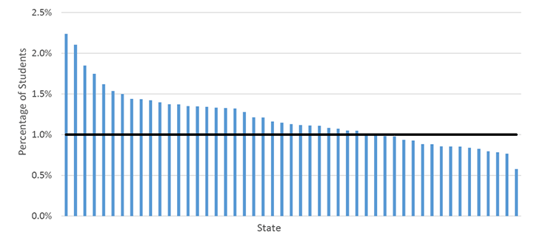
National Data

Slide 11
WV Alternate Summative Assessment Participation for Math, SY 2016, Grades 3-11 by District
Hancock
WV% = 1.40
(Target % = 1.0)
Brooke
Ohio
Marshall
Wetzel
Monongalia
Pleas-
Tyler
Marion
Morgan
Berkeley
ants
Preston
Mineral
Jeff-
Dodd-
Harrison
Taylor
Hampshire
erson
Wood
Ritchie
ridge
Barbour
Grant
Wirt
Tucker
Hardy
Cal-
Gilmer
Lewis
Jackson
houn
Upshur
Randolph
Mason
Roane
Braxton
Pendleton
Cabell
Putnam
Clay
Webster
Kanawha
Nicholas
Pocahontas
Above WV % (>1.40%)
Wayne
Lincoln
Boone
Fayette
At or below WV % (≤1.40%) but above 1.0%
Mingo
Greenbrier
Logan
Raleigh
At or below target (≤1.0%)
Wyoming
Sum-
mers
Monroe
McDowell
Mercer
Note: Results exclude WVSDB and Institutional Programs
Data source: WVEIS RPTCARD16_PWVN307A

Slide 12
WV Alternate Summative Assessment Participation for ELA, SY 2016, Grades 3-11 by District
Hancock
WV% = 1.40
(Target % = 1.0)
Brooke
Ohio
Marshall
Wetzel
Monongalia
Pleas-
Tyler
Marion
Morgan
Berkeley
ants
Preston
Mineral
Jeff-
Dodd-
Harrison
Taylor
Hampshire
erson
Wood
Ritchie
ridge
Barbour
Grant
Wirt
Tucker
Hardy
Cal-
Gilmer
Lewis
Jackson
houn
Upshur
Randolph
Mason
Roane
Braxton
Pendleton
Cabell
Putnam
Clay
Webster
Kanawha
Nicholas
Pocahontas
Above WV % (>1.40%)
Wayne
Lincoln
Boone
Fayette
At or below WV % (≤1.40%) but above 1.0%
Mingo
Greenbrier
Logan
Raleigh
At or below target (≤1.0%)
Wyoming
Sum-
mers
Monroe
McDowell
Mercer
Note: Results exclude WVSDB and Institutional Programs
Data source: WVEIS RPTCARD16_PWVN307A

Slide 13
Recommended Strategy #2
Gather data on the characteristics of students participating in the alternate assessment- Use existing data from national studies as a benchmark for judging whether there might be students participating in the Alternate Assessment (AA) who do not have a significant cognitive disability.

Slide 14
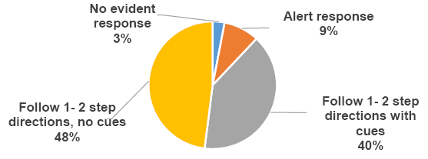
Communication Considerations
Receptive

Slide 15
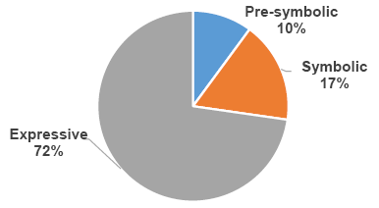
Communication Characteristics
Expressive

Slide 16
Recommended Strategy #3
Create or examine state definition of “students with the most significant cognitive disabilities” and revise guidelines, as needed, for determining whether a student should participate in the alternate assessment.
Make sure the problem is not a lack of implementation of the definition.

Slide 17
Strategy #3 Continued
Assessment regulations require that the state definition:
  Address cognitive functioning and adaptive behavior;
  Identify exclusionary factors (e.g. EL, low performance); and
  Reflect the instructional needs of students with the most significant cognitive disabilities (extensive, direct individualized instruction; substantial supports).

Slide 18
WVDE Definition
Students with the most significant cognitive disabilities (moderate to severe intellectual disability) have general intellectual functioning more than three standard deviations below the mean, in consideration of 1.0 standard error of measurement as determined by a qualified psychologist, using an individually administered intelligence test; and the student exhibits concurrent deficits in adaptive functioning expected for his or her age across multiple environments based on clinical and standardized assessment in at least one of the following domains: conceptual, social, or practical.

Slide 19
Recommended Strategy #4
Provide Professional Learning for IEP Team members and other educators on the nature of the alternate assessment and who should participate in it.
Include, at minimum:
Using participation guidelines to make assessment participation decisions.
Differentiating instruction (DI) and providing better access (UDL) to academic content.
Selecting, implementing, and evaluation accessibility features and accommodations for instruction and assessment.

Slide 20


3B2 District Action Plans
Improvement Plan Action Steps Examples
Train principals and IEP Teams on how to analyze data and inform parents on what it means to be on an alternate diploma.
Train teachers on the Guidelines for Participation on Alternate Assessment.
Provided Professional Learning opportunities to raise awareness of implications and limitations of alternate diploma.

Slide 21
Recommended Strategy #5
Provide information sessions for parents of students with disabilities so that they can participate in the IEP decision-making process about the assessment in which their child participates.

Slide 22
Strategies for meeting the 1% participation cap
Gather district and school data on current participation rates in the alternate assessment.
Gather data on the characteristics of students participating in the alternate assessment.
Create or examine a state definition of “students with the most significant cognitive disabilities” and revise guidelines, as needed, for determining whether a student should participate in the alternate assessment.
Provide PD for IEP team members and other educators on alternate assessment and who should participate in it.
Provide information sessions for parents of students with disabilities so that they can participate in the IEP decision-making process about the assessment in which their child participates.

Slide 23
ESSA 1% State-level Cap Waiver Requirements
The waiver must be submitted at least 90 days prior to the start of State’s testing window.
The waiver must provide State-level data from the current or previous school year to show:
The number and percentage of students in each subgroup who took the alternate assessment and
The State has measured the achievement of at least 95% of all students and 95% of children with disabilities subgroup who are enrolled in grades for which the assessment is required.

Slide 24
Waiver Requirements Continued…
Include assurances from the State that it has verified that each LEA that the State anticipates will assess more than 1% of it’s assessed students in any subject for which assessments are administered in that school year using the alternate assessment.
Followed each of the State’s guidelines and
Will address any disproportionality in the percentage of students in any subgroup.

Slide 25
Include a plan and timeline by which
The State will improve the implementation of its guidelines by reviewing and if necessary, revising its definition.
The State will take additional steps to support and provide appropriate oversight to each LEA that the state anticipates will assess more than 1% of it’s assessed students.
The State must define how it will monitor and regularly evaluate each LEA to ensure that the LEA provides sufficient training such that the staff that participate as members of an IEP Team understand and implement the guidelines.
The State will address any disproportionality in the percentage of students taking an alternate assessment aligned with alternate academic achievement standards.

Slide 26

Dawn Embrey-King
Coordinator WVDE OSE
dembreyking@k12.wv.us
304-558-2696 (53222)

