Slide 1
America Makes Summer 2022
Project Call Announcements
August 1, 2022
Jason Thomas
America Makes, NCDMM
America Makes Portfolio Coordinator
jason.thomas@ncdmm.org

Slide 2
Open Project Call 2022
August 1, 2022

Slide 3
Open Project Call 2022
1 step response – Full Proposal
Shortened proposal response format
5 technical and 1 EWD topics
Team members receiving government funding must be an America Makes member
  Information, data, outcomes should be firewalled from non-America Makes members

Slide 4
Topics
Design –Design Best Practices and Surface Finishing in Complex Thermal Management Applications
Material – Relationships of defects (size, shape) and microstructure to fatigue properties in AM materials
Process – Innovation in Rapid Tooling By A Novel Additive Manufacturing Process Chain
Value Chain – Demonstration of combined methods/frameworks of in-situ inspection, ex-situ inspection, and process monitoring to ensure quality of parts and AM processes
AM Genome – Characterization of Transient Phenomena Impacting In-situ Molten Pool Temperature Measurement for AM of Reactive Metals
EWD – AM Material Safety – Materials (polymers, resins, powdered metals) safety including at minimum procurement, storage, use, production, and disposal

Slide 5
Open Project Call 2022 Schedule
Event | Date
Project Call Announcement and Posting | 7/25/2022
Project Call Kickoff Webinar – Registration Required | 8/1/2022
Questions from Proposers about Scope or Approach Due | 8/4/2022
Responses to Proposers about Scope or Approach Due | 8/10/2022
Deadline for team members receiving federal award funding to be an America Makes Member | 9/2/2022
Fully Executed NDA with NCDMM (only if proposal contains proprietary information) | 9/2/2022
Full Project Proposal Submission Due Date (Note: No Concept Paper Submission) | 9/16/2022
Anticipated Decision and Notification to Project Proposal Teams | 10/17/2022
Anticipated Date to have ALL Projects on Contract | 11/9/2022
All project finalized reports and deliverables received no later than | 6/9/2023

Slide 6
Funding Overview: 4 Awards
Funding Description | Amount
Total Federal Funding Available (not per award) | $1,200,000
Max Federal Award Per Proposal | $300,000
Cost Share (50% minimum) | 50% of federal award amount requested per proposal
Maximum Allowed Period of Performance (PoP) – shorter periods are acceptable* | 7 Months (5 months execution and 2 months reporting) – no extensions will be considered
*PoP may be longer if contracting can be expedited, but no proposed PoP’s longer than 7 months will be considered for funding. Effort beyond the proposed PoP (no guarantee of follow-on funding) may be included in Project Strategic Relevance Appendix

Slide 7
Minimum Deliverables
Minimum Deliverables | Timeline
Written Final Report (minimum one round of revisions completed with PM/NCDMM prior to final submission) | Due on or prior to end of proposed period of performance or June 9, 2023 (whichever occurs first, non-negotiable deadline, no extensions will be considered)
TRX, MMX, webinar, or other America Makes hosted forum to brief membership | Minimum of one presentation prior to closeout, two at most
Financial and man-hour reports | Monthly
Lead organization shall participate on at least one working group, advisory group, steering committee, etc. relevant to the subject matter of the project. | Minimum of one presentation outlining all deliverables (CDIP, associated tangible artifacts, and associated roadmap requirements), KPP’s, and data management plan within 60 days of project start date. Minimum of one presentation of milestone achievements, KPP’s, and lessons learned relevant to the fulfillment or creation of roadmap requirements within 60 days of PoP end date. Hours attending and participating in meetings or activities shall be tracked and reported
Data Management Plan, Key performance parameters (KPP’s), Planned project deliverables list with corresponding (existing/ new) Technology/ Education & Workforce Development (EWD) Roadmap Requirements | Draft at time of proposal Final 60 days after project start date

Slide 8
Minimum Deliverables
Minimum Deliverables | Timeline
Data Management Plan, Key performance parameters (KPP’s), Planned project deliverables list with corresponding (existing/ new) Technology/ Education & Workforce Development (EWD) Roadmap Requirements | Lead organization will conduct a review of a relevant America Makes deliverable currently on the digital storefront, determine if the information exhibits necessary details to readily foster reproduction of the data/results, and deliver a presentation (private forum) identifying opportunities for improvement or lessons learned to address FAIR (findable, accessible, interoperable, and reusable) data principles and improving AM data management practices while citing specific examples from the deliverable to support these findings which shall be utilized to benefit data management practices on the proposed project

Slide 9
Proposal and Contracting Updates
Executive Summaries must contain information which is publicly releasable, non-proprietary
  Purpose
    To aid in America Makes public release process for award announcement
    To demonstrate impact and merits of Institute’s efforts to the public
No fee allowed
Cover page should include DUNS and CAGE of at least team lead
Teams must submit additional information to accelerate contracting
  Sub-recipient agreement will be included in RFP, must be reviewed and any requested changes be sent in with proposal
  No response certifies agreement as is upon award
    Otherwise, award will be canceled

Slide 10
Rapid Innovation Call (RIC) 2022

Slide 11
Schedule
Event | Date
Announcement – Immediate Call for Topics | 7/25/2022
Kickoff Webinar – Registration Required | 8/1/2022
Due date for Topics (NEW!!!) | 8/26/2022
RMAG presentation to EC | 9/27/2022
Project Call Announcement and Posting | 10/3/2022
Project Call Kickoff Webinar – Registration Required | 10/10/2022
Questions from Proposers about Scope or Approach Due | 10/13/2022
Responses to Proposers about Scope or Approach Due | 10/19/2022
Deadline for team members receiving federal award funding to be an America Makes Member | 10/21/2022
Fully Executed NDA with NCDMM (only if proposal contains proprietary information) | 10/21/2022
Full Project Proposal Submission Due Date (Note: No Concept Paper Submission) | 11/4/2022
Anticipated Decision and Notification to Project Proposal Teams | 11/30/2022
Anticipated Date to have ALL Projects on Contract | 1/1/2023
All project finalized reports and deliverables received no later than | 6/1/2023

Slide 12
Generation of Additive Material Allowables for Ti-6Al-4V (GAMAT)

Slide 13
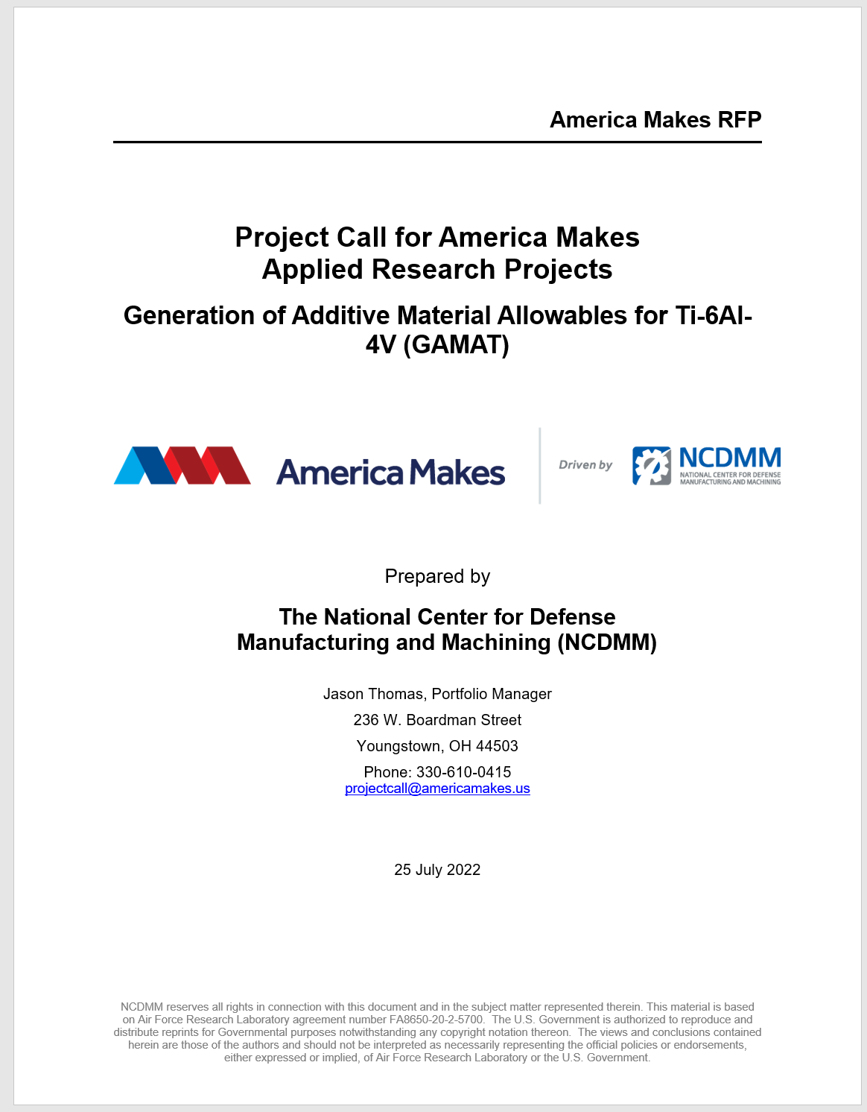
GAMAT Overview
Only proposal lead must be a member
1 step response – Full Proposal

Slide 14
Schedule
Event | Date
Project Call Announcement and Posting | 7/25/2022
Kickoff Webinar – Registration Required | 8/1/2022
Questions from Proposers about Scope or Approach Due | 8/4/2022
Responses to Proposers about Scope or Approach Due (All questions and responses will be shared with all proposers on www.americamakes.us) | 8/10/2022
Deadline for proposal lead to complete a fully executed America Makes Membership Agreement | 8/15/2022
Fully Executed NDA with NCDMM (only if proposal contains proprietary information) | 8/15/2022
Full Project Proposal Submission Due Date (Note: No Concept Paper Submission) | 8/29/2022
Anticipated Decision and Notification to Project Proposal Teams | 9/9/2022
Anticipated Date to have ALL Projects on Contract | 11/1/2022

Slide 15
Background and Objective
Qualification of Additive Manufacturing (AM) machines and materials is a major barrier for the broad adoption of AM
One of the most significant gaps to the approval of AM parts is a lack of widely accepted and available design data for engineers and designers to use
While there are some existing organizational or company specific proprietary AM design databases, there is currently a very limited amount of publicly available industry or government accepted standard design data for AM in the public domain
This data is needed across government and industry to support broader adoption of AM
Laser Powder Feed Directed Energy Deposition (L-DED) process-specific project which results in a set of publicly available, statistically substantiated, bulk material property data with a corresponding material and process specification

Slide 16
Requirements
Approaches in response to the GAMAT project call shall address the following minimum requirements:
  Establish and manage a Public Steering Committee comprising relevant subject matter experts from government, industry, and academia.
  Identify publicly available material and process specifications for L-DED Ti-6Al-4V, or ones that can be released to use for the project.
  Provide a summary of existing and past work on the material/process combination with an explanation of what and how that data will be leveraged for this project.
  Generate draft material and process specifications and physically validate material and process tolerances according to specification methods/requirements
  Develop a test matrix and execute a test plan
  Conduct a Government Technical Team review and obtain consensus of initial test matrix and test plan (including what material and process specifications will be followed and any deviations) prior to executing B-basis and/or A-basis test matrices.

Slide 17
Requirements
Methods and plans for generating and inspecting test coupons
    All coupons will be inspected through various methods that will be documented in the test plan.
    Consideration for the necessity of high-fidelity inspection, such as CT, on a subset of coupons throughout all phases shall be addressed and documented in a test matrix.
    Consideration for the necessity of high-resolution microscopy, such as SEM, on outliers and questionable data shall be addressed and documented in a test matrix.
An execution plan for testing, analyzing, and delivering B-Basis material allowables using virgin powder via a mature laser powder-based DED process.
    Minimum tests shall include: Tensile, Compression, Shear, Bearing, Fatigue, Modulus, Fatigue Crack Growth, Facture Toughness, Coefficient of Thermal Expansion, Thermal Diffusivity, Specific Heat, Density.
    Plan should include using and comparing multiple statistical methods.
Delivery and reporting of raw data curves (e.g. stress strain curves) and all test information and properties defined in the relevant testing specification including information listed as available upon request.
Define a powder reuse strategy for future work and execute a review by the Public Steering Committee and Government Technical Team.

Slide 18
Requirements
Conduct a review of B-basis allowable results to obtain consensus/acceptance by the Government Technical Team.
Conduct refinement of the test matrix and test plan before proceeding to A-basis allowable delivery once reviewed and approved by the Government Technical Team.
Generate and inspect coupons, and complete A-Basis equivalent allowables for Tensile, Compression, Shear, Bearing properties using and comparing multiple statistical methods.
Conduct and complete an investigation of powder reuse per definition.
Conduct a Government Technical Team review of A-basis allowable results and obtain acceptance by Government Technical Team.
Fractography analysis of a sub-set of LCF/HCF test bars (at least the ones subjected to prior high fidelity NDI and potential outliers) and correlation with NDI data, including preliminary assessment of the effect of material anomalies
Report Test Lab Certifications as part of initial approach and describe a plan to obtain the Government Technical Team’s consensus no later than 3 months after award

Slide 19
GAMAT – 1 award anticipated
Funding Description | Amount
Total Federal Funding Available | $3,000,000
Max. Federal Award Per Proposal | $3,000,000
Minimum Cost Share (percentage of federal award amount requested per proposal) | 25%
Maximum Allowed Period of Performance (PoP) – shorter periods are acceptable | 25 Months (22 months execution and 3 months reporting)

Slide 20
Eligibility
The lead Proposer is a current member of America Makes and in good standing by Monday, August 15, 2022. Information on how to join America Makes is available at www.americamakes.us/membership.
Cost share accrued in this project may also be applied towards membership, as with other project calls. However, cost-share proposed on a future project cannot be counted towards a new America Makes membership. To become a member by the deadline, organizations shall commit to a cash payment and / or complete an @Program MOU
A 25% cost share is required for each project submittal. Example: If $1.00 of funding is requested from America Makes, $0.25 in cost share must be committed against that $1.00 for a total scope of $1.25.
The lead Proposer is fully responsible for all project and subcontract performance.
The lead Proposer shall be registered in U.S. System for Award Management (SAM) and have a cage code and duns number before submitting a proposal.
Proposal team acknowledges that information from this project will be shared with America Makes members in accordance with the membership agreement.
Proposal team arrangements are identified, and relationships are fully disclosed.

Slide 21
Minimum Deliverables
Minimum Deliverable | Timeline
Technical Progress reports | Quarterly
Virtual teleconferences with the Public Steering Committee | Monthly
Virtual teleconference updates for Government Technical Team | Quarterly
Schema and Data Compliance Reviews, Data shall: Be provided electronically, demonstrate pedigree and provenance, identify test apparatus/manufacturing/fabrication equipment and calibration, testing standards or processing specifications used including sample preparation and/or manufacturing equipment configuration, experimental/characterization/manufacturing process conditions and procedures, raw mechanical test data, data reduction and statistical analysis procedures, uncertainty associated with data and method used to calculate uncertainty | Quarterly

Slide 22
Minimum Deliverables (Cont.)
Minimum Deliverable | Timeline
Financial and man-hour reports | Monthly
Program Review meeting | Annually
Data Persistence Plan (how will data be stored and accessed after project conclusion) | Initial at proposal Final at 1st program review
Data Management Plan Including at minimum: Any commercial software packages to be used, standards or data schemas to be used, and methodology for notating and labelling data to enable linking of various sample properties and characteristics, and plans for incremental delivery of data | Initial at time of proposal Final at 1 program review
Test Lab Certifications documented and obtain consensus of Government Technical Team | Initial at time of proposal Final 3 months after award

Slide 23
Minimum Deliverables (Cont.)
Minimum Deliverable | Timeline
Lead proposer shall participate in at least one - Design, Materials, AM Genome, or Value Chain working groups | Minimum of one (1) presentation outlining all deliverables (CDIP, associated tangible artifacts, and associated roadmap requirements), KPP’s, and data management plan - 6 months after award Minimum of one (1) presentation of milestone achievements, KPPs, and lessons learned relevant to the fulfillment or creation of roadmap requirements - 21 months after award. Attend weekly/bi-weekly meetings as scheduled - Hours attending and participating in meetings or activities shall be tracked and reported
Raw materials test data (feedstock, process, material, post-process, property) available in a static format and in a database with property meta-data; non-destructive inspection data and meta-data | Delivered or posted to database regularly as available
Virtual Milestone and Go/No-Go reviews | As necessary

Slide 24
Minimum Deliverables (Cont.)
Minimum Deliverable | Timeline
Kickoff Meeting | NLT 1 month after award
Establish a Public Steering Committee and a communication cadence with Government Technical Team | 3 months after award
Establish a Test Matrix and Test Plan | 3 months after award
Identify and cite Standards and material/process specifications to be leveraged by this program | 3 months after award
Define powder reuse strategy | 15 months after award

Slide 25
Minimum Deliverables (Cont.)
Minimum Deliverable | Timeline
Material Specification, including powder handling and characterization | 15 months after award
AM Process Specification, including all critical processing parameters (machine make/model, gas, laser power, speed, hatch spacing, etc.) | 15 months after award
Applicable post-process specifications | 15 months after award
Statistically based mechanical properties curves using one or more statistical methods consistent with a B-Basis (90/95) for Ti6Al4V material produce via a mature laser powder-based DeD process. | B-Basis or equivalent 15 months after award
Statistically based mechanical properties curves using one or more statistical methods consistent with a A-Basis (99/95) for Ti6Al4V material produce via a mature laser powder-based DeD process. | 22 months after award

Slide 26
Minimum Deliverables (Cont.)
Minimum Deliverable | Timeline
Final project report including at minimum: critical process parameters, lessons learned, standards used and any deviations from those standards Minimum of one round of revisions completed with PM/NCDMM prior to final submission Complete first draft shall be submitted to PM/NCDMM no later than 22 months after award | 25 months after award
Presentations by the project team at 4 national meetings such as TRX, MMX, RAPID, etc. regarding the interim and final deliverables to promote the outcomes of the work | No later than (NLT) 25 months after award

Slide 27
Reporting
Technical Progress Reports
Virtual teleconferences with Public Steering Committee
Schema and Data Compliance Reviews
Financial and man-hour reports
Presentation at annual DoD review or site visit.
Data persistence plan

Slide 28
Reporting
Material Specification including powder handling and characterization
AM Process Specification including all critical processing parameters (machine make/model, gas, laser power, speed, hatch spacing, etc.)
Applicable post-processing specifications
Statistical methods reported for achieving statistically based mechanical properties consistent with B-basis and/or A-basis Ti-6Al-4V material produced by a mature laser powder-based DED process
Reports, presentations, or teleconferences provided upon request by NCDMM or AFRL
Finalized, written report (minimum of one round of revisions completed with PM/NCDMM prior to final submission) including at minimum: critical process parameters, lesson learned, standards/specifications used, and any deviations from those standards/specifications
Presentations at 4 national meetings regarding interim and final deliverables to promote outcomes of the work

Slide 29
Proposal and Contracting Information
Executive Summaries must contain information which is publicly releasable, non-proprietary
  Purpose
    To aid in America Makes public release process for award announcement
    To demonstrate impact and merits of Institute’s efforts to the public
No fee allowed
Cover page should include DUNS and CAGE of at least team lead
Exhibit VI. Listing of all Test Lab Certifications and Pertinent Test Lab Qualification Details

Slide 30




When America Makes
America Works
AmericaMakes.us
@AmericaMakes
/AmericaMakes

