Slide 1
How to Organize a Research Paper using Notecards
Source: Bonita Springs Middle
Language Arts Department

Slide 2
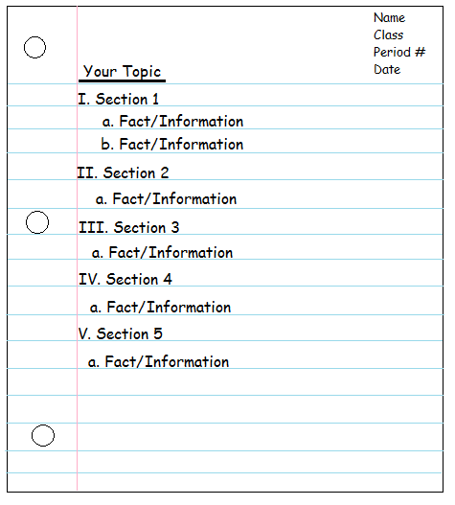
MLA Research Outline
First, you’ll need your MLA Research Outline.
It should look like this.

Slide 3
How do I organize my research?
Use notecards! (3x5 index cards)
Organize your notes to match the sections of your outline.
Color code your notes by section.
Use different colored notecards for each section!

Slide 4
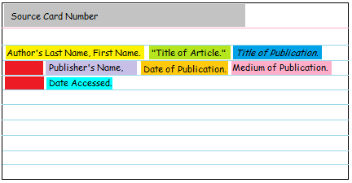
What are source cards?
First, you will need a source card. This is how you will keep track of where you got each piece of information.
*If any information is missing from your source, skip that portion of the citation and move onto the next available piece of information. See notes about “Publisher’s Name” and “Publication Date”.
*Your source card should be white.
Your source card should like something like this
Any line after the first line in your citation should be indented about a thumb space.
Refer to your Purdue OWL handout for information on how to format your citation.
If this information isn’t available, use the abbreviations “n.p.” or “n.d.”

Slide 5
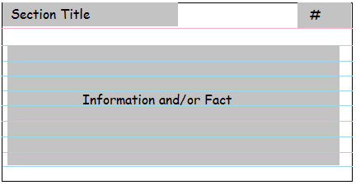
What should my notecards look like?
Your notecards should include the following information: Section Title, Source Number, and 1 Fact or Piece of Information from your source.
Use a different color index card for each section of your paper
This should match the source card number.
This should match the section title from your outline
Only 1 fact per card.

Slide 6
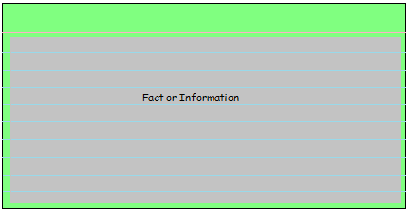
Notecard: Part 1
Finally, you are ready to write down a fact or piece of information on your Notecard.
Remember: DO NOT write down exactly what your source says. Paraphrase the information, or write it down in your own words. This will help you avoid plagiarism. If you MUST write down an exact quote, make sure you put quotation marks around it and note the speaker (“Quilting is my favorite hobby.” – Susan Jones of the Florida Quilting Committee).

Slide 7
How do I paraphrase?
When you paraphrase, you’re basically reading the information and then summarizing the key pieces.
http://www.brainpop.com/english/writing/paraphrasing/

Slide 8
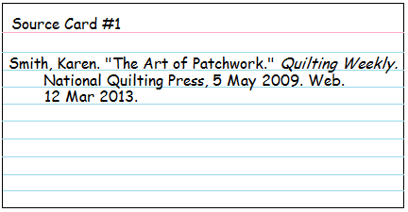


Notecard: Part 2
*Each Source Card should have a different number, but several Notecards may have the same Source Card number. This is because you might take many different pieces of information from the same source.
Make sure that you document the Source where you got each piece of information directly on your Notecard. You must do this AS SOON AS YOU FIND A FACT THAT YOU PLAN TO USE!

Slide 9

Notecard: Part 3
You should choose a different color for each section in your outline. Then, you should match the color of the index card to the color from your outline.
This will make writing your paper a lot easier!

Slide 10
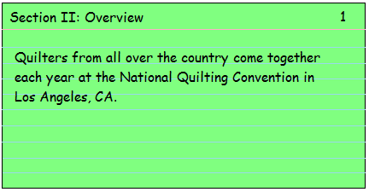
What should my finished notecard look like?
3
This is your second step. Make sure to record the number of the Source Card that has the citation information for the place where you got this information.
Finish here by deciding which section of your outline this fact best fits.
2
1
Start here by paraphrasing (or occasionally directly quoting) one fact or piece of information from your Source.

Slide 11
Works Cited
Landsberger, Joe. “Organizing Research: Creating Notecards.” Study Guides and Strategies. N.p., n.d. Web. 23 Apr. 2013.
“Paraphrasing.” BrainPOP, n.d. Web. 23 Apr. 2013.
The Purdue OWL Family of Sites. The Writing Lab and OWL at Purdue and Purdue U, 2008. Web. 23 Apr. 2008.

