Slide 1
Welcome to Medical Terminology
Unit 1
Objectives:
  Identify and define the four word parts.
  Differentiate an acronym, eponym and an abbreviation
  Analyze and define medical terms.
  Build medical terms for given definitions.

Slide 2

Dr. Smith enters the nurse’s station and tells you that Mrs. Jones needs to have an exploratory laparotomy, but suspects he will end up doing a bilateral salpingoophorectomy. Before she goes to surgery, he orders a CXR, EKG, CBC, and ABG done stat.
Mrs. Smith needs what? When? Huh?

Slide 3
Origins of Medical Language
Medicine has a language of its own.
75% of all medical terms are derived from Latin or Greek
Used to convey the greatest amount of information with the least confusion and the most precision.
A Single medical term can describe a disease, condition or procedure that might otherwise take several words.
Example: appendectomy – surgical removal of the appendix
      pericarditis – inflammation of the sac containing the heart

Slide 4
Abbreviations
Shortened forms of words
Used in many health fields
Each medical facility has an approved abbreviation list
It is the responsibility of healthcare workers to learn the meanings of the abbreviations used in the facility in which they work. ***When in doubt, spell it out!!
Example:
noc (t) – night
po – by mouth

Slide 5
Eponyms
Words named after people
Examples:
Parkinson’s disease - is named after James Parkinson, English physician who first described the disease in 1817 as shaking palsy.
Lou Gehrig’s Disease – is named after the famous New York Yankee who suffered from the disease.
Down Syndrome – is named after John Langdon Down, the British physician who described the syndrome in 1866.

Slide 6
Acronym
Short word formed from the 1st letters of the longer phrase
Example:
SARS (Sever Acute Respiratory Syndrome)
LASER (Light Amplification by Stimulated Emission of Radiation)
MASH (Mobile Army Surgical Hospital)
Can you think of any?

Slide 7
Initialism
Formed by the initial letters of a series of words but is pronounced by its letters, not as a word itself
Example:
ICU (Intensive Care Unit)
ESRD (End Stage Renal Disease)
ER (Emergency Room)
Can you think of any?

Slide 8
With the advancement of medical and scientific knowledge, medical language changes. Some words are discarded, the meanings of others are altered, and new words are added.
These terms can be learned by two ways:
  1. Memorizing medical terms. (Monotonous ☹)
  2. Learning word parts and how they fit together to form medical terms. (Easier ☺)
  *Don’t Worry!!! It is impossible to learn all medical terms but knowing the parts will help you figure them out!

Slide 9

The Four Word Parts
Word Parts are the KEY!!!
Most medical terms are built with some or all of the following word parts:
  1. WORD ROOTS
  2. SUFFIXES
  3. PREFIXES
  4. COMBINING FORMS

Slide 10
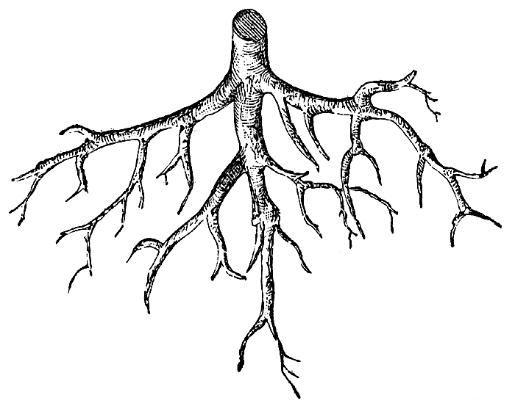
Word Root the core of the word
The word root contains the fundamental meaning of the word.
Usually, but not always, indicates the involved body part.
Since the word root is the core of the word, each medical term contains one or more word roots.
Example:
Gastr - stomach

Slide 11
More Examples of Word Roots
Play/er; In this word, play is the word root.
Arthr/itis; In this medical term, arthr (which means joint) is the word root.
Hepat/itis; In this medical term, hepat (which means liver) is the word root.

Slide 12
Suffix
The suffix appears at the end of the word root to modify its meaning.
Most medical terms have a suffix.
The suffix frequently indicates a procedure, condition, or disease such as:
–scopy, meaning visual examination (procedure)
–tomy, meaning surgical incision (procedure)
-itis, meaning inflammation (condition)
-oma, meaning tumor (disease)

Slide 13
Suffix Examples
Play/er in this word, -er is the suffix.
Hepat/ic in this medical term, -ic (which means pertaining to) is the suffix.
  Hepat is the word root for liver; therefore hepatic means pertaining to the liver.
Hepat/itis in this medical term, -itis (which means inflammation) is the suffix.
The term hepatitis means inflammation of the liver.

Slide 14
Prefix
The prefix appears at the beginning of a word root and modifies its meaning.
Serves to further define a root word
Prefixes can indicate;
  A number such as bi-, meaning two.
  A position, such as sub-, meaning under.
  A direction, such as intra-, meaning within.
  Time, such as brady-, meaning slow
  Negation, such as a-, meaning without

Slide 15
Prefix Examples
Re/play - In this word, re- is the prefix.
Sub/hepat/ic - In this medical term, sub- (which means under) is the prefix.
What does the term Subhepatic mean?
Subhepatic means pertaining to under the liver.
Intra/ven/ous - In this word, intra- (which means within) is the prefix.
Identify the word root in the medical term Intravenous.
The word root is ven, which means vein.

Slide 16
What is the suffix in the word intravenous?
The suffix is –ous, which means pertaining to.
So what does the word intravenous mean?
Intravenous means pertaining to within the vein.

Slide 17
Combining Vowel
Usually an “o.”
Join the root with a suffix or another root.
Used to ease pronunciation so not all terms will have them.
Rules for use:
1. used when the suffix begins with a consonant.
neur/o + –plasty = neuroplasty
2. NOT used when the suffix begins with a vowel.
neur/o + -itis = neuritis
3. used when 2 or more root words are joined.
gastr/o + enter/o + -itis = gastroenteritis

Slide 18
Examples of Combining Vowels
In the word men/o/pause
  O is the combining vowel used between two word roots
In the medical term arthr/o/pathy
  O is the combining vowel used between the word root arthr and the suffix –pathy (which means disease). Why?
In the medical term sub/hepat/ic
  The combining vowel is not used between the prefix sub- and the word root hepat. Why not?

Slide 19
Combining Form
A combining form is a word root with the combining vowel attached, separated by a vertical slash.
Examples
  arthr/o
  oste/o
  ven/o
The combining form is not a word part per se; rather it is the word root and the combining vowel.

Slide 20
Summary
Word root- core of a word; for example, hepat
Suffix- attached at the end of a word root to modify its meaning; for example, -ic.
Prefix- attached at the beginning of a word to modify its meaning; for example, Sub-
Combining Vowel- usually an o used between two word roots or a word root and a suffix to ease pronunciation; for example hepat o pathy
Combining form- word root plus combining vowel separated by a vertical slash; for example, hepat/o.

Slide 21
Things to Consider…
Spelling is extremely important!
    Many word sound the same but have very different meanings
        Example:
        ileum – is part of the small intestine
        ilium – is part of the pelvic (hip) bone
Pronunciation- is also important.
    Words spelled correctly but pronounced incorrectly may be
    misunderstood
        Example:
        prostate – a male gland that lies under the urinary
        bladder and surrounds the urethra
        prostrate – to collapse and to be lying flat or to be
        overcome with exhaustion

Slide 22
Pronunciation
Accent marks
A single accent mark (') is called a primary accent and is used with the syllable that has the strongest stress.
A double accent mark (") is called a secondary accent and is given to syllables that are stressed less than primary syllables.

Slide 23
Pronunciation
Diacritics are marks placed over or under vowels to indicate the long or short sound of the vowel.
  Macron ( ¯ )
    The long sound of the vowel.
  Breve ( ˘ )
    The short sound of the vowel.
  Schwa ( ə )
    Indicates the central vowel sound of most unstressed syllables.

Slide 24
HAPPY MEDICAL TERM BUILDING
THE END
☺

Slide 25
Answer the following questions and turn them in
Give me an example of an eponym
What is the plural of vertebra?
If a patient has hypotension, what can you tell me about their blood pressure? (hint: tension refers to the blood pressure)
Divide the following terms into their smaller word parts using the combining form for root words when necessary:
prenatal
hepatomegaly
osteoarthralgia
Which term is spelled correctly and why?
      Pyderma or Pyoderma

Slide 26
Answer the following questions and turn them in
Explain the difference between mucous and mucus.
Explain the difference between a sign and a symptom
Explain the difference between infection and inflammation
What are the signs/symptoms of infection?
What are the signs/symptoms of inflammation?
Great aunt Martha fell down the stairs and broke hurt wrist. She is experiencing erythema, edema, pain and the wrist is warm to the touch. What is Great Aunt Martha experiencing?
Divide the following terms into their respective word parts and define the term.
    Pyelitis
    Pyrosis
    Atheroma

Slide 27
The Medical Record
May be written on paper or digital
Describes information about the pt. and his/her health care
Contains the dates, observations, medical or surgical interventions, and treatment outcomes provided during a hospitalization or visit to a health care facility
Used to ensure that the pt. receives quality care
The actual record belongs to the health care provider, but the information in it belongs to the pt.

Slide 28
The Medical Record
Serves as:
  Basis for planning care and Tx
  Means for doctors, nurses, and others caring for the pt. to communicate
  Legal documentation describing the care the pt. received and can be used as evidence in court
  Means by which the pt. insurance company can verify the services billed were actually provided

Slide 29
The Medical Record
May include:
  Private and confidential information about family relationships, sexual behavior, substance abuse, and even personal thoughts and feelings
  This is very personal information and is protected by Health Insurance Portability and Accountability Act (HIPAA) in 1996 (more about this Monday!)

Slide 30
The Medical Record
The Electronic Health Record (EHR) usually contains the following general components:
  Patient Data
  Medical History (Hx)
  Physical Examination (PE)
  Consent Form
  Informed Consent
  Physician’s Orders
  Nurse’s Notes
  Physician’s Progress Notes
  See pgs. 19-20
  Consultation Reports
  Ancillary/Misc. Reports
  Diagnostic Tests/Laboratory Reports
  Operative Report
  Anesthesiology Report
  Pathology Report
  Discharge Summary

Slide 31
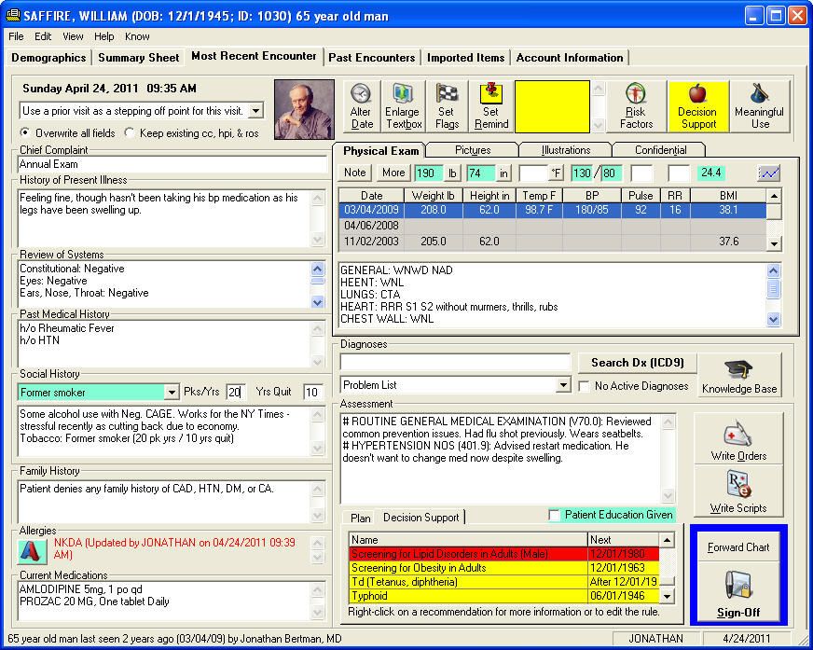
The Medical Record

Slide 32
The Medical Record
https://www.youtube.com/watch?v=Z84fL4HzBmw
https://www.youtube.com/watch?v=hcrS13OWQ1U

Slide 33
SOAP: Chart Note
Subjective – includes symptoms that the subject feels and describes to the health care professional. Not perceptible to the observer. Ex. Dizziness, pain, tightness
Objective – signs that can be seen, felt, smelled, heard, or measured by the health care provider. Ex. VS such as TPR and BP, physical exam findings such as lung sounds
Assessment – Interpretation of the subjective and objective findings and generally includes a diagnosis.
Planning- includes management and Tx regimen for the pt.

