Slide 1

Dialectical Journal
The dialectical journal is a type of double-entry note-taking which you use while reading literature. In two columns, write notes that dialogue with one another, thereby developing critical reading and reflective questioning. We practiced this with The Scarlet Letter.

Slide 2
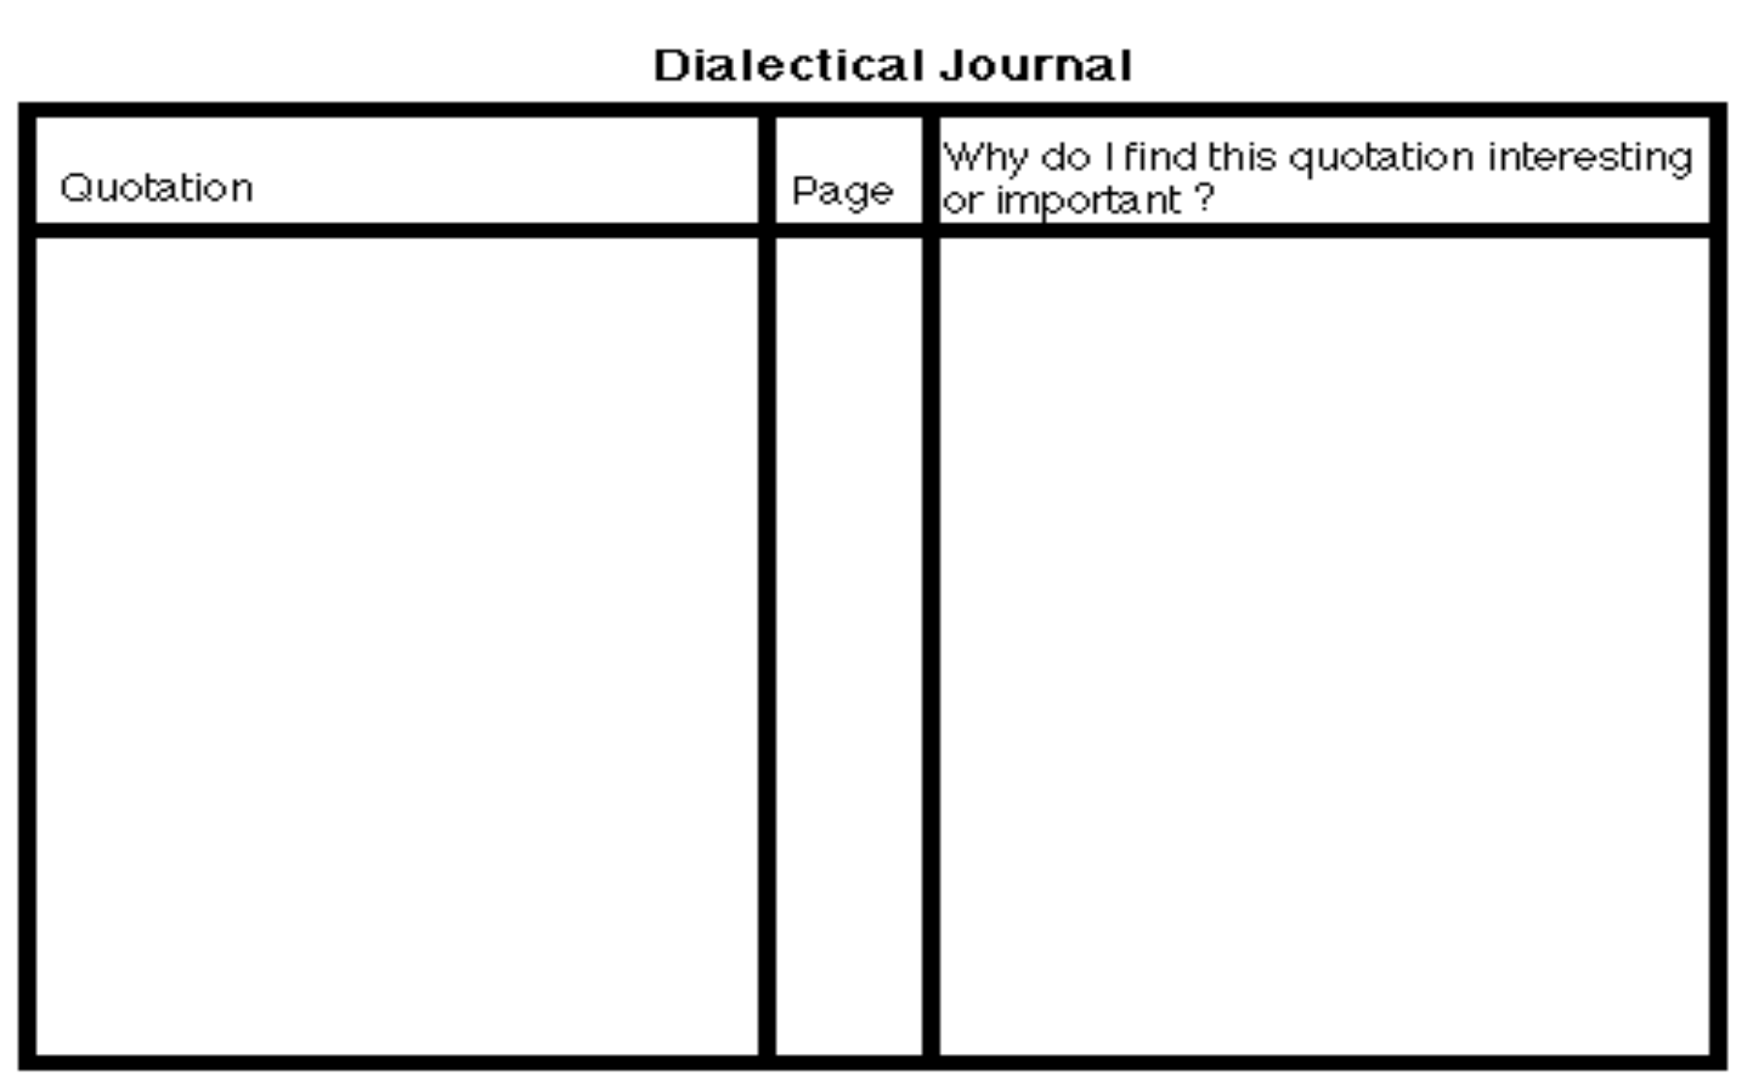
Use this model to set up your dialectical journal for Huckleberry Finn

Slide 3
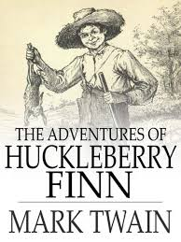
In Huckleberry Finn you will identify one quotation from almost each chapter, which you feel is important or noteworthy.
You will have 30 quotes with 30 journal entries discussing each quote.

Slide 4
This will be done on your own paper.
Number and write the exact quote in the left hand column of your dialectical journal.
Put the page number where the quote may be found in the center column.
In the right hand column, discuss why you chose the quote and what makes it important to the text.

Slide 5
You should have one quotation for every chapter you read until Ch.31.
You will identify some quotations that are important because they reflect:
Irony
Internal conflict External Conflict Sensory language
Etc. (Lit terms)

Slide 6
What do I write for responses to the text?
Raise questions about the beliefs and values implied in the text
Give your personal reactions to the passage
Connect to your own experiences
Reflect on how it makes you feel as compared to the intended tone of the author
Argue with or speak to the characters or the author

Slide 7
What do I write for responses to the text?
Make predictions
Cite literary terms, including figurative language and its effectiveness
Reflect on passages that surprise you or interest you

Slide 8
EXAMPLE
“The house on Mango Street is ours, and we don’t have to pay rent to anybody, or share the yard with the people downstairs, or be careful not to make too much noise, and there isn’t a landlord banging on the ceiling with a broom.” (Cisneros3) “Quote” “Quote” | She is listing experiences people who rent homes and apartments might have experienced as well. This might pull those readers closer to her through common experience. It also serves to pull the reader who has never rented into her narrative. She lists multiple inconveniences and negative aspects of this lifestyle (paying rent, sharing yard, having to be quiet) and this begins to create an image. While Esperanza’s family no longer has to deal with these problems their neighbors on Mango Street do. It provides a window into a lifestyle. “Response” “Response”

Slide 9
EXAMPLE
“But my mother’s hair, my mother’s hair, like little rosettes, like little candy circles all curly and pretty because she pinned it in pincurls all day, sweet to put your nose into when she is holding you, holding you and you feel safe, is the warm smell of bread before you bake it, is the smell when she makes room for you on her side of the bed.” (Cisneros 6) | This long list of similes and metaphors describing her mother’s hair must be important. She describes her father’s hair in one sentence – as well as the hair of the other family members. The repetition of “holding you” is a clue as well. She obviously has a strong connection to her mother and it must be the most important relationship in her life – at least in her family. Other evidence of this closeness is the association of a smell – the smell of bread – with her mother. Olfactory memories are some of the strongest. It reminds me of smell associations I have. Like Coppertone sunscreen and the trip my husband and I took to Pie de la Cuesta just before we moved away from Mexico. Every time I smell it I am transported back to that carefree time – and for this reason I keep buying it. Warm bread connotes comfort and care. It takes time an patience to bake bread – just like being a mom.

Slide 10
Huck Finn Dialectical Journal (30 pts) | Level 4 (Five Points) | Level 3 (Four points) | Level 2 (Three points) | Level 1 (Two points)
Quotations and Plot Details | Detailed, meaningful | Less detailed but still good | Few good details | Hardly any good details
Interpretation | Thoughtful, avoids cliches | Intelligent, discusses theme | vague, unsupported, plot summary | plot summaries and paraphrases
Literary Elements | Discusses diction, imagery, syntax, etc and how these contribute to meaning | Includes them but doesn't explain how they contribute to meaning | Lists literary elements but little discussion of meaning | Few literary elements, almost no discussion of meaning
Questions and Connections | Insightful personal connections, thought- provoking questions | Some personal connections, questions arise from text | Few connections, obvious questions | Few connections, no questions
Coverage of text | Covers text thoroughly | Covers important parts thoroughly | Covers most parts, but quickly | Way too short
Presentation | Neat, organized, looks professional, follows directions | Neat and readable, follows directions | Neat but hard to read, doesn't follow directions | Hard to read, doesn't follow directions

Slide 11

THIS MAJOR ASSESSMENT IS
DUE December 7 and 8! !

