Slide 1

The CrissCross Method &Polyatomic ions

Slide 2
Bonding Review
Always Trying to Fulfill the OCTET RULE!
Ionic - electron transfer
  Forms between a metal and a nonmetal
  The metal gives up the electrons and the nonmetal takes them
Covalent - electron sharing
  Forms most often between two nonmetals
  Electron shared pairs are formed to allow both elements to fulfill the octet rule.

Slide 3
CrissCross Method
Determine the charges/oxidation #’s for each element.
By criss crossing the charges of the elements you can easily write the chemical formula
Example: Hydrogen + Oxygen
  H + O → IONS = H⁺¹ + O^{–2}
  Criss cross the oxidation #
    just the numbers - not the + / - signs
  Write the numbers as subscripts
    bottom right of symbol

Slide 4





CrissCross Method
→This becomes
H⁺¹ O⁻²
CrissCross the numbers
H₂O₁
Final: H₂O
Where is the 1 in the final formula?

Slide 5
CrissCross Method
You Try
Mg + O
Ca + P
K + S
C + H
As + S
C + O

Slide 6
CrissCross Method
You Try
Mg + O
Ca + P
K + S
C + H
As + S
C + O
→ Mg₂O₂
→ MgO
→ Ca₃P₂
Just like with Fractions in math the Numbers will reduce!
→ K₂S
→ CH₄
→ As₂S₃
→ C₂O₄
→ CO₂

Slide 7
Polyatomic Ions
Polyatomic Ion - A covalently bonded group of atoms that acts as a unit and has its own charge.
  Most simple polyatomic ions are anions.
MUST keep the atoms together!!!
CANNOT change anything about a polyatomic ion
  Not the type of atoms
  Not the number of atoms
  Not the electric charge
How are you going to remember this????
  Anytime you see a Polyatomic Ion
    PUT IT IN PARENTHESIS!!!

Slide 8
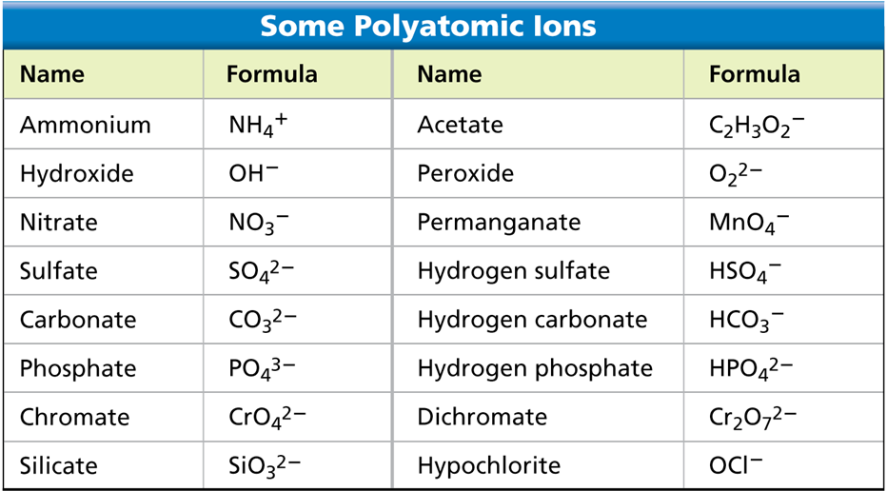
Polyatomic Ions

Slide 9
Polyatomic Ions & Bonding
Bonding works the same way as it did for binary compounds.
Treat the polyatomic ion as a single entity (a single element)
The crisscross method is the most useful, efficient, and effective way for bonding with polyatomic ions.

Slide 10



Criss Cross & Polyatomic Ions
Sodium + Sulfate
  Na + SO₄
  Na⁺¹ + (SO₄)⁻²
Do the Criss Cross
Na₂(SO₄)₁
Final: Na₂(SO₄)

Slide 11
You Try
Magnesium + Sulfate
  Mg + SO₄

Slide 12
You Try
Magnesium + Sulfate
  Mg + SO₄
  Mg⁺² + (SO₄)⁻²

Slide 13
You Try
Magnesium + Sulfate
  Mg + SO₄
  Mg⁺² + (SO₄)⁻²
  Criss Cross
    Mg₂(SO₄)₂
Final: Mg(SO₄)
Remember the ratio can be reduced! (the 2’s reduce to 1:1)

Slide 14
You Try
Beryllium + Phosphate
  Be + PO₄

Slide 15
You Try
Beryllium + Phosphate
  Be + PO₄
  Be⁺² + (PO₄)⁻³

Slide 16
You Try
Beryllium + Phosphate
  Be + PO₄
  Be⁺² + (PO₄)⁻³
  Criss Cross
    Be₃(PO₄)₂
Note that the crisscross puts the subscript 2 OUTSIDE of the parenthesis, showing that there are TWO phosphate ions
How many ATOMs of each element are in this molecular formula?
Be = 3
P = 1 x 2 = 2
O = 4 x 2 = 8

Slide 17
Bell Ringer
Bond & then Name:
  Mg + P
  Cs + Se
  C + S
  Li + F
Bond:
  Ammonium and Acetate
  Potassium and Permanganate
  Barium and Nitrite

Slide 18
Naming with Polyatomic Ions
Compounds containing polyatomic Ions always have IONIC bonds.
Naming these compounds is much like naming binary ionic compounds
  List the cation (positive charge) first
  Then the anion (negative charge)
    Typically the polyatomic ion
  Use the normal name for the cation and the given name for the polyatomic ion
    Na(OH) or NaOH = Sodium Hydroxide

Slide 19
Formulas & Names
Use a compound’s formula to determine its name
  Na₂O → Sodium Oxide
  K₂(CO₃) → Potassium Carbonate
Use a compound’s name to determine its formula
  Lithium Bromide → LiBr
  Aluminum Phosphate → Al(PO₄) or AlPO₄
You must be able to go back and forth!

Slide 20
You Try
Write the formula for
  Calcium Chloride
  Calcium Oxide
  Magnesium Sulfate
Give the name for the following compounds
  KBr
  BeS
  Cs(MnO₄)

Slide 21
You Try
Write the formula for
  Calcium Chloride → CaCl₂
  Calcium Oxide →
  Magnesium Sulfate →
Give the name for the following compounds
  KBr →
  BeS →
  Cs(MnO₄) →

Slide 22
You Try
Write the formula for
  Calcium Chloride → CaCl₂
  Calcium Oxide → CaO
  Magnesium Sulfate →
Give the name for the following compounds
  KBr →
  BeS →
  Cs(MnO₄) →

Slide 23
You Try
Write the formula for
  Calcium Chloride → CaCl₂
  Calcium Oxide → CaO
  Magnesium Sulfate → MgSO₄
Give the name for the following compounds
  KBr →
  BeS →
  Cs(MnO₄) →

Slide 24
You Try
Write the formula for
  Calcium Chloride → CaCl₂
  Calcium Oxide → CaO
  Magnesium Sulfate → MgSO₄
Give the name for the following compounds
  KBr → Potassium Bromide
  BeS →
  Cs(MnO₄) →

Slide 25
You Try
Write the formula for
  Calcium Chloride → CaCl₂
  Calcium Oxide → CaO
  Magnesium Sulfate → MgSO₄
Give the name for the following compounds
  KBr → Potassium Bromide
  BeS → Beryllium Sulfide
  Cs(MnO₄) →

Slide 26
You Try
Write the formula for
  Calcium Chloride → CaCl₂
  Calcium Oxide → CaO
  Magnesium Sulfate → MgSO₄
Give the name for the following compounds
  KBr → Potassium Bromide
  BeS → Beryllium Sulfide
  Cs(MnO₄) → Cesium Permanganate

Slide 27
Polyatomic Names
-ate endings are the base polyatomics
-ite ending = 1 less Oxygen than –ate
“Per-” prefix on –ate ending = 1 more Oxygen
“Hypo-” prefix on –ite ending = 1 less Oxygen

Slide 28
Order of Oxygens
Per _____ ate (Most)
-ate
-ite
Hypo ______ ite (Least)

