Slide 1
Today in Pre-Calculus
Do not need a calculator
Review Chapter 1
Go over quiz
Make ups due before: Friday, May 27

Slide 2
Domain
Look for square roots and denominators
Square roots set radicand ≥0 (numerator) or >0 (denominator). Solve for x. If x² or higher, test.
Denominators, if not under radical, set ≠ 0, and solve. These solutions must be excluded from domain.
( or ) point not included
[ or ] point included

Slide 3
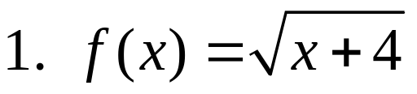
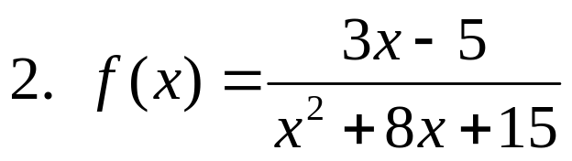
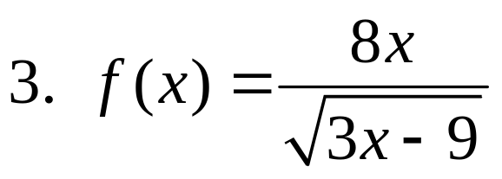
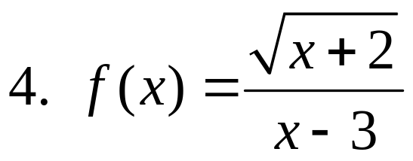
Domain - examples

Slide 4
Increasing/Decreasing
Read from left to right, is graph going up (increasing), down (decreasing) or constant.
Think in terms of slope (for curves tangent lines to the curves).
State intervals using x values.

Slide 5
Extrema
Local (relative) Minima and Maxima
Absolute Minima and Maxima
State as “local minimum of y-value at x =___”
Note: the x values should match all of the intervals in increasing/decreasing.

Slide 6
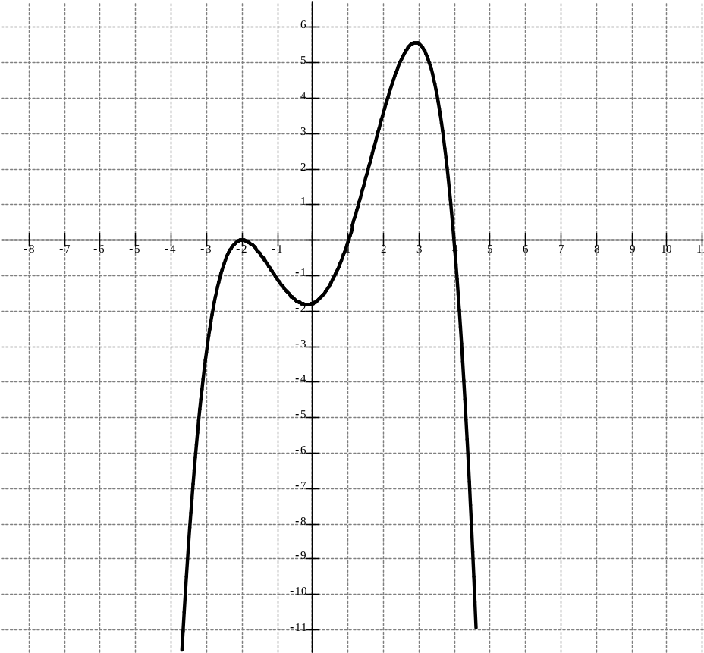
Example
Using the graph: state on what intervals the function is increasing, decreasing , and/or constant. State the boundedness of the function. State any local or absolute extrema

Slide 7
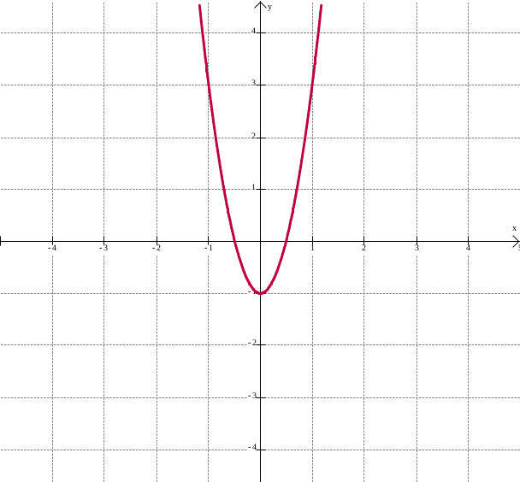
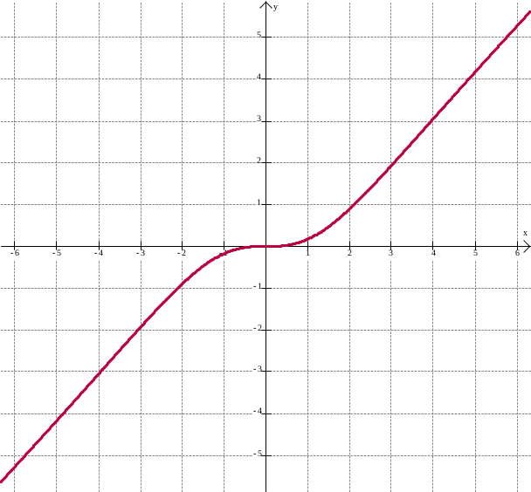
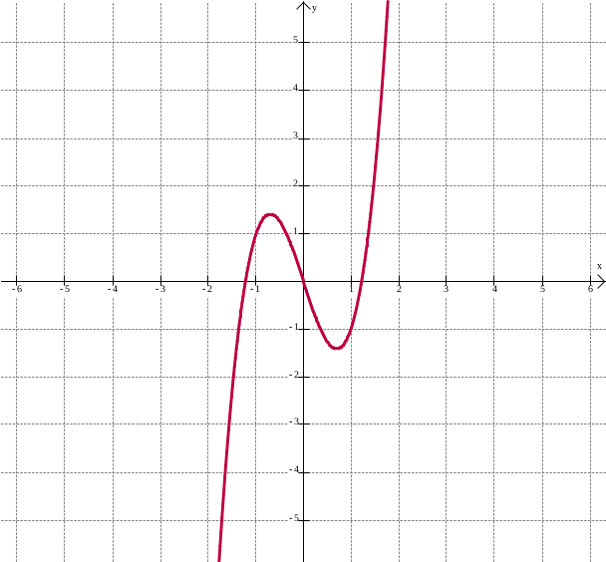
Symmetry
Graph can be symmetry to x-axis, y-axis (even functions) or origin (odd functions).
For origin symmetry parts in quadrant 1 have mirrors in quadrant 3, quadrant 2 mirrors are in quadrant 4.

Slide 8
Continuity
Is graph continuous? (Can you draw the entire graph without picking up your pencil?
Discontinuity:
  Removable (just a hole)
  Jump
  Infinite (do pieces on either side of graph at the point of discontinuity go to infinity –positive or negative)

Slide 9
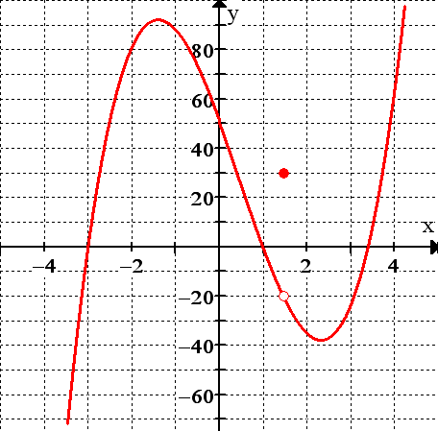
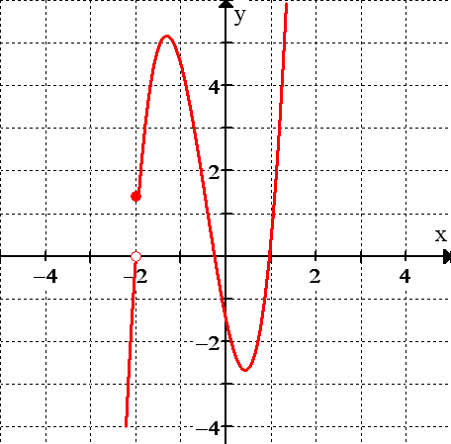
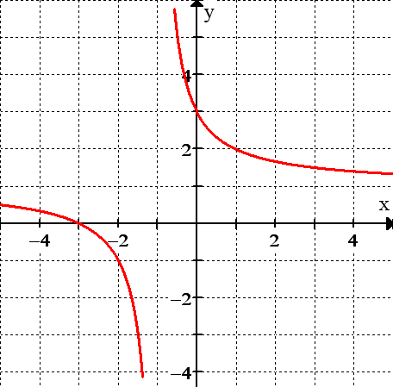
Continuity

Slide 10
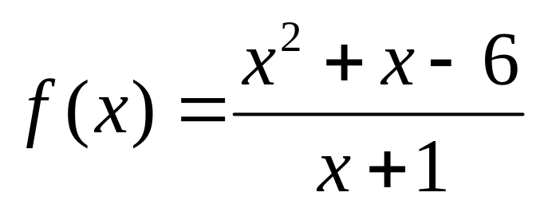
Asymptotes
Vertical asymptotes – occur where function DNE – check domain of function (term does not divide out)
Horizontal asymptotes – from end behavior
Slant asymptotes – degree in numerator must be one more than degree in denominator, use polynomial long division

Slide 11
Intercepts
x – intercept: set numerator = 0 and solve for x
y – intercept: substitute 0 for x and simplify

Slide 12
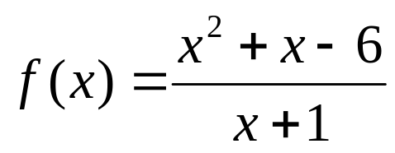
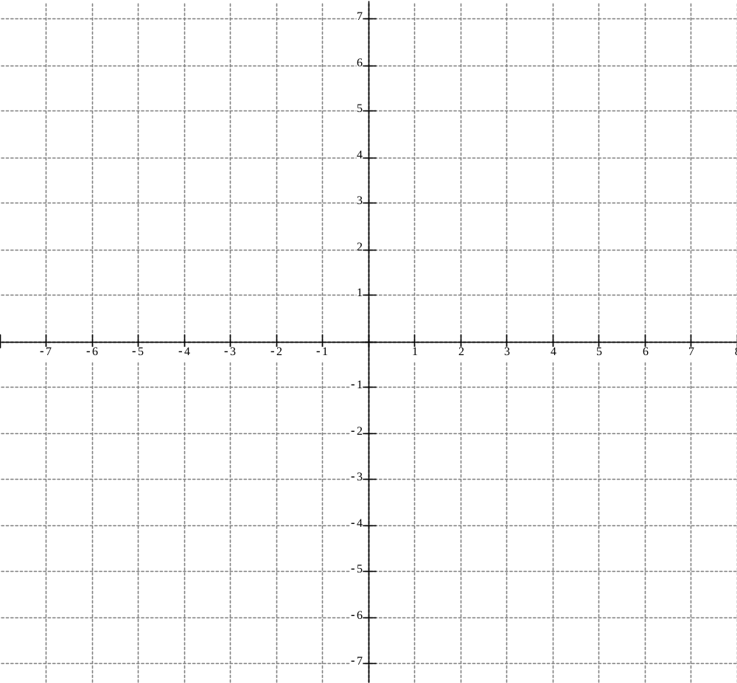
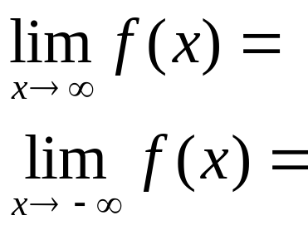
Sketching Graph

Slide 13
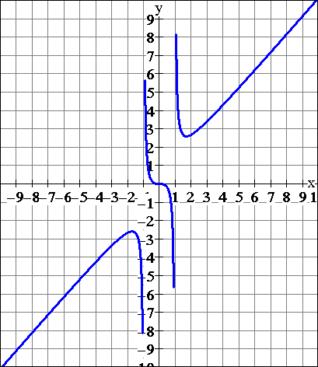
Inverse and One-to-One Functions
Reversing the x- and y-coordinates of all the ordered pairs in a relation gives the inverse.
The inverse of a relation is a function if it passes the horizontal line test.
A graph that passes both the horizontal and vertical line tests is a one-to-one function. This is because every x is paired with a unique y and every y is paired with a unique x.

Slide 14
Composition of Functions
Functions that are combined but not by using arithmetic operations
Combined by applying them in order (be careful!)
Let f and g be two functions such that the domain of f intersects the range of g. The composition f of g, (f◦g)(x)=f(g(x)).

Slide 15
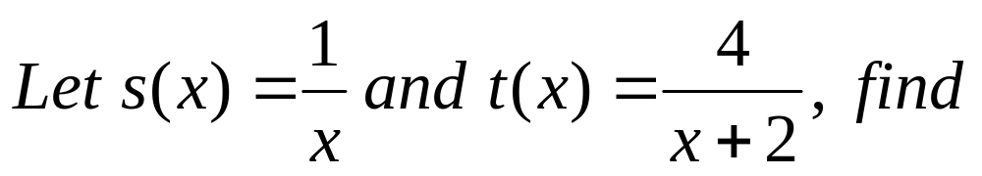
Example
(s◦t)(x) = b) t(s(2)) =
c) s(t(3) = d) s(s(5)) =
e) t(t(x) =

Slide 16
Decomposition of Functions
Allows us to think of a complex function in terms of two or more simpler functions.
In the composition f(g(x)), view f as the outside function and g as in the inside function.
It is often useful to represent a function h(x) as the composition of f(x) and g(x).

Slide 17
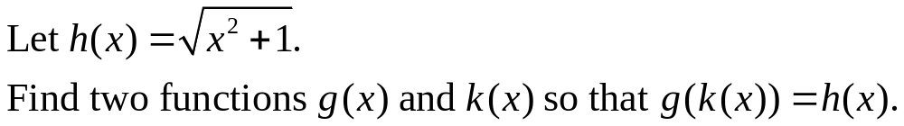
Example

Slide 18
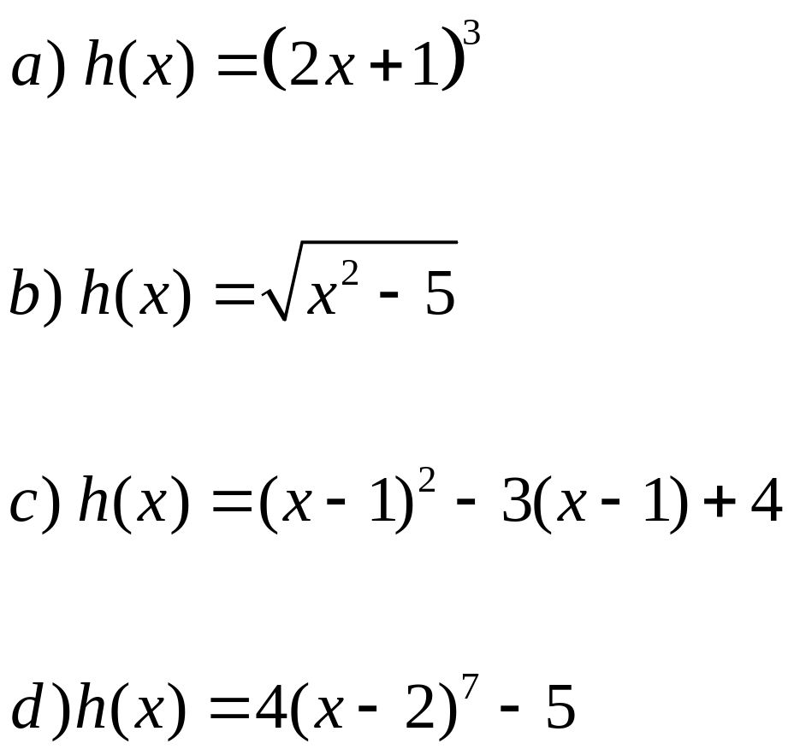
Examples
Find two function f(x) and g(x) so that h(x)=f(g(x))

