Slide 1
Algebraic expressions
Presented by mr. laws
Math I/JCMS

Slide 2
STANDARD
A,SSE.1 – interpret expressions that represent a quantity in terms of its content.
A.SSE.1a – interpret parts of an expression, such as terms, factors, and coefficients.
A.SSE.2 – Use the structure of an expression to identify ways to rewrite it.

Slide 3
Key vocabulary
Algebraic Expression
Constant
Coefficient
Equivalent
Distributive Property
Variable
Term

Slide 4
Essential Question
How can you interpret algebraic expressions that represent a quantity in terms of its content?

Slide 5

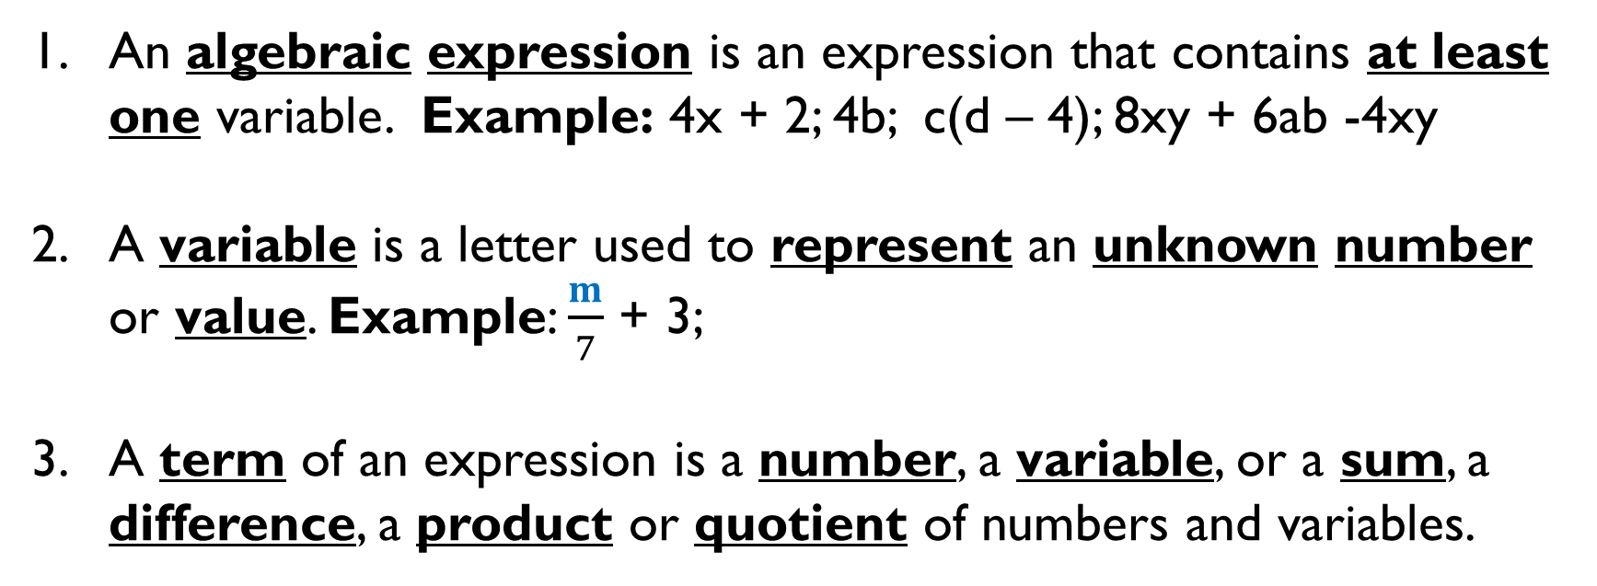
What is an algebraic expression?
An algebraic expression is an expression that contains at least one variable. Example: 4x + 2; 4b; c(d – 4); 8xy + 6ab -4xy
A variable is a letter used to represent an unknown number or value. Example: $\frac{m}{7}$ + 3;
A term of an expression is a number, a variable, or a sum, a difference, a product or quotient of numbers and variables.
$$b ∙c$$

Slide 6
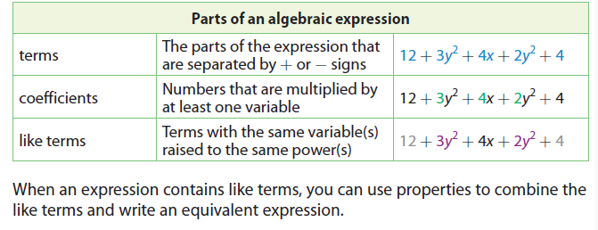
What are Parts of an Algebraic Expression?

Slide 7



Simplifying algebraic expressions
Example # 1: 7p – 2p ;
$${9k}^{2}+ k^{2}$$
a.
7p – 2p
Step 1 – Look for like terms with the expression.
5p
Step 2 – Combine Like Terms (CLT) Note: When CLT make sure you include the operation to the left of the number. Ie. -2p
b.
$${9k}^{2}+ k^{2}$$
Step 1 – Look for like terms with the expression.
$${10k}^{2}$$
Step 2 – Combine Like Terms (CLT) Note: When CLT make sure you include the operation to the left of the number.

Slide 8
Simplifying algebraic expressions
Example # 2: 8x – 4 – 2x
8x – 4 – 2x
Step 1 – Look for like terms with the expression.
8x – 2x – 4
Step 2 – Combine Like Terms (CLT) Note: When CLT make sure you include the operation to the left of the number. Ie. -2x, -4
6x – 4
Step 3 – Rewrite the algebraic expression.

Slide 9




Simplifying algebraic expressions
Example # 3:
$$n^{2}+5n+1−{6n}^{2}+3$$
Step 1 – Look for like terms with the expression.
$$n^{2}+5n+1−{6n}^{2}+3$$
Step 2 – Combine Like Terms (CLT) Note: When CLT make sure you include the operation to the left of the number.
$$n^{2}−{6n}^{2}+5n+1+3$$
$$−{5n}^{2}+5n+4$$
Step 3 – Rewrite the algebraic expression.

Slide 10
What is distributive property?
Distributive Property requires you to combine addition and multiplication You will multiply the number on the outside of the parenthesis with terms on the inside of the parenthesis. It is written in the form of:
a(b + c) = ab + ac and (b + c)a = ba + ca
or
a(b – c) = ab – ac and (b – c)a = ba – ca
Example: 5(a + 2) = 5a + 10; (3 + x)2 = 6 + 2x ; 6(a – b) = 6a – 6b

Slide 11
Simplifying algebraic expressions
Example # 4: 5(9x + 3)
Step 1 – Use the Distributive Property to simplify the expression.
5(9x + 3)
Step 2 – Rewrite the equivalent algebraic expression.
5(9x + 3)
45x + 15

Slide 12
Simplifying algebraic expressions
Example # 5: -6(2a – 4)
Step 1 – Use the Distributive Property to simplify the expression.
-6(2a – 4)
Step 2 – Rewrite the equivalent algebraic expression.
-6(2a – 4)
-12a + 24

Slide 13
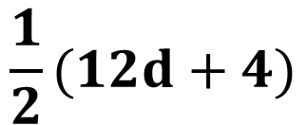


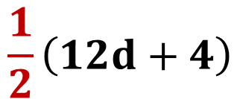
Simplifying algebraic expressions
$$\frac{1}{2}(12d+4)$$
Example # 6:
$$\frac{1}{2}(12d+4)$$
Step 1 – Use the Distributive Property to simplify the expression.
Step 2 – Rewrite the equivalent algebraic expression.
$$\frac{1}{2}\left(12d+4\right)$$
$$6d+2$$

Slide 14
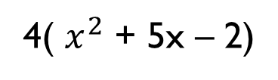
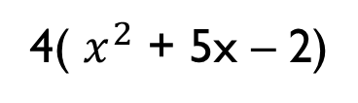
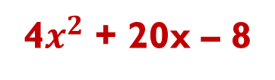
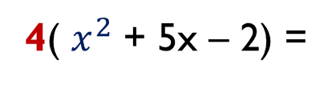
Simplifying algebraic expressions
Example # 7:
4( $x^{2}$ + 5x – 2)
Step 1 – Use the Distributive Property to simplify the expression.
4( $x^{2}$ + 5x – 2)
Step 2 – Rewrite the equivalent algebraic expression.
4( $x^{2}$ + 5x – 2) =
4$x^{2}$ + 20x – 8

Slide 15
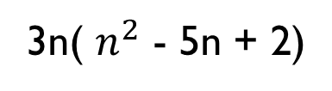
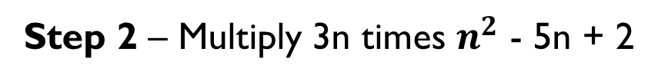
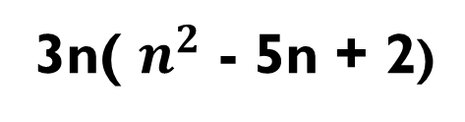
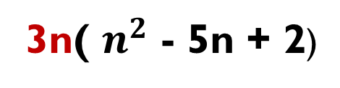
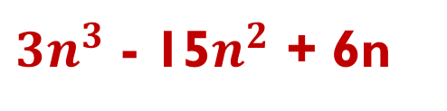
Simplifying algebraic expressions
Example # 8:
3n( $n^{2}$ - 5n + 2)
Step 1 – Use the Distributive Property to simplify the expression.
3n( $n^{2}$ - 5n + 2)
Step 2 – Multiply 3n times $n^{2}$ - 5n + 2
3n( $n^{2}$ - 5n + 2)
Note– when multiplying coefficient with exponent, you add the exponents.
${3n}^{3}$ - 15$n^{2}$ + 6n

Slide 16
Summary
What have you learned about this lesson?
What are some important steps to remember algebraic expressions?
Make sure you review your notes, add additional questions or notes, and write a summary or reflection.

Slide 17
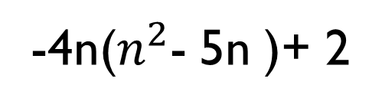
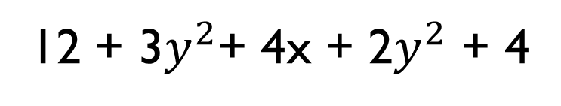
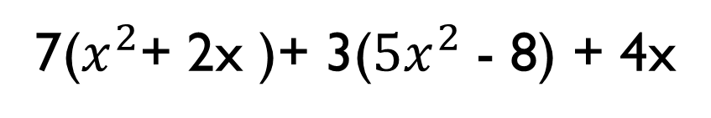
Your Turn
I. Simplify the following algebraic expressions.
a.
12 + 3$y^{2}$+ 4x + 2$y^{2}$ + 4
b.
5p – 3 (3p – 1 )
c.
7($x^{2}$+ 2x )+ 3(${5x}^{2}$ - 8) + 4x
d.
-4n($n^{2}$- 5n )+ 2

