Slide 1
4.8: Isosceles & Equilateral Triangles
Objective:
To understand and apply properties of isosceles and equilateral triangles.
Assignment: 4.8 p. 276: 1-10, 12-16, 22-26
Supplies:
Math Notebook

Slide 2
4.8: Isosceles & Equilateral Triangles
Vocabulary | Sketch | Things to Remember
Isosceles Triangle Legs Vertex Angle Base Base Angles |  | At least 2 legs are congruent. If 3 legs are congruent it is a special isosceles triangle called an equilateral triangle.

Slide 3
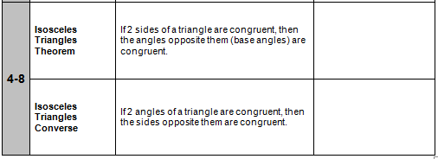
4.8: Isosceles & Equilateral Triangles
Geometry Handbook p. 16
Note: The Isosceles Triangle Theorem is sometimes stated:
Base angles of an isosceles triangle are congruent.

Slide 4
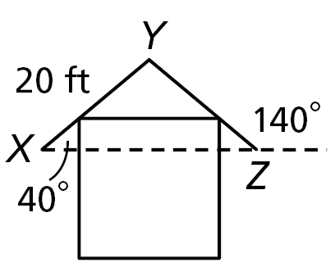
4.8: Isosceles & Equilateral Triangles
Example 1:
If XY = 20 feet, explain why YZ is the same.
Statement Justification
m∠X=40° Given
m∠XZY+140°=180° Def of linear pair
m∠XZY=180°-140° Subtraction property of equality
m∠XZY=40° simplification
m∠XZY= m∠X Substitution property
∆XYZ is an isosceles isosceles ∆ converse
XY=YZ def of isosceles ∆
YZ=20 ft substitution.

Slide 5
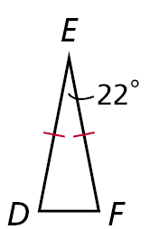
4.8: Isosceles & Equilateral Triangles
Find m∠F.
Statement Justification
ED=EF Given
m∠E=22° given
∆DEF is an isosceles isosceles ∆ theorem
∠D≅∠F def of isosceles ∆
m ∠E+m∠F +m∠D=180°
triangle sum theorem
22° +2m∠F =180° Substitution
2m∠F =158° subtraction POE
m∠F =79° division POE.

Slide 6
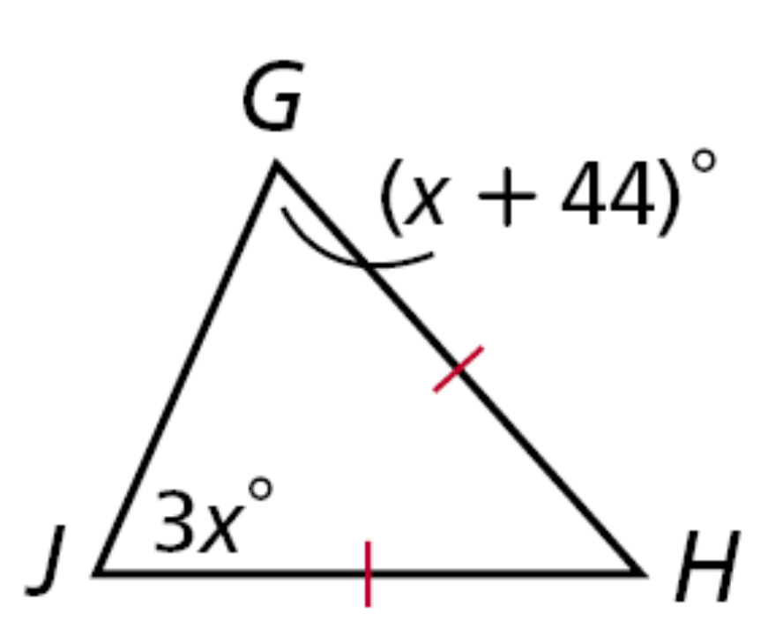
4.8: Isosceles & Equilateral Triangles
Find m∠G.
X+44=3x
44=2x
22=x
m∠G=22+44
m∠G=66

Slide 7
4.8: Isosceles & Equilateral Triangles
Equilateral Δ Corollary:
If a triangle is equilateral, then it is equiangular.
Converse of Equilateral Δ Corollary :
If a triangle is equiangular, then it is equilateral.

Slide 8
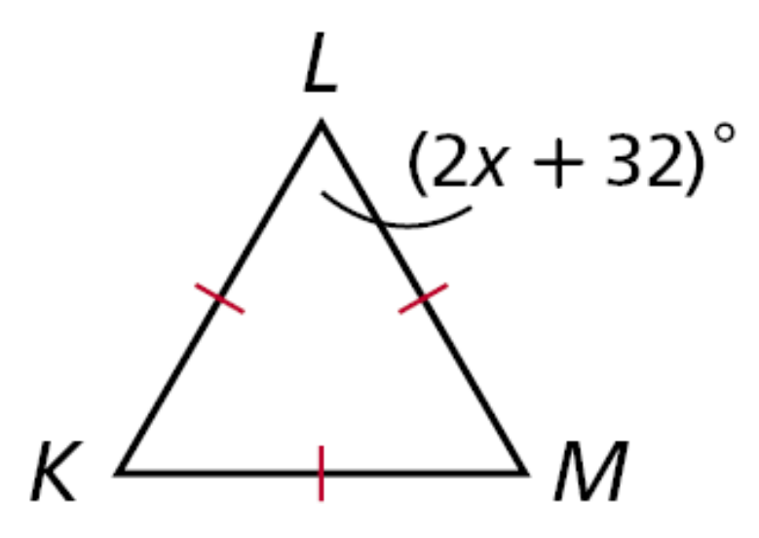
4.8: Isosceles & Equilateral Triangles
Find the value of x.
2x+32=60
2x=28
X=14

Slide 9
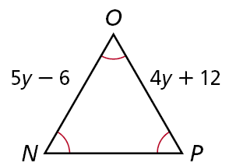
4.8: Isosceles & Equilateral Triangles
Find the value of y.
5y-6=4y+12
Y=18

Slide 10
4.8: Isosceles & Equilateral Triangles
Assignment:
4.8 p. 276: 1-10, 12-16, 22-26
Next week final on Thursday 1/22
Final will be about 50 multiple choice questions
  covering all material from the beginning of the school year.
After the final if you choose you can retake
    up to 5 ~10 point quizzes or tests.
Please look at your progress report to decide which, if any quizzes or tests you would like to retake.
  Write which tests or quizzes you want to retake on your progress report and turn in by end of class Friday, so I can print out those quizzes or tests out.

