Slide 1
New Employee Orientation
August 2, 2022
Jasper City Schools
Notes:
Welcome to the Jasper City School System.
Today’s objective is to provide an overview of several items related to payroll and benefits.
We hope that most of your questions will be answered as we go along
but we will take time to answer questions at the end of the presentation.
The one question that is on everyone’s mind is…
Next slide

Slide 2

Welcome!
Let's begin with the most important question:
When do I get paid?

Slide 3
First paycheck schedule:
Nine and Ten month employees
  September 30* (you may request 13 checks your first year, moving paydate to August 31)
Eleven month employees
  August 31*
Twelve month employees
  July 28*
  *Checks are issued on the last working day of the calendar month.
Notes:
Your new employee packet has a Payroll Calendar with Pay Period Cut Off Dates for the 2021-2022 school year.
Each pay period ends approximately mid-month...
Except December which ends quite early so we can get payroll processed in time to issue checks before employees leave for winter break.
When you receive your first paycheck you may notice the difference between your gross pay and the amount you actually receive.
Next slide.

Slide 4
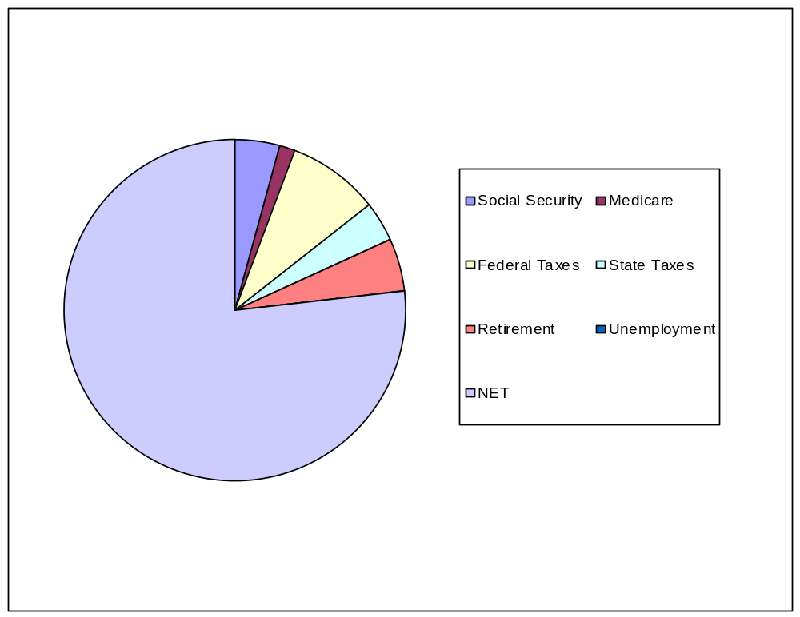
What about Take Home Pay?
Employees hired after
January 1, 2013: TIER II
Annual Salary $44,208
Wages $3,684.00
Soc Sec -228.41
Medicare - 53.42
Federal -368.00
State -200.00
Retirement -228.41
6.20%
Take Home $2,605.76
Notes:
This chart lists mandatory deductions for every employee in the system.
On an individual basis employees may have additional deductions, but never fewer deductions.
In addition to the taxes that are withheld from your check, the board also has financial obligations to meet on behalf of every employee.
Next slide.

Slide 5
What about Take Home Pay?
Employees hired before
January 1, 2013: TIER I
Wages $3,684.00
Soc Sec -228.41
Medicare - 53.42
Federal -368.00
State -200.00
Retirement -276.30
7.50%
Take Home $2,557.87
Notes:
This chart lists mandatory deductions for every employee in the system.
On an individual basis employees may have additional deductions, but never fewer deductions.
In addition to the taxes that are withheld from your check, the board also has financial obligations to meet on behalf of every employee.
Next slide.

Slide 6
Salary
Employees are placed on the salary schedule based on years of experience prior to joining the Jasper City School System.
The salary schedule increases every year until it reaches the top according to that particular class of employee. This is called a step raise.

Slide 7
Summary of Payroll Procedures
Employees who are away from work must enter their absence on Kelly Educational Services website, and document the reason for the absence.
This includes, but is not limited to:
  Sick leave
  Personal leave
  Vacation leave
  Professional leave
  Jury duty
  Military leave
Please see your local school bookkeeper for specific submission instructions.

Slide 8
Importance of Sick Leave
Sick Leave may be used when
-An employee is ill or has suffered bodily injury.
-A member of the employee’s immediate family is ill.
-A death has occurred in the employee’s immediate family.
The State of Alabama has issued legal opinions stating that sick leave cannot be used for any other reasons. Also sick leave cannot be used for time prior to retirement.
Notes:
Sick Leave guidelines are set by the State Department of Education.
Employees earn sick leave based on the number of contract months worked.
Sick leave can be used for the following:
Personal Illness
Family Illness
Death in the Family
Your sick leave is one of the most valuable things you earn as an employee.
There are two reasons to guard your sick leave carefully.
First—things happen in life that we never expect and having adequate sick leave to cover an absence will help keep your paycheck coming in.
Second—when you are ready to retire, the sick leave balance that you have is converted to service credit.
This credit can be used to attain minimum service requirements for retirement or it may be added to total service credit if the minimum service has been attained.
For instance, if you have 188 sick leave days available when you are ready to retire you can add one year of service credit. So you could work for 24 years, use sick leave for service credit and attain the 25 years required for retirement.
Next slide.

Slide 9
Sick Leave Bank
Commit five (5) days to the bank to become a member.
Eligible to give or receive donations in case of catastrophic illness.
Borrow a maximum of fifteen (15) days against future days earned.
  An approved loan application is required.
  Submit loan request to Mrs. Shipman.
Notes:
Membership in the sick leave bank is strictly voluntary but enrollment is offered on a limited basis.
Date employed.
Open Enrollment.
When an employee is hired.
During the annual open enrollment.
Days borrowed from the sick leave bank must be repaid. If an employee terminates and days are owed to the SLB, the employee will be docked for each day outstanding.
Next slide.

Slide 10
Kelly Educational Services (KES)
KES is our time-keeping and teacher substitute service. All employees (other than bus drivers) must enter their absences on the KES software (using the Frontline system).
You will be provided with a username and password with which to enter this information. Absences must be entered at least one day in advance, if known. Unexpected absences may require a telephone call to KES. Your bookkeeper will assist you with this information.

Slide 11
Summary of Payroll Procedures
All employees receiving compensation for any work performed on school premises must be paid thru the school payroll system. This is a Federal Fair Wage and Hour requirement. No exceptions to this procedure are allowed.

Slide 12
Summary of Payroll Procedures
All employees must electronically sign in each morning, using their identification badge. Laptops are on-site, and your building bookkeeper can provide assistance. Bus drivers may sign in remotely.

Slide 13
Summary of Payroll Procedures
Hourly employees must clock in and out for all duties performed. This includes any duties performed on school premises outside normal work schedule. Hourly employees must clock in and out for lunch.

Slide 14
Summary of Payroll Procedures
Schedule an appointment with Nikki Shipman, Payroll Specialist. She will provide you with your employment forms and employee identification number. Mrs. Shipman will also provide you with insurance information.
Your building principal will provide to you your JCS email address.

Slide 15
Direct Deposit
Improved Security
No waiting in lines at the bank
Money available the morning of payday
Choose your own bank
Notify Payroll Department immediately
  If you change banks and/or your account is closed.
  If your account number changes.
Notes:
Direct Deposit is recommended for all employees and is the most secure method of payroll delivery.
It is so important that you understand that if there is any change in your bank account you must notify the payroll department immediately.
We depend on you, the employee, to keep us up to date with your financial information.
Next slide.

Slide 16
How do I purchase things I need to do my job?
Start with your new best friend - your SCHOOL BOOKKEEPER!
A purchase order must be completed for EVERY PURCHASE
No orders until you receive an APPROVED purchase order.
All technology purchases must go through the technology department.
We are exempt from sales taxes.
Plan ahead - purchase orders take time to process through the system.
State-funded classroom supply monies will be available to you on October 1.
Notes:
PEEHIP is the acronym for Public Education Employees Health Insurance Plan.
PEEHIP has two options for hospital/medical coverage and hopefully you have taken some time to review your packet and have made your decision.
Each employee is eligible, on a voluntary basis, for certain types of health insurance. A full insurance allocation is available for each full time employee.
The state insurance allotment is $800 per month to assist in the purchase of such insurance.
Your out-of-pocket expense is noted here… single coverage is $30 per month and family coverage is $207 per month. Family plus spouse is $307 per month.
Compared with the monthly premium for insurance coverage, the out-of-pocket rates are great.
Monthly premiums are payroll deducted.
Your first check, issued on September 30, will have a deduction for the premium that pays for the October coverage.
As new employees you can choose to have your insurance coverage begin during the month you officially start work, August 5th, or the first day of the following month, September 1st. Information on coverage prior to October 1st and payment of the premiums due was included in your packet.
Before you turn in your insurance enrollment or status change form please make sure that you have not overlooked the question regarding tobacco use for you and /or your spouse. This is required information.
If you don’t give an answer you will be charged a $50 tobacco surcharge per month in addition to any other premium that you pay for hospital/medical coverage.
PEEHIP also offers insurance coverage for those who may be covered by hospital/medical insurance carried by their spouse.
Next slide.

Slide 17
How do I purchase things I need to do my job?
We can order on-line through Amazon and other vendors, but there are limitations and restrictions - check with your bookkeeper.
You may need to check out a purchasing card from your school office. Again, check with your bookkeeper.

Slide 18
Teacher Classroom Supply Monies
This year, the state will fund each teacher with $900 to be used for classroom supplies.
These funds will be accessed to you through a purchase order.
Funds cannot be used on food, personal items, etc. They are to be used strictly for classroom supply items.
Contact your school bookkeeper when you are ready to access these funds.

Slide 19
Teacher Receipt Books
Your school bookkeeper will give to you a pre-numbered receipt book with YOUR name on it.
DON'T LOSE THIS!
As you receive monies from students (field trip fees, various event fees, etc.), each payment of $10.00 or more requires a receipt.
Each receipt must be signed by you and a copy provided to the student.
Do not white out receipts.
Do not destroy receipts.
Notes:
The 3-1 rule is used to determine how much insurance coverage an employee earns for the summer months following the school year worked.
In the case of a nine-month employee here today this would be June, July & August of 2017.
If you work September, October & November, you earn the June 2017 insurance allocation.
December, January & February earns the July 2017 allocation.
March, April & May earns the August 2017 allocation.
Next slide.

Slide 20
Teacher Receipt Books
If there is an error, write "void" on the receipt, leave it intact in the book, and write the next receipt as the replacement.
Stay in numerical order within the receipt book.
Turn in the receipt book and monies collected to your school bookkeeper, DAILY.
This is your responsibility, and your proof that you have collected and receipted from students in a fair manner.

Slide 21
Public Monies
There are very specific rules and restrictions when dealing with public monies.
Be sure to follow instructions when receiving and disbursing public monies.
If you unsure as to which form to use, where to sign, etc.
ASK!

Slide 22
Professional Development
Approval Process:
- Get the conversation started
- Grade level/Department Representative
- Principal
Complete Leave Request:
- Know the Fund Source - might ask bookkeeper
- Sign
- Forward to School office for principal signature
- Central Office must sign approval
- Make sure you have approved copy before date of PD

Slide 23
Professional Development
Expense Reimbursement:
- Expense Reimbursement Form is on JCS website
- List of required attachments is on the form, including
itemized receipts, mapquest
- Expenses must fall within allowed travel times – these
are included in the Employee Handbook, online
- Meal reimbursement limits are inclusive of maximum
20% tip.
- enter your approved absence in KES

Slide 24
DOCUMENT SERVICES
On JCS website, under Faculty Information, choose ESS (Employee Self Service)
Receipt of e-mail on payday of direct deposit information
Provide your monthly pay information for future use
Provide W-2 information
Retrievable only through network access

Slide 25
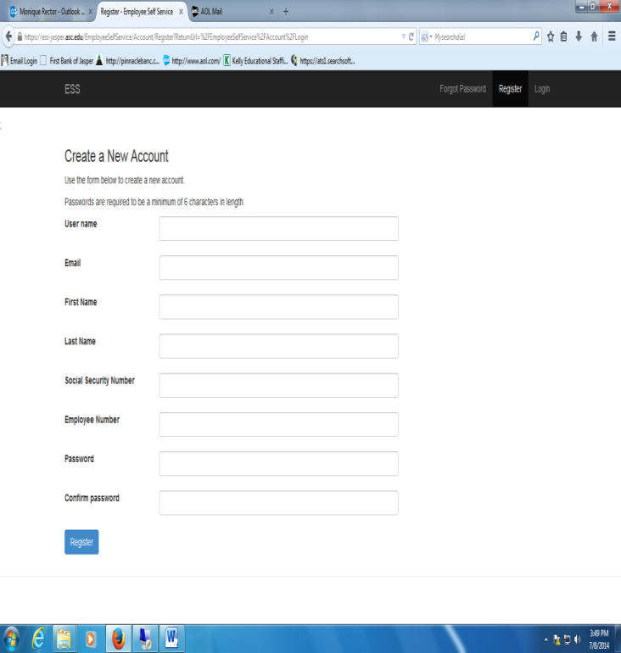
Document Services Sign-In
User Name – Create any user name you want. Be sure it is something
On your first visit you will create an account.
you will remember.
SSN – enter your actual Social Security Number.
Employee Number – your Central Office-issued employee number. It is printed on your paystub.
Password – must be at least 6 characters in length.
Click REGISTER.
CAUTION – write down your User Name and Password in case you forget it.

Slide 26
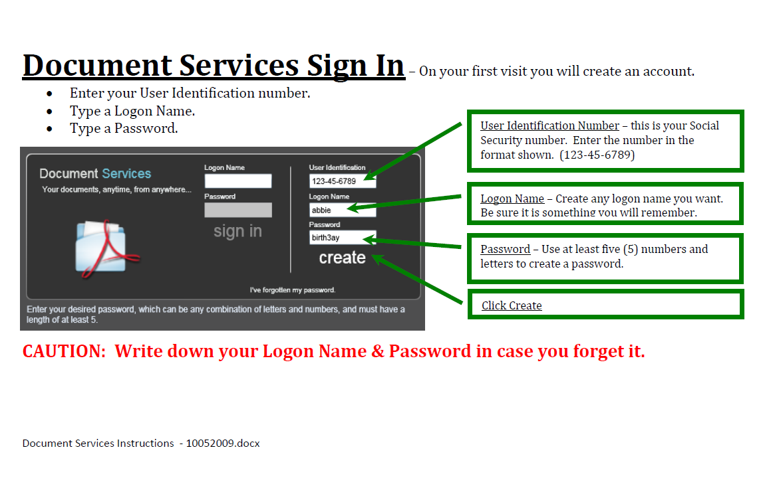

Slide 27
Faculty Information
On the JCS website, the Faculty Information tab has very useful information available to you anytime.
The Employee Handbook is located on the Faculty tab.
Scroll down to Employment-Related Information, and you will find resources concerning your employment, including 2 powerpoint presentations that require your viewing.

Slide 28
Faculty Information
Please view both the Preventing Sexual Harrassment PP and the Payroll & Benefits PP.
There are four statements of agreement on the last page of the Employee Handbook. Once you are in agreement, please sign and return to your school bookkeeper by Wednesday, August 17.

Slide 29
Who do I call?
For questions about
Payroll & Benefits?
  Nikki Shipman, Payroll Specialist
  Central Office, 205-384-6880
Absences?
  School Bookkeeper
  Purchase Orders?
  School Bookkeeper
  Ashley Aaron, Bookkeeper
  Central Office, 205-384-6880

Slide 30
Who do I call?
Contacts at the Board Office 205-384-6880
Payroll & Benefits
  Nikki Shipman, Payroll Specialist
General Concerns & Board Issues
  Monique Rector, Chief School Financial Officer
Contracts, Teacher Certificates & Transcripts & Federal Programs
  Rita Pilling, Federal Programs Director
  Kristy Watkins, Curriculum Director
  Kristi Bozeman, Secretary to the Superintendent

