Slide 1
Navajo Rug Weaving
Math Connection

Slide 2
Designs and patterns
GEOMETRIC SHAPES
Lines and Plane Figures
horizontal line
perpendicular lines
obtuse angle
pentagon
circle
equilateral triangle
parallelogram
cube
pyramid
polygon
vertical line
curve
triangle
hexagon
arc
scalene triangle
rhombus
diagonal line
right angle
square
octagon
ellipse
isosceles triangle
trapezoid
parallel lines
acute angle
rectangle
polygon
right triangle
quadrilateral
tesselation

Slide 4
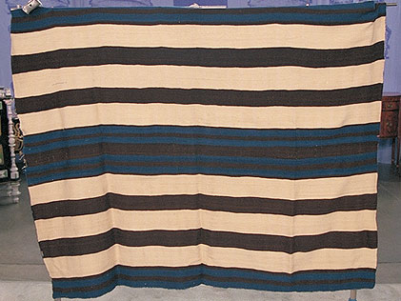
Chief Blanket
First Phase:
Early 1700’s to around 1820’s
Brown, blue and white
Bands and strips

Slide 5
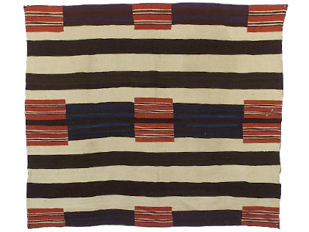
Second Phase
Second Phase Chief Blanket 1
1850’s to around 1880
12 rectangles grouped in twos
“Some” yellow and green

Slide 6
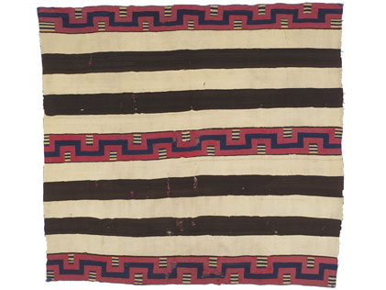
Chief Blanket
Second Phase Chief Blanket 1
1850’s to around 1880
12 rectangles grouped in twos
“Some” yellow and green

Slide 7
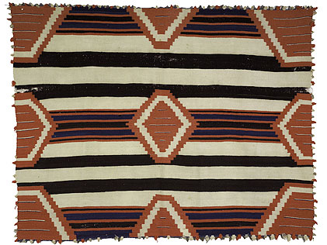
Chief Blanket
Third Phase
After 1880’s
9 diamonds and ½ diamonds

Slide 8
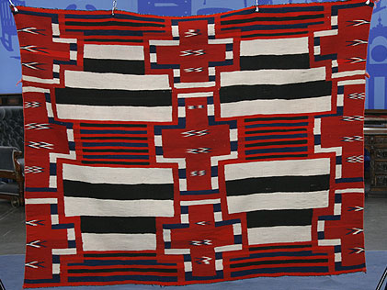
Chief Blanket
Third Phase:
Added elements inside the diamonds, including:
zigzags
crosses
thin lines
stacked elements, and
triangles.

Slide 9
Other Designs and Patterns

Slide 10
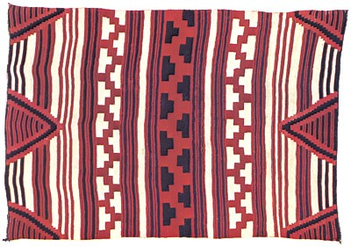

Slide 11
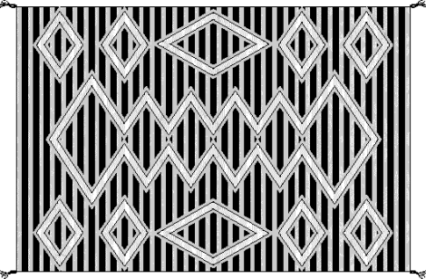

Slide 12
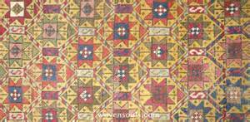

Slide 13


Slide 14
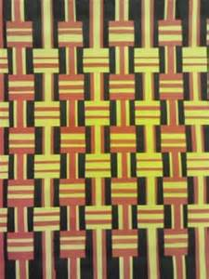

Slide 15
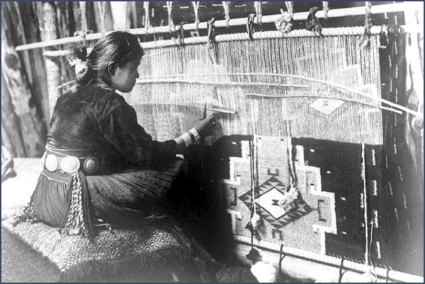
Nizh0n7 D00 Ak0t4edo

