Slide 1
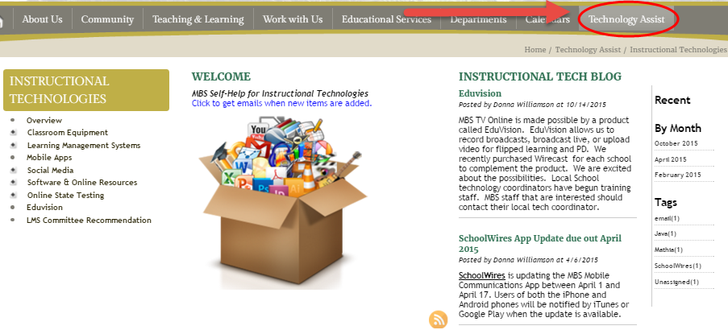
MBS Tech Assist
Technical Assistance for Parents, Students, and Staff
Where and When YOU Need it!

Slide 2
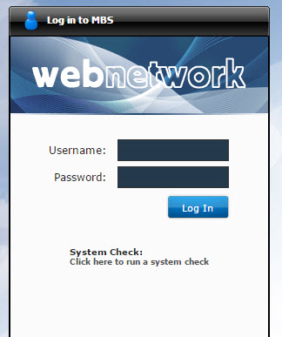
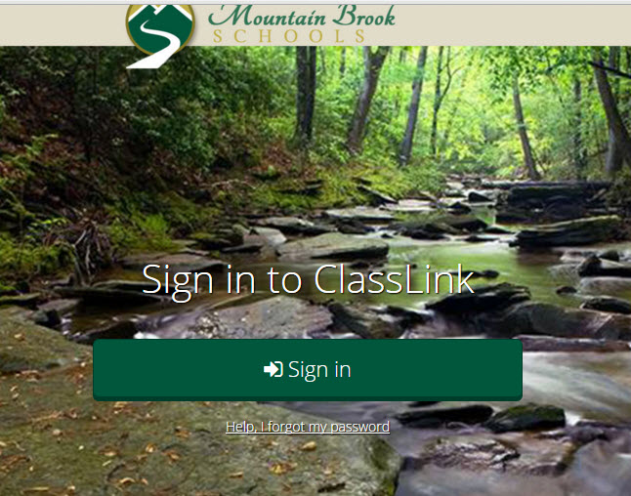
MBS Launches New Portal

Slide 3
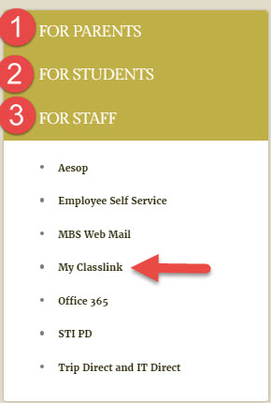
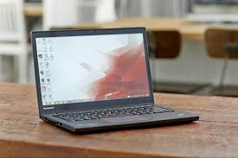
Access
www.mtnbrook.k12.al.us

Slide 4
At Home or on Campus
Parents
Students
Staff

Slide 5
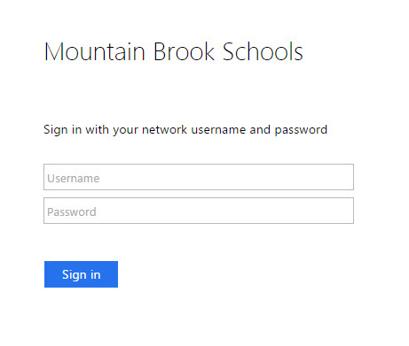
Off Campus
Use same Username
Use same Password

Slide 6
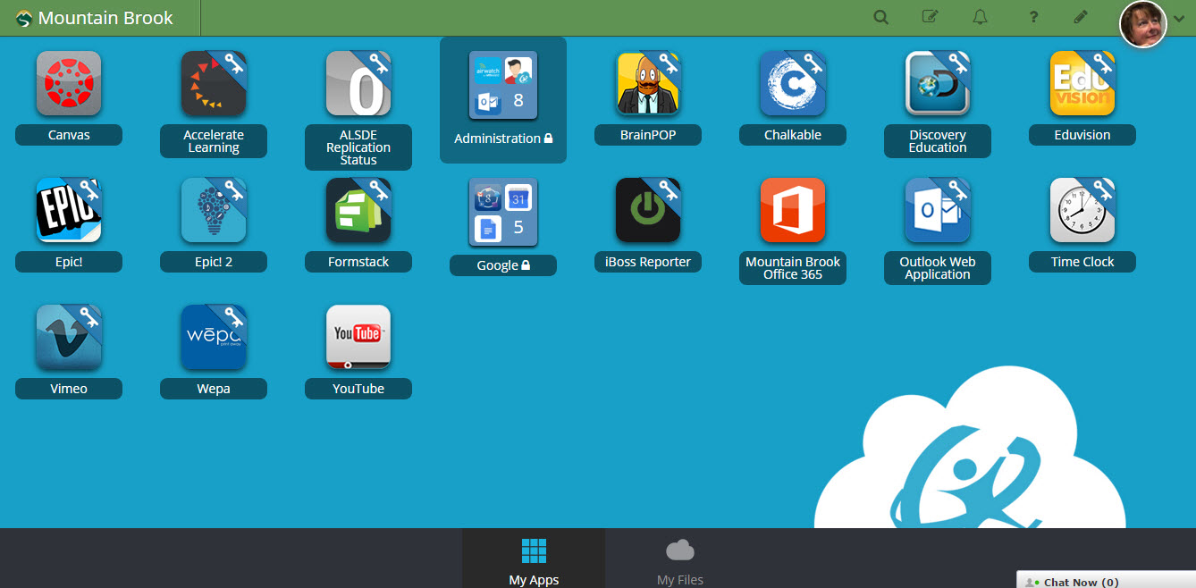
ClassLink Dashboard

Slide 7

Pause….

Slide 8

What is Cloud Computing?

Slide 9
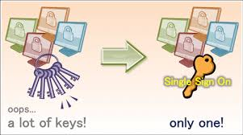
What is Single Sign On (SSO)?

Slide 10
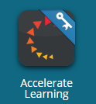

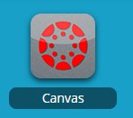

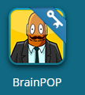
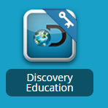
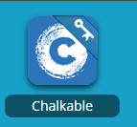
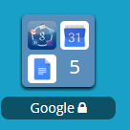
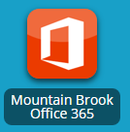
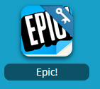


How does it work?

Slide 11


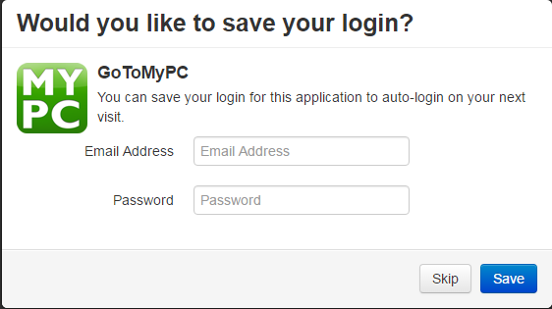
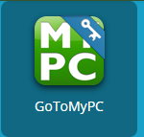
How does it work?
Enter username and Password
Save
Repeat for Each App
Save
Click on App
Enter the requested information

Slide 12
ClassLink Dashboard—My Files

Slide 13
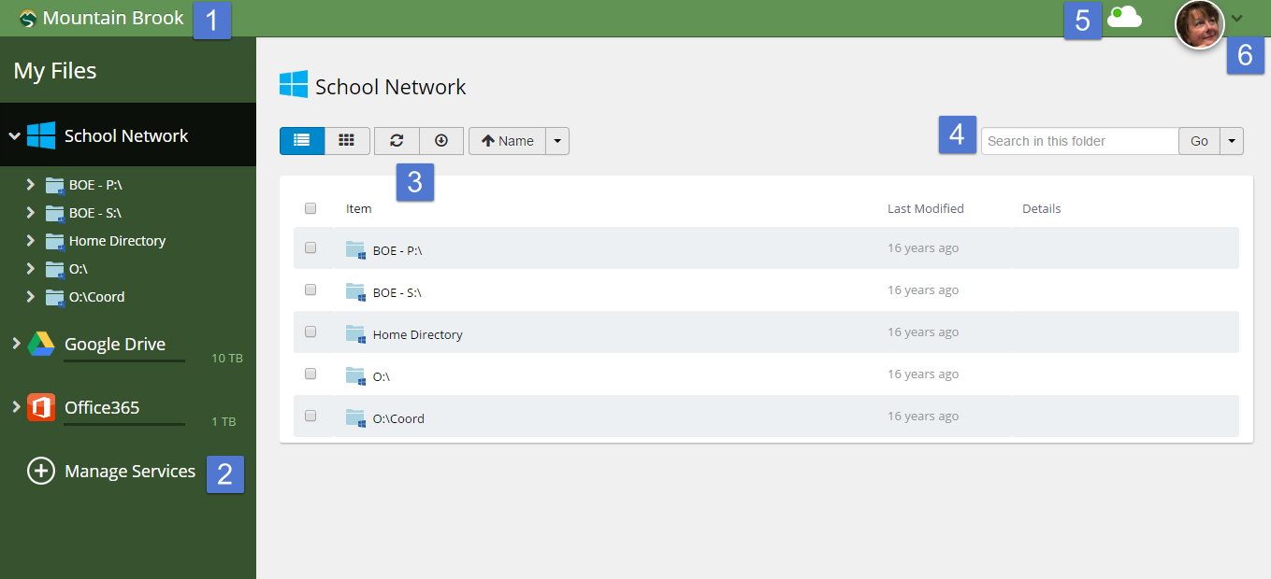
Important Features

Slide 14
Toggling Back and Forth from Apps to Files

Slide 15
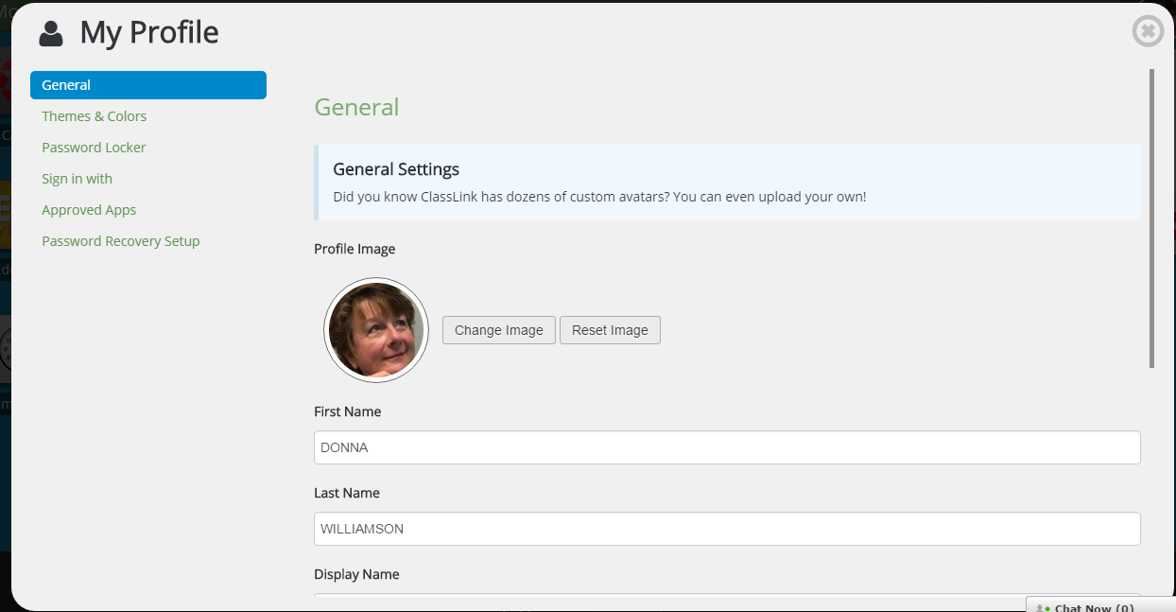
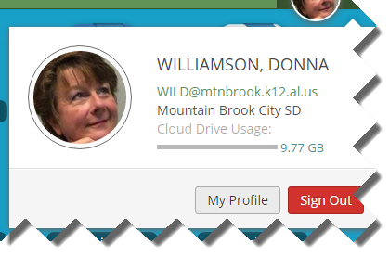
Your Profile and Logging Out

Slide 16
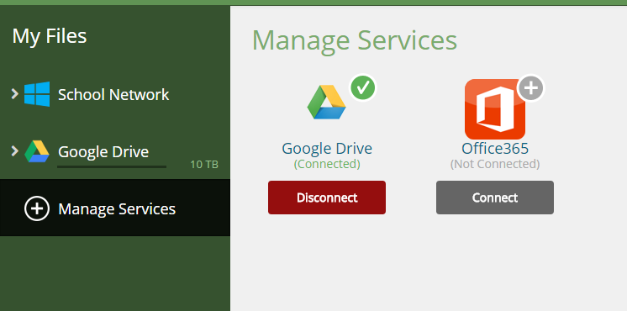
Staff and Students:
Connecting your Cloud Storage
You can only connect one
account. You CAN NOT connect
Your personal account and your
School account. The
expectation is that only school
Google and Office 365 account
will be linked.

Slide 17
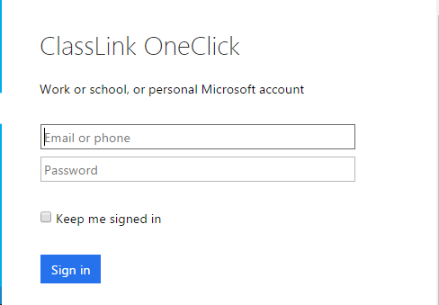
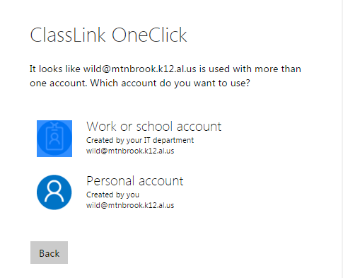
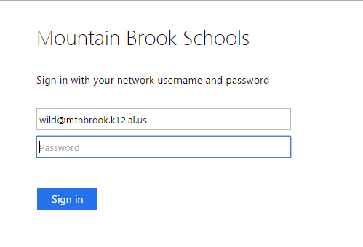
Office 365
Connection
Enter school email
account.
You may be re-
directed
to the screen
on the right.
If this box appears,
re-enter your information
and sign in.

Slide 18
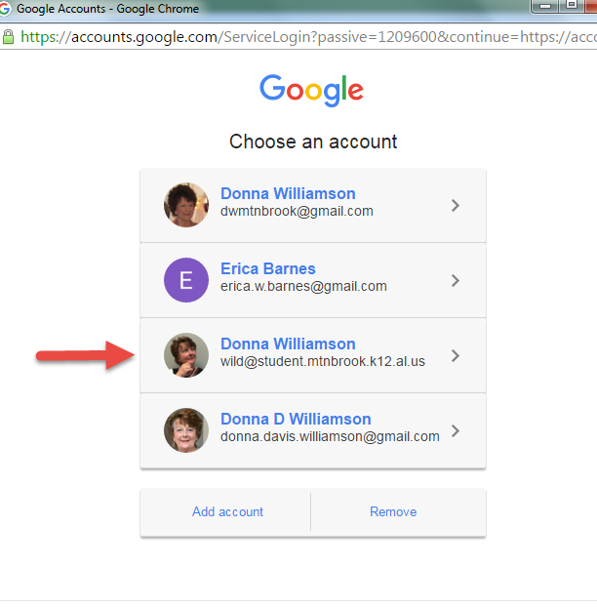
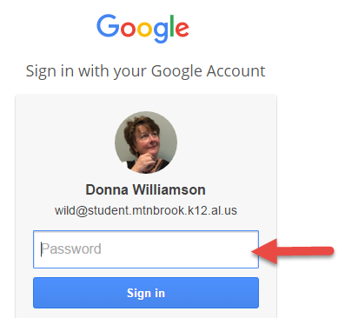
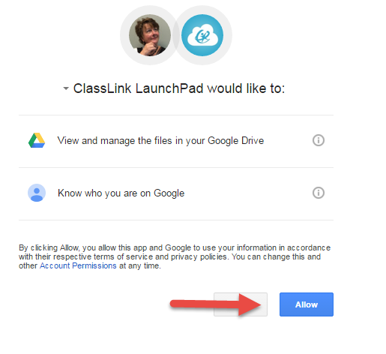
Google
Connection
Choose your school
  account.
  @student.mtnbrook.k12.al.us
Enter your password
and sign in.
3. Click Allow

Slide 19
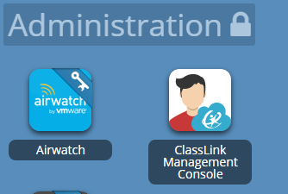
Online App Missing?
Staff and Students: Contact your local school technology
Parents and District Personnel: Contact the district office
BWF: Sharon Mumm
CB: Kenneth Camp
CES: Paula Stanbridge
MBE: Thea Patrick
MBJH: Suzan Brandt
MBHS: Joani Kay
District: Donna Williamson
Email Addresses Available under
Tech Assist tab on Mountain Brook Schools website.

Slide 20
Assigning Apps is Quick and Easy
App(lication) must listed on the vetted application list. To check, click on Tech Assist tab on MBS webpage and click Vetted Online Apps.
  If it is not on the list, go to Tech Assist tab on website (www.mtnbrook.k12.al.us) and click Forms. Look for the Form…Request App Review and enter information so we can vet it!
If it is on the list, contact your technology coordinator and ask them to add the app to your group menu in Class Link.

