Slide 1
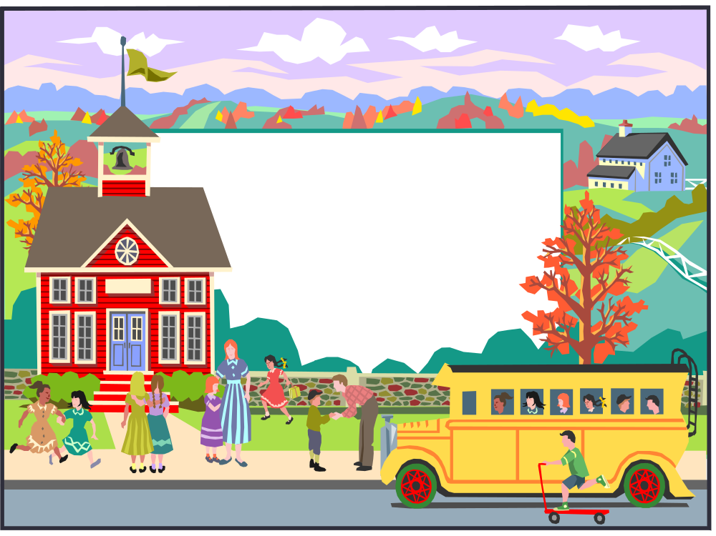
Mrs. Mull’s 2nd Grade Class
Welcome Students!

Slide 2

Welcome to 2nd Grade!
This is an important year for you!
We will all grow and learn together
We work together as a team and strive to do our best each and every day.

Slide 3
Classroom Community
Our classroom is a community. In our community, we have rules to help us get along with each other.
Our class rules are:
  Be respectful and responsible.
  Be organized and follow directions.
  Be prepared

Slide 4

All About Me
My Background
  I have a husband Terry and 2 boys.
  I attended college and have 2 master’s degrees
My Experience
  I’ve been teaching for 31 years.
  I have taught Preschool through 2nd grade.

Slide 5
Goals
To give you the academic tools you need to progress to 3rd grade.
To provide a supportive learning environment.
To have fun while we learn.
To make new friends and discover new interests.

Slide 6
Class Subjects
The subjects we cover during 2nd grade are:
  Reading, Writing, and Spelling
  Math
  Science
  Social Studies & Health
  Music, Art, Gym, Technology, Media (Library)

Slide 7
What you should expect from me!
Weekly newsletters containing important information.
Updated information on NEW school website www.hcs-k12.org under Mrs. Mull. (after fair week)
Preparation of your child for 3rd grade.
Make your child feel safe at school.
Challenge your child to the best of his or her abilities.

Slide 8

Math
Our district teaches from the Investigations
Daily fact practice and fact assessments are part of the program.
Your child will have some math homework Monday through Thursday. If there is not any “official” homework please student skills being taught
Please have your child practice math facts at home.

Slide 9

Reading
We use the Scott Foresman Reading Street Series.
Each newsletter will include skills we are working on.
Please have your child read 15 minutes daily at home. Please practice weekly vocabulary and amazing words

Slide 10

Spelling
Each child will get spelling words each week.
Please have them practice words daily for weekly test.
You can play hangman, use our classroom webpage, or practice printing your spelling words for daily practice.

Slide 11

Science
Our Science is incorporated into our reading series.
Each newsletter will talk about skills we are working on.

Slide 12

Social Studies
Our Social Studies is incorporated into our reading.
Each newsletter will tell you the focus of our learning.

Slide 13

Art
Students will have Art one time per week.

Slide 14
Grades
Letter grades are given in math, reading, writing, and spelling.
The other subjects are given S,N,I, or U.
  Interims will be sent home half way into the grading period. Grade cards will be issued every 9 weeks.

Slide 15
Specials Schedule
Daily 1:33 – 2:25
Monday Technology-Mrs. Shipley
Tuesday P. E. – Ms. Boggs
(wear gym shoes)
Wednesday Music – Mrs. Miller
Thursday Art – Mrs. Burke
Friday Library

Slide 16
Discipline Policy
We use a “Flip Card” system in our classroom.
Each child is given a pocket of colored cards: Green, yellow, orange, red.
We start our day on green cards. Each time we have a behavior issue, a card is flipped.
Consequence for “color change” are as follows: Green-Great Day! Yellow: warning Orange: Take away 5 minutes of recess Red: Take away 10 minutes of recess, repeated 15 minutes – note or call home if concerned.
Students can always work back to green throughout day with good behavior.
Please work with us by talking about good behavior at school. We want school to be a place for learning. Your support with this will be greatly appreciated!

Slide 17
Homework
Reading: Monday – Thursday
  Read & record take home book reading or reading from home books.
Math: Daily as needed
  Practice facts
  Practice skills being taught (newsletter)
Spelling: Daily as needed
  Practice for tests on Fridays
Return all work in homework folder with name on papers. ☺

Slide 18

Check out our NEW classroom website (after fair week).
Hillsboro City Schools
Mrs. Mull's Classroom
Mrs. Mull 2nd Grade Room 440 phone: 393-3132 ext. 5440 lmull@hcs-k12.org

Slide 19
Let’s Have a Great Year!

