Slide 1
Powerpoint
Tips and Tricks
To view this as a presentation, choose “Slide Show – From Beginning”

Slide 2

Tips and Tricks
Original Background
Text Animation
Hyperlink Words or Shapes
Adding Sound
Dim Effect
Header
Podcast
End Slide

Slide 3
Original Background
First Method
There are two methods to create an original background:
Insert a picture
  choose the picture; stretch it to fit the slide
Click on Picture Tools Contextual Tab
  Choose Color (on the left side)
  Under the Recolor section, choose Washout
    This lightens the picture without taking out the color
  If necessary, right click and choose “Send to Back” so the textboxes appear
Second Method

Slide 4
Original Background
Second Method
Choose Design ribbon / Background Styles
Choose Format Background
Choose Picture or Texture Fill (then Insert From . . .)
This method will NOT allow the picture to be washed out
  NOTE: make sure the picture is one that will not fight with the text
Click on “Apply to All” – this makes the background appear on all existing and all new slides
Table of Contents
To change the color of a hyperlinked word, choose the Design tab; Colors; Create New Theme Colors. At the bottom of this dialog box is “Hyperlink” and “Followed Hyperlink.” Change the colors so both are easy to see in the presentation.

Slide 5
Text Animation
This determines how the text appears on each slide
Add text to the slide
Select the textbox – NOT the individual lines
Animation ribbon – choose the appropriate effect
  Don’t go overboard by using different effects; be consistent!
Choose how the text is going to appear:
  Mouse click
  With previous (comes in at the same time another effect takes place – i.e., a transition)
  After previous (comes after the other effect takes place)
Table of Contents

Slide 6
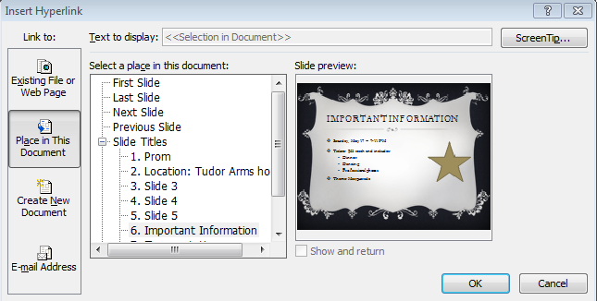
Hyperlink
To link two slides together
Select the word or shape that is going to be linked
Choose Insert ribbon / Hyperlink, or right click and choose Hyperlink
In the “Insert Hyperlink” dialog box, choose “Place in This Document”
  Choose the appropriate slide from the list of slide titles; click OK
Next

Slide 7
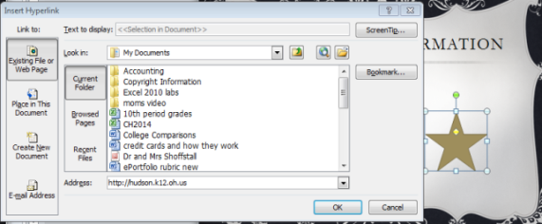
Hyperlink
To link to a web page
Select the word or shape to receive the hyperlink
Choose Insert / Hyperlink (or right click)
Choose “Existing File or Web Page”
Type in the appropriate URL; click OK.
Table of Contents

Slide 8

Sound
Determine which slide will receive the sound
Insert ribbon / Audio – locate the music clip
Click OK
A speaker will appear on the slide
Select the speaker; this opens the Audio Tools Contextual Tab.
  Format tab
  Playback tab
Continue

Slide 9
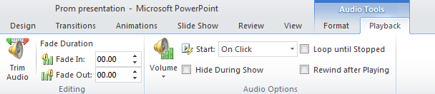
Sound
Audio Tools Contextual Tab - Playback tab options:
    Fade in or fade out
    Audio Options:
      start the music with a mouse click
      start the music Automatically
      play the music Across Slides
  Loop (plays over and over during the presentation)
  Trim Audio option - shorten the clip
Hide During Show - hides the speaker during the presentation
Table of Contents

Slide 10
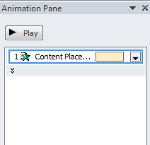
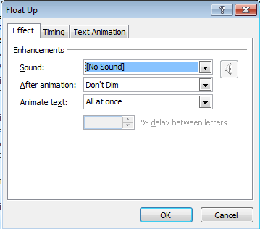
Dim Effect
This option makes the lines of text change color. The reason for using this is so the audience focuses on the information that is being presented.
Text animation must be added to the text first.
Click on the textbox; on the Animation Ribbon, turn on the Animation Pane
Click on the down arrow; choose Effect Options
Effect tab; click on “After animation” to show the options – More Colors; Don’t Dim; Hide After Animation; Hide on Next Mouse Click
Choose the appropriate option – or choose “Hide After Animation”
Click OK
Table of Contents

Slide 11
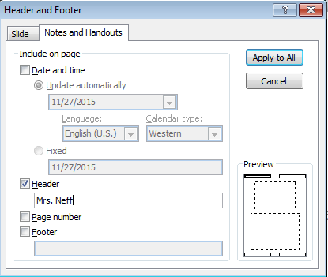
Header and Footer
Choose Insert / Header & Footer
Click on the Notes and Handouts tab
Deselect “Date and time”
Select “Header” and type in your name (names)
Click on “Apply to All” – the header will be on all slides
The header will only appear on the printouts or when you’re viewing your presentation in the Print Preview mode
Table of Contents

Slide 12
Podcast
PowerPoint
Audacity
Choose File / Export as .wav
Click OK
If prompted, save your podcast in your server space (in your PPT folder)
In PowerPoint – choose Insert / Audio / From File
Follow directions given above for adding sound
Remember to ☑ Hide During Presentation
Record the audio using Audacity
File / Export as .wav
  Click ok
  Save in your server space; in your PowerPoint folder
Table of Contents

Slide 13

Now it’s your turn to put together a PowerPoint presentation using the Tips and Tricks you learned within this presentation.
PowerPoint
Tips and Tricks
Click to end the presentation

