Slide 1
Music as Poetry
Mr. Beckett

Slide 2
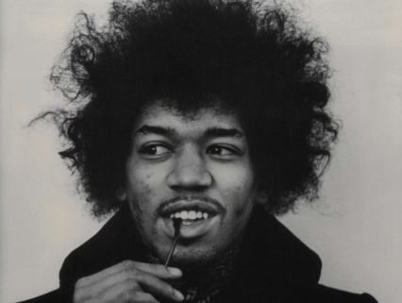
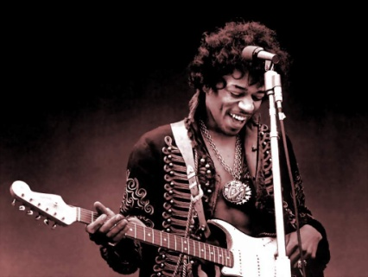
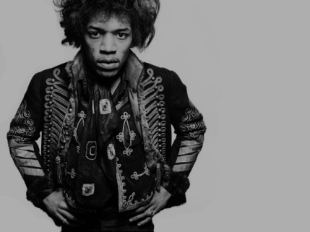
Jimi Hendrix: “Wind Cries Mary”
James Marshall Hendrix (November 27, 1942-September 18, 1970)
Widely considered one of the greatest guitarists of all time.
Although his death was never fully explained, it was believed he overdosed on sleeping pills, choking on his own vomit.

Slide 3
“Wind Cries Mary”: Song Meaning
This song is clearly about loss.
Speaker has lost his love, Mary.
Pain is so much that even the inanimate world around him feels the loss.
This will be his last love and the last name the wind “blows.”

Slide 4
“Wind Cries Mary”: Imagery
The imagery is gloomy:
  Jacks in boxes
  Clowns gone to bed
  Happiness staggering
  Red footprints
  Broom drearily sweeping
  Broken pieces of life
  Queen weeping
  Wind crying and screaming.
This imagery expresses the speaker’s feelings of depression, gloom, and loss.

Slide 5
“Wind Cries Mary”: Poetic Devices
Personification:
  Happiness staggering
  Footprints dressed
  Wind whispers, cries, screams
  Broom drearily sweeping
  Traffic lights shine blue emptiness
  Wind remembering, having old age, having wisdom
Personification shows nothing is safe in the world from the speaker’s depression.
The entire world is affected by the loss of Mary.
He cannot look anywhere without seeing this.
Even the wind, which might also represent time, is done after the loss of Mary.

Slide 6
“Wind Cries Mary”: Tone is Gloomy, Dismal, Depressing, Doleful
Hendrix’s voice is desperate and defeated.
  Especially at the end of each verse and the chorus.
He chose the blues for this song.
The da, dun, dun, sound is a descending and “low” sound, and matches the tone of the song.

Slide 7
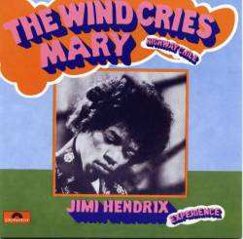
“Wind Cries Mary”: Why?
Song is #379 out of top 500 Rolling Stone singles of all time.
Hendrix is one of the first “old” musicians I liked as a teenager.
It really is poetic. I can picture this blue world he creates very vividly as the song goes on. It is beautiful, even if sad.

Slide 8
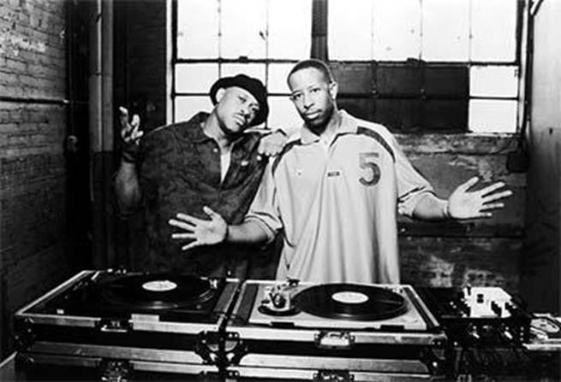
Gang Starr: “Above the Clouds”
Keith Edward Elam (July 17, 1961-April 19, 2010) better known as Guru.
Born in Boston but moved to Manhattan for graduate school.
Gang Starr began in 1987: Guru and DJ Premier.
Six albums that were influential on the hip-hop world.
Died of cancer at the age of 48.

Slide 9
“Above the Clouds”: Message
This song is a song of bragging, like many hip-hop songs.
This song is like a beautiful treatise for enlightening, original, positive hip-hop.
Not commonplace, petty, or negative.
Many rappers were getting rich quick on the radio in the 90s, selling out.
This song sets out a standard for deeper moves with hip-hop.

Slide 10
“Above the Clouds”: Imagery
Guru’s imagery is divine, spiritual, and immortal.
  Above the clouds
  Force
  Constellations
  Brainwaves
  Jewels
His imagery goes against the other imagery, which is evil and mortal.
  Evil factors
  Demonic chapters
  Curb
  Cell
He does this to separate himself from the other rappers, who will not be immortal or remembered.

Slide 11
“Above the Clouds”: Poetic Devices
Metaphor: Guru = lord, master, king, narrator, warrior, street preacher
Other rappers = evil factors, ten percenters, fire power.
His Lyrics = disaster, force, mind power, jewels
Hyperbole:
  A force that can’t be compared to any firepower
  The brainwave causes vessels to circulate
  Seeking everlasting life through this hell
  Brainwaves swell turning a desert to a well
  Above the clouds
  Infinite skills
  Creating miracles

Slide 12
“Above the Clouds”: Poetic Devices (cont.)
The use of metaphor, hyperbole, and simile all combine to demonstrate Guru’s dominance and superiority in the hip-hop world.
Instead of saying something basic, like “I’m the dopest MC,” Guru goes deeper with the use of these poetic devices and elevates his lyrics, and hip-hop itself.

Slide 13
“Above the Clouds”: Tone is celebratory and didactic.
Guru is trying to convince the listener he is superior.
  The “narrator you select” wants to be a legend.
The samples add to this goal:
  Sample 1: An announcement of a force from space.
  Sample 2: JFK speaks of knowledge and peace.

Slide 14
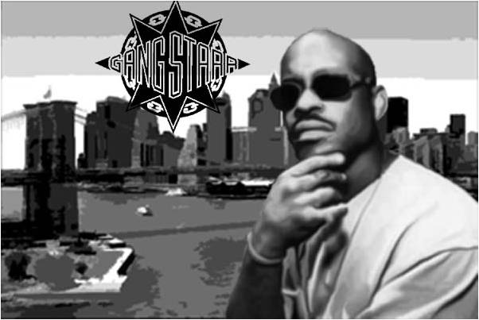
“Above the Clouds”: Why do I like it?
Hip-hop was not—and especially now IS not—usually like this with lyrics and purpose.
Guru’s rhyming delivery has been criticized as weak and monotone, but his WORDS elevate the music.

