Slide 1
Core Focus on Decimals
& Fractions
Lesson 4.2
Adding and Subtracting Fractions

Slide 2
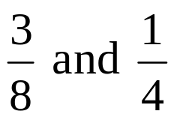
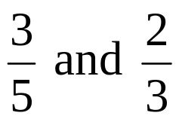
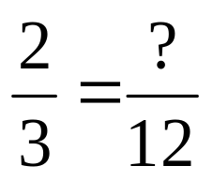
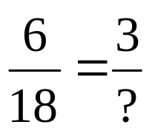
Warm-Up
What is the least common denominator for ?
What is the least common denominator for ?
Replace the ? with a number to make the two fractions equivalent.
3. 4.
8
15
8
9

Slide 3

Adding and Subtracting Fractions
Lesson 4.2
Find sums and differences of fraction expressions.

Slide 4
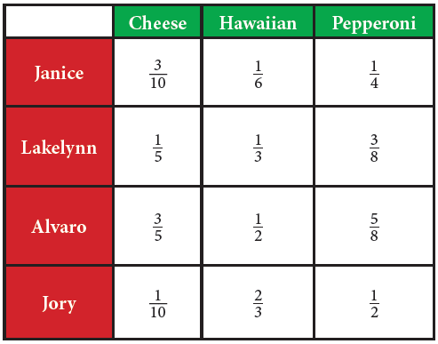
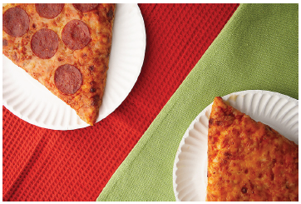
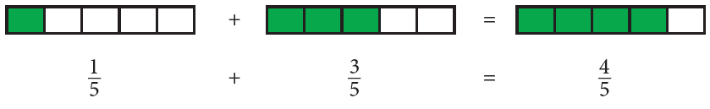
Explore! Pizza Party!
Janice was ordering pizzas for her friends.
The table shows the fractions of the pizzas
each person said they could eat.
How much cheese pizza do Lakelynn and Alvaro think they can eat together? Lay out the fraction tiles to represent the amounts of cheese pizza which Lakelynn and Alvaro want. Combine the fraction tiles to find the total. Simplify the fraction, if needed. Draw a picture of the fraction model you used and write the addition equation on paper.

Slide 5
Explore! Pizza Party!
Step 1 Follow the process shown for Lakelynn and Alvaro to answer the following questions.
a. How much cheese pizza will Janice and Jory eat together?
b. How much Hawaiian pizza will Jory and Lakelynn eat together?
c. How much pepperoni pizza will Lakelynn and Alvaro eat together?
Step 2 Look at the equations. What do you notice about the denominators of the fractions being added and the denominator of the answer? What about the numerators? How might you add fractions with common denominators without using fraction tiles?

Slide 6
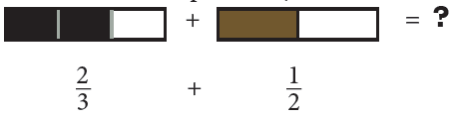
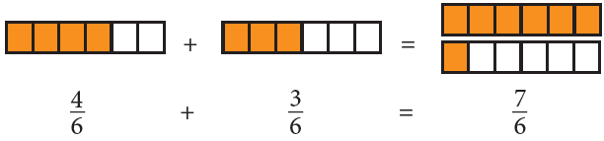
Explore! Pizza Party!
How much Hawaiian pizza with Jory and
Alvaro eat? Lay out fraction tiles to
represent the amount of Hawaiian pizza
Jory and Alvaro eat.
Find the least common denominator of the
two fractions.
2: 2, 4, 6, 8 3: 3, 6, 9, 12 LCD = 6
Replace the original fraction tiles with equivalent fractions using the LCD. Combine the tiles to find the answer.

Slide 7

Explore! Pizza Party!
Simplify the fraction, if needed. All
improper fractions should be written
as mixed numbers.
Step 3 Follow the process shown for Jory and Alvaro to answer the following questions. Draw pictures of the fraction tiles used in the process. Write the addition equation on your paper.
a. How much cheese pizza will Janice and Lakelynn eat?
b. How much Hawaiian pizza will Lakelynn and Alvaro eat?
c. How much Hawaiian pizza will Janice and Jory eat?
d. How much pepperoni pizza will Janice and Alvaro eat?
e. How much pepperoni pizza will Janice and Jory eat?
f. How much pepperoni pizza will Alvaro and Jory eat?
Step 4 How might you add fractions with unlike denominators without using tiles?

Slide 8
Add or Subtract Fractions With Common Denominators
Add or subtract the numerators.
Write the sum or difference over the common denominator.
Simplify the fraction.

Slide 9
Add or Subtract Fractions With Unlike Denominators
Rewrite the fractions using the least common denominator (LCD).
Add or subtract the numerators.
Write the sum or difference over the common denominator.
Simplify the fraction.

Slide 10


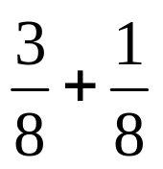
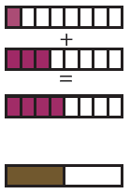
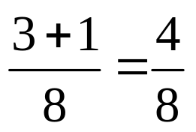
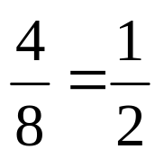

Example 1
Kiley practiced of her piano music in the morning. That afternoon she practiced of her music. What fraction of her music did she practice?
Write the problem.
Add the numerators and
write the sum over the
common denominator.
Simplify the fraction.
Kiley practiced of her piano music.

Slide 11
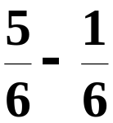
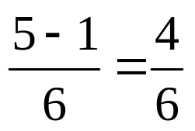
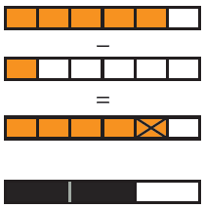
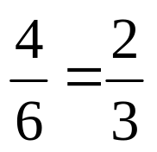
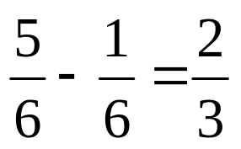
Example 2
Find the value of .
Subtract the numerators.
Write the difference over
the common denominator.
Simplify the fraction.

Slide 12


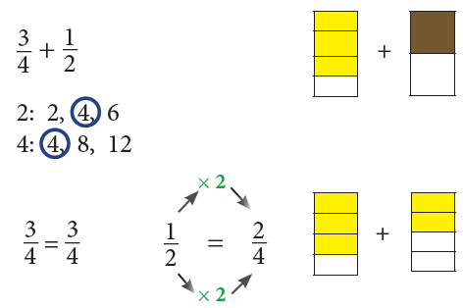
Example 3
Mallory made gallon of ice cream. Logan made gallon. How many total gallons of ice cream do they have together?
Write the problem.
Find the least common
denominator for the set
of fractions.
Rewrite the fractions
using the LCD.

Slide 13
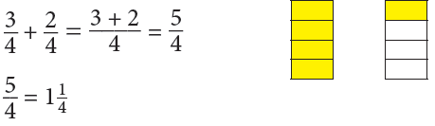


Example 3 Continued…
Mallory made gallon of ice cream. Logan made gallon. How many total gallons of ice cream do they have together?
Add the numerators.
Change the improper
fraction to a mixed
number.
Mallory and Logan made a total of gallons of ice cream.

Slide 14
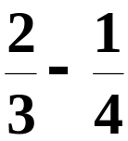
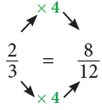
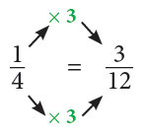
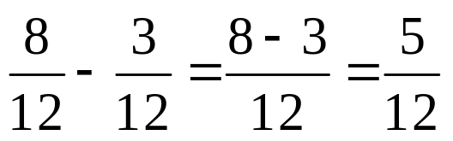
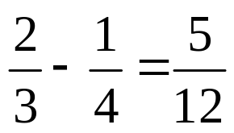
Example 4
Find the value of .
Find the LCD. 3: 3, 6, 9, 12
4: 4, 8, 12, 16
Rewrite fractions using
using the LCD.
Subtract the numerators.

Slide 15
Communication Prompt
Is it easy for you to use fraction tiles when adding or subtracting fractions? Why or why not?

Slide 16
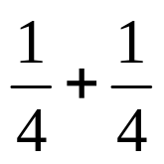

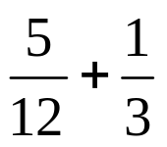

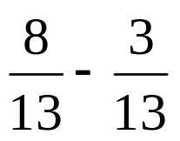

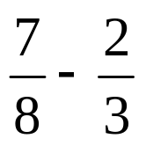

Exit Problems
Find the value of:

