Slide 1
The distance between two bar lines is
A measure

Slide 2
The distance between two pitches is
Interval

Slide 3
The volume of the music is
Dynamics

Slide 4
To gradually get louder is
Crescendo

Slide 5
“Piano” means
(not the instrument)
soft

Slide 6
The person who takes a song and adds to or changes it
Arranger

Slide 7
The person who writes the song
Composer

Slide 8
The ending (or tail) section of the music
Coda

Slide 9
A ____________ separates music into measures.
Bar line

Slide 10
Using consonants to clearly pronounce the words of a song
Diction

Slide 11
How high or low a note is
Pitch

Slide 12
A musical sentence is
A phrase

Slide 13
The speed of the music is
Tempo

Slide 14
The highest male voice part is
Tenor

Slide 15
The middle male voice part is
Baritone

Slide 16
The highest part of any changed male voice is
Falsetto

Slide 17
“Forte” means
Loud

Slide 18
To gradually get softer
Decrescendo

Slide 19

Name the letter of the note:
G

Slide 20

Name the letter of the note:
A

Slide 21
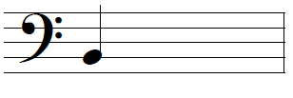
Name the letter of the note:
B

Slide 22
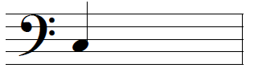
Name the letter of the note:
C

Slide 23
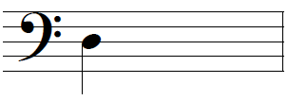
Name the letter of the note:
D

Slide 24

Name the letter of the note:
E

Slide 25

Name the letter of the note:
F

Slide 26

Name the letter of the note:
G

Slide 27

Name the letter of the note:
A

Slide 28

Name the letter of the note:
B

Slide 29
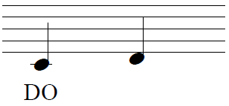
Name the syllable of the second pitch.
Re

Slide 30
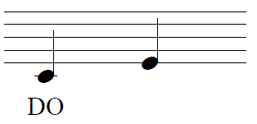
Name the syllable of the second pitch.
Mi

Slide 31
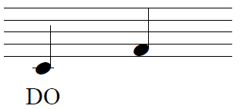
Name the syllable of the second pitch.
Fa

Slide 32
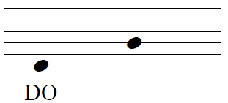
Name the syllable of the second pitch.
Sol

Slide 33
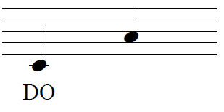
Name the syllable of the second pitch.
La

Slide 34
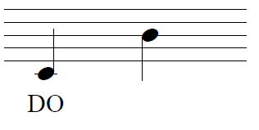
Name the syllable of the second pitch.
Ti

Slide 35
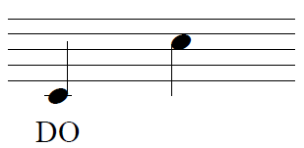
Name the syllable of the second pitch.
Do

