Slide 1
Welcome!
Beginning of the Year Form:
Student Learning Goals
With Bridget McMillen and Erin Beard
Right now:
Find a seat. Get comfy.
If you haven’t already,
  Log on to TeachBoost
  Watch TeachBoost BOY form screencast -- sent out in all staff email
Extra laptops are available. Help yourself.
Notes:
E&B: circulate while participants come in; encourage people to make sure they can log in to TeachBoost; start looking at handouts
At 4:25ish: Introduce us

Slide 2
Format of Today
Bridget and Erin share info and tools for SLGs, which are part of the Beginning of the Year (BOY) form you will complete in TeachBoost.
Workshop: Time to apply info from presentation to start/continue drafting BOY form
Shout out: Many thanks to Erin Whitlock, OEA consultant, who provided us with the tools and info in these slides!! Thanks to Erin, this info is clear, practical, and aligns with state expectations.
Notes:
4:25 Bridget

Slide 3
Target
I can draft my Beginning of the Year (BOY) form.
Actions we’ll complete to support your success on the target:
Log on to TeachBoost - the district eval system file cabinet
Identify the elements of ODE’s Educator Framework and reasons for SLGs
Determine focus of SLGs
Understand components of SLGs: demographics, timeframe, standard(s), baseline data, assessment, rationale, strategies, conference with supervisor
Understand strategies for goal success such as tiering and progress monitoring
Work time
Notes:
bridget

Slide 4
How to Ask Questions/
Address Concerns
During presentation: Email
During work time and beyond: Face-to-face or email
Parking lot
bridget.mcmillen@medford.k12.or.us
erin.beard@medford.k12.or.us
Notes:
bridget

Slide 5
ODE Teacher Evaluation Framework Required Elements
(1) | (2) | (3) | (4) | (5)
Standards of Professional Practice | Differentiated Performance Levels (4 levels) | Multiple Measures | Evaluation and Professional Growth Cycle | Aligned Professional Learning
outlined in rubric
rubric reflection, goals, evidence, artifacts, observations
schedule of forms, observations, conferences outlined in manual
PD offerings and opportunities
Notes:
Erin Multiple measures: SLGs, PRG, PPG
2 minutes

Slide 6
Purposes of SLGs
Snapshot of educator effect on student learning and growth
One of multiple measures in educator evaluation system
An “artifact” of what educators do on a microscopic scale
Tip: To get the most out of SLGs, make goals that will
help you help students learn and grow
inform the collaborative conversation w/ your supervisor
Notes:
Erin: 2 minutes

Slide 7
SLG Evaluation Cycle
I SLGG Development Process
Essential Parts of SLGG Process
Collaborative Questions
V Summative Conference: Discussion of impact on practice and summative rating/professional growth
II SLGG Initial Collaborative Goal Meeting
III
SLGG Mid-Course Review
IV Summative Conference:
Final review of SLGG & Scoring
Notes:
Erin: 1 minute

Slide 8
BOY Drafting Tool
Handout
Paper copy that mimics form you will complete in TeachBoost
You DON’T HAVE TO use this tool. This is meant to be helpful...not additional work!
Next several slides walk you through the BOY drafting tool
Notes:
Erin: 2 minutes

Slide 9
Determine Focus of SLG
Look at rubric reflection and/or summative evaluation/feedback from last year
  Where did I hold lots of strengths/consistency?
  Where did I improve?
  Where could I still improve?
Tip: Overlap endeavors -- not mandatory but might save time, energy
Write a goal that will impact the most students (see info on next slide)
Keep in mind what you are working on for your PPG or PRG
Notes:
Bridget:

Slide 10

Determine Focus of SLG
Pick Class/Course
    Elementary: self-contained class - by subject
    Secondary: pick largest class/course
    Specialists/Counselors: group students based on similar grade, need, ability level, and try to get as many students as possible
Entire class/course is covered within your 2 goals
Notes:
Bridget and Erin
Example for secondary – if have multiple preps, you pick the preps you have in common: if I have 2 geometry, 1 algebra, 1 advanced algebra, and 1 pre-calculus, I will choose geometry and include all those students between my two goals. If the classes are a trimester long, I write them for a trimester – if they are semester-long, I write the goal for a semester – if they are year-long, I write them for a year
At the Elementary level you will pick a subject - reading, math writing that is a focus of your instructional growth for the year . We typically write our goals for the year.

Slide 11
Class/Course Clarifications
Largest group of students – between the two goals, all of the students in your largest group need to be covered
Common Questions/Conversations:
  Can an elementary teacher set a science goal?
    Yes, elementary teachers can set goals on any subject for which they are responsible
  Teachers in multiple buildings example
    Do not have to write goals for all buildings – can focus on one building and even one grade/level
  Specialists / Special Ed / ELL / counselors
    All of caseload will not necessarily be covered
Notes:
Bridget and Erin
Yes! Elementary can pick goal topics in any area- keep in mind you will need to provide a pre, post and progress monitoring systems check for the goal that you write - your goal needs to reflect a change or growth in instruction - and should not be based on a short instructional unit - but on a teaching technique that you are refining over several units of instruction You can pick a goal that is a focus for your PLC .. but you do not have to … make it work for you

Slide 12
BOY Form: Describe Demographics and Learning Needs
Demog. / learning needs info could be...
Gender
Race/Ethnicity
ELL – ELPA levels
SPED – IEP Goals/Accommodations
504 Plans – Accommodations
Past Academic Performance
What else???
Description of the demographics and learning needs of students in the course/class
Should be helpful for educator in setting goal or evaluator in understanding goal
Heads up:: Description vs. different expectations
    It is ok to tier targets
    It is not ok to assume tiered targets would be needed based only on context; must gather baseline
Notes:
Bridget

Slide 13

BOY Form: Content Standards/Skills
Clear statement of relevant content and skills
Should include specific state or national standards
Rationale for the importance of the selected content/standards
Common Questions/Conversations:
  Can I set a behavior goal?
    Mostly no, some yes (if responsible to teach behavior)
  Can my evaluator tell me what my goal is on or say all people will set a ____ goal?
    No – the educator originates the goal and chooses the content/standard(s) for their SLGG
Notes:
Erin

Slide 14
BOY Form: Content Standards/Skills, cont.
More Common Questions/Conversations:
  Cognitive skills vs. content skills
    Both are ok
  National vs. state vs. industry standards
    If educator is responsible for them, they have stretch, and they are important learning = ok for SLG
Notes:
Erin

Slide 15
BOY Form:
Define the Timeframe
Length of Goal
    Elementary: year-long
    Secondary: length of actual class/course
    Specialists/Counselors: length of instruction (can vary)
Why?
State expectation
Key component of SMART goal
Notes:
Bridget and Erin
options for specialists include joining a PLC - that the whole team is working on a goal .. it should be a goal that you are working on for a good chunk of your instructional time track and assess… Be careful of picking a small sample to think about common assessments / instruction ex I can work with 4-6 on Comprehension supports .. and track impact of my support on ATI kids in Grades 4-6 … gives a wider base of data

Slide 16
BOY Form: Baseline Data
According to baseline data what are the learning needs of my students?
Attach supporting baseline (pre-assessment) data
Notes:
bridget

Slide 17
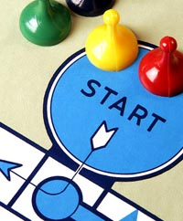
Baseline Data
Baseline data provides information about the students’ current performance at the start of course/class/focus of goal.
Generally the most recent data available; can include the prior year’s assessment scores or grades, results from a beginning of the year benchmark assessment, a pre-test, or other evidence of students’ learning.
Use baseline data to determine students’ strengths and areas of weaknesses, which then inform the goal.
Notes:
Bridget

Slide 18
Baseline Data
Common Questions/Conversations:
  Intact group
    Pre- and post-test data needed
    If a student leaves/un-enrolls from class/course, they’re not part of intact group
    If a student comes after pre-test given, not part of your intact group *
    District attendance agreement: student must be present 80% of time to be considered part of intact group
  Students have no background data or have zeroes for baseline
    Establish trend data
Notes:
Bridget
* At the Elm if the student is there from the first quarter … they are intact ..

Slide 19
BOY Form: Write Your SLG
A rigorous yet realistic goal for student growth that is developmentally appropriate. The goal should be rigorous yet attainable. The goal can be tiered for specific students in the class/course to allow all students to demonstrate growth.
FYI: You can include a definition of minimum instruction (attendance) requirement:
Student must attend at least 80% of the time
Notes:
ERIN

Slide 20

Rigor – The Outer Stretch of Realistic
Rigor – six criteria that best practice looks at
  Getting students to a higher level of cognition
  Releasing responsibility of learning to the student
  Tiers (as appropriate)
  Supported individual needs with strategies
  Rationale to help decrease gap
  Help students progress through standards
What is challenging AND realistic?
Why?
  Key component of SMART goal
  State expectation
Notes:
Erin

Slide 21
Tiering
  Tiered targets within a SLG
    If baseline data analysis shows wide range of skill/ability
    Different targets for different groups of students -- but still must include all students!!
  Targeted SLG
    Subgroups of students or specific skills -- ok as long as all students are covered between two goals
Notes:
Bridget
Write a goal where you will impact the most students -
note specialist goals can focus on multiple grades- and be based on an instructional focus..ie developing fluency
Example for secondary – if have multiple preps, you pick the preps you have in common: if I have 2 geometry, 1 algebra, 1 advanced algebra, and 1 pre-calculus, I will choose geometry and include all those students between my two goals. If the classes are a trimester long, I write them for a trimester – if they are semester-long, I write the goal for a semester – if they are year-long, I write them for a year

Slide 22
Tiering Example
Baseline Score Range | Target Score on End-Of –Year Portfolio
20-30 | 70
31-50 | 80
51-70 | 90
71-85 | 90 & score of 85+ on capstone project
86-95 | 95 & score of 85+ on capstone project
Notes:
Bridget

Slide 23
Possible score 1-6 Student | Audience & Purpose | Idea Development
Student 3 | 1 | 1
Student 8 | 1 | 1
Student 13 | 1 | 1
Student 17 | 1 | 1
Student 1 | 2 | 2
Student 4 | 2 | 2
Student 7 | 2 | 1
Student 10 | 2 | 2
Student 16 | 2 | 2
Student 20 | 2 | 1
Student 2 | 3 | 3
Student 5 | 3 | 2
Student 6 | 3 | 2
Student 9 | 3 | 3
Student 11 | 3 | 2
Student 12 | 3 | 3
Student 14 | 3 | 3
Student 15 | 3 | 2
Student 18 | 3 | 3
Student 19 | 3 | 3
Notes:
Bridget:
Spreadsheet so you can sort by columns
Erin FYI: In secondary gradebook, there is an export to Excel feature.
‹#›

Slide 24
Tier-ing - Scatterplot
We have a pre-assessment with 20 multiple choice questions, each worth 5 pts.
SLD
ELD
SLD
Attendance/ EBD
TAG
0
ELD
SLD
100
Lowest possible score
Highest possible score
ELD
Notes:
Bridget
Any clusters?
How many tiers do we see?
Quartiles? Quintiles?
Start adding context
Highlight anything that matters for learning needs (ELD, SpEd, attendance, behavior, TAG, etc.)
Connect these to strategies and/or rationale

Slide 25
More Considerations With Tiers
Additional info could make baseline even more useful:
  Other relevant baseline data
    Same/similar subject
      Other baseline assessments you’ve done
      Teacher reports
      IEP’s PLAAFPs
    Other content areas
      Reading/writing
      Math
Notes:
Bridget

Slide 26
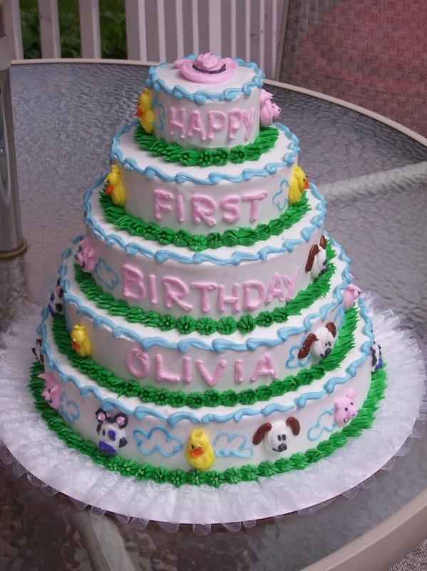
More Considerations With Tiers
Additional info could make baseline even more useful:
  Individual historic data
    How have they done from year to year in…
    Same/similar subjects?
    Other content areas?
      Reading/writing
      Math
    Did they meet typical growth?
      If not, how much did they grow?
    Did they meet grade level proficiencies (what was their grade in same/similar subject)?
SLG
Notes:
Bridget

Slide 27
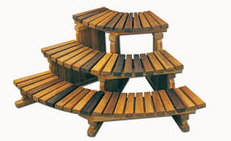
More Considerations With Tiers
Additional info could make baseline even more useful:
  Class historic data
    How far did students go in years past?
      Similarities (to this year)?
      Differences?
  Establish trend data
    When are goals due?
    How many times could you progress monitor prior to that to establish growth trend?
Notes:
Bridget

Slide 28
Tip: Progress Monitor
You are more likely to hit your goals if you progress monitor (e.g. monthly data check ins)
Could be quick formatives
This info could also be used at Mid Year conference with your supervisor as evidence of progress toward goals
Pick tools to progress monitor and calendarize -- then it’s more likely to happen
Notes:
Erin

Slide 29
Tip: Progress Monitor
Possible score 1-6 Student | Idea Development Pre 9/11/15 | 9/25/15 | 10/9/15 | 10/23/15
Student 3 | 1 | 1 | 1 | 1.5
Student 7 | 1 | 1 | 1.5 | 1.5
Student 8 | 1 | 1 | 1 | 1.5
Student 13 | 1 | 1 | 1 | 1.5
Student 17 | 1 | 1 | 1 | 1.5
Student 20 | 1 | 1 | 2 | 2.5
Student 1 | 2 | 1 | 2 | 2
Student 4 | 2 | 2 | 2 | 2.5
Student 5 | 2 | 2 | 2.5 | 2.5
Student 6 | 2 | 2 | 2.5 | 2.5
Student 10 | 2 | 2 | 2 | 2.5
Student 11 | 2 | 2 | 3 | 2.5
Student 15 | 2 | 2 | 2 | 2
Student 16 | 2 | 2 | 2 | 2
Student 2 | 3 | 3 | 3 | 3
Student 9 | 3 | 2 | 3 | 3
Student 12 | 3 | 3 | 3 | 3.5
Student 14 | 3 | 3 | 3.5 | 3.5
Student 18 | 3 | 2 | 3 | 3
Student 19 | 3 | 4 | 3 | 3.5
Student Learning and Growth Goals
Notes:
Erin

Slide 30
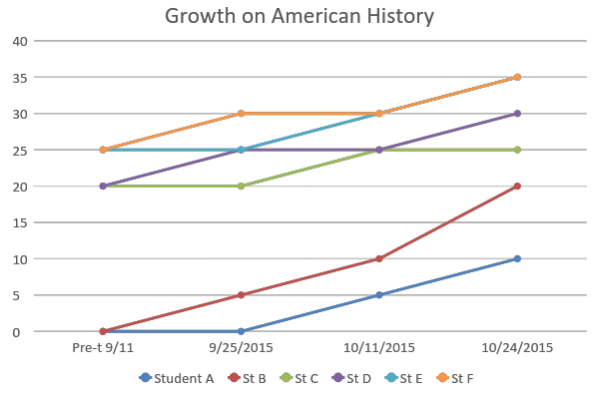
Tip: Progress Monitor
When are the approximate times where it would make sense to progress monitor? Calendarize it.
Notes:
Erin

Slide 31
Growth Goals vs. Achievement Goals
Growth for All Students
Starts with baseline data
Includes all students regardless of ability level
Students can show various levels of growth- students may have individualized finish lines
Does not have to consider baseline data
Does not have to include all students
Student goals are a “one-size-fit-all”
All students are expected to cross the same finish line regardless of where they start
Notes:
Bridget

Slide 32
Achievement vs. Growth
Scores will improve from 65% of students meeting benchmark to 80%
Students in Group A will improve 15 points; Students in Group B will improve 12 points & Students in Group C will improve 8 points
All students will improve 2 levels on the rubric
ACHIEVEMENT…
Why?
GROWTH…
Why?
GROWTH…
Why?
Growth for All Students
Notes:
Bridget

Slide 33
Growth for All Students
Acceptable SLGs | Unacceptable SLGs
From Sept to January, all of my students will progress at least one fitness level as measured by the FitnessGram during the fall semester. | 80% of students will pass the end-of-course exam.
From Oct to January, all students will meet their target score as measured by the American Government pre-/post-assessment: | Students scoring 80 or lower on the pre-assessment will increase their scores by at least 10 points. Any students scoring 81 or higher on the pre-assessment will maintain their scores.
Baseline Score Range | Target Score on End-Of –Year Portfolio
20-30 | 70
31-50 | 80
51-70 | 90
71-85 | 90 & score of 85+ on capstone project
86-95 | 95 & score of 85+ on capstone project
Notes:
Bridget

Slide 34
Growth for All Students
Acceptable SLGs | Unacceptable SLGs
From Sept to January, all of my students will progress at least one fitness level as measured by the FitnessGram during the fall semester. | 80% of students will pass the end-of-course exam. Does not show growth Timeframe is partially unclear
From Oct to January, all students will meet their target score as measured by the American Government pre-/post-assessment: | Students scoring 80 or lower on the pre-assessment will increase their scores by at least 10 points. Any students scoring 81 or higher on the pre-assessment will maintain their scores. Students scoring at 50 need to make greater gains Growth is non-existent for students at 81+, who may also need to be challenged with higher goal and/or additional assessment to illustrate growth No mention of post-assessment No specific time frame
Baseline Score Range | Target Score on End-Of –Year Portfolio
20-30 | 70
31-50 | 80
51-70 | 90
71-85 | 90 & score of 85+ on capstone project
86-95 | 95 & score of 85+ on capstone project
Notes:
Bridget

Slide 35
Growth for All Students
Acceptable SLGs | Unacceptable SLGs
By June ‘15, 15 of 25 students will meet their growth target and the remaining 10 will show growth within -5 scale score of their target as measured by the STAR Reading Assessment. | Given the STAR Reading Assessment at __ grade, 85% of students will achieve a score of ___ or above.
By Spring ’15, all English Language Learners scoring a 1-2 on the ELPA will increase one level or more as measured by the ELPA assessment (other students are in my second goal). | At least 18 of 21 students achieve a score of 6 or higher on the Music Mastery Rubric
From Fall ‘15 to Spring ’16, all students at __ level will improve their reading fluency by 30 wpm, students at __ level improve by 35 wpm, and Sts at __ will improve by 40wpm, as measured by an ORF assessment. | At least 17 of 20 students achieve a score of 3 or higher on the AP Chemistry exam.
Student Learning and Growth Goals
Notes:
Bridget

Slide 36
BOY Form: Write Your SLG
A rigorous yet realistic goal for student growth that is developmentally appropriate. The goal should be rigorous yet attainable. The goal can be tiered for specific students in the class/course to allow all students to demonstrate growth.
FYI: You can include a definition of minimum instruction (attendance) requirement: Student must attend at least 80% of the time
Notes:
Erin

Slide 37
BOY Form: Types of Measures
Assessments are measures of student learning aligned to state or national standards
What are the categories?
  Category 1 – Smarter Balanced, Extended
  Category 2 – Meet state criteria & at least school-wide at grade/content-level
Common Questions/Conversations:
  Mandatory category – NONE!
  District/school assessments in small districts/small departments
    Singletons/ only person = “school-wide”
Notes:
Erin

Slide 38
Types of Measures
Measures of student learning and growth include two categories of measures:
Category | Types of Measures | Guidance
1 | Oregon’s state assessments SMARTER Balanced (formerly OAKS) Extended Assessments | Same assessment and administration guidelines are used statewide
2 | Commercially developed assessments that include pre- and post-measures Locally developed assessments that include pre- and post-measures Results from proficiency-based assessment systems Locally-developed collections of evidence, i.e. portfolios of student work that include multiple types of performance | Same assessment and administration guidelines are used district-wide or school-wide Assessments meet state criteria
Notes:
Erin

Slide 39
Types of Measures cont.
  2016-17:
  All Teachers: Your two goals can both be based on measures from Category 2
  The statewide summative assessment does NOT have to be used (optional)
  Whatever assessment you use, assessments need to be standards-based (meet state criteria)
  Descriptive rubrics would need to accompany assessment data and also need to be aligned with standards
  Assessments should also be comparable across classrooms as this supports validity -- at least school wide at grade/content
Notes:
Erin
POINTS TO MAKE:
-OAKS not required
[next slide]

Slide 40
BOY Form: Reasons
(Rationale)
Detailed description of the reasons for selecting this specific area
Discussion of baseline data
Discussion of current practice within school and/or classroom
Common Questions/Conversations:
  Connected to collaborative finalization conversation
  Connected to checklist
  Connected to scoring rubric
Notes:
Bridget

Slide 41
Reasons Example
I chose this goal because our school improvement goal is around reading and my PLC is focused on reading this year. The DRA2 was administered during the first two weeks of school. 32 out of the 58 students are currently reading below grade level. Of those students not yet reading on grade level, many of them are close and this data makes me confident that with strategic interventions this gap can close dramatically by the end of the year.
Notes:
Bridget

Slide 42
BOY Form: Strategies for Goal Attainment
Relevant instructional strategies used to help accomplish goal
Heads-up: Once goals are submitted, you can’t change the goals, but you can adjust the strategies as needed.
See next slide for strategy considerations
Notes:
Erin

Slide 43
Strategies for Goal Attainment
Consider:
What strategies will release learning to the student?
What strategies will help students get to higher levels of cognition?
What strategies have the biggest impact?
What strategies are my colleagues trying?
What could I do the same/differently from my last goal?
What do I need from my evaluator to support this goal?
What do I need in my own professional growth to support this goal?
Are there any systemic pieces needed to support this goal (e.g., assessments, collaborative time, etc.)?
What could I do the same/differently from my last goal?
Notes:
Erin

Slide 44
At Beginning of the Year Conference
With Your Supervisor
You will work with your administrator to:
  Collaboratively finalize your goal in TeachBoost
  Handout: Use the ODE Quality SLG checklist
  Handout: Review the ODE SLG Scoring Rubric
Handout: Topics/questions to address during conference. Includes questions that should not be asked.
Notes:
Bridget

Slide 45
SLG Resources
Handouts provided today (embedded in slides)
Goal banks and SLG support:
  OEA's Center for Great Public Schools Student Learning and Growth Goal bank
  ODE’s Educator Effectiveness Toolkit
Notes:
Erin

Slide 46
SLG Evaluation Cycle
I SLGG Development Process
Essential Parts of SLGG Process
Collaborative Questions
V Summative Conference: Discussion of impact on practice and summative rating/professional growth
II SLGG Initial Collaborative Goal Meeting
III
SLGG Mid-Course Review
IV Summative Conference:
Final review of SLGG & Scoring
Notes:
Erin

Slide 47
Other Part of BOY Form
Professional Goals (PPG, PRG)
Use rubric reflection(s) to inform goals
Overlapping endeavors may help with time, energy...but it’s not mandatory!
Resources
  Drafting handout
  In TeachBoost Library
    Rubric(s)
    Artifact examples
    PPG and PRG Examples
Notes:
Erin

Slide 48
Right Now
Work time!
Start/continue drafting BOY form -- on paper or directly in TeachBoost (if needed, watch screencast for how to create BOY form in TeachBoost -- sent out in all staff email).
Ask one of us and/or colleagues for help if needed
Notes:
Bridget

Slide 49
Thank You!!
Reminder: BOY form completed in TeachBoost and conference with supervisor due by October 30th.
Reminder: Once goals are submitted, you can’t change the goals, but you can adjust the strategies as needed.
Notes:
Erin and Bridget

