Slide 1
Benchmark 5
America Since WWII

Slide 2
1. President Eisenhower described which situation as a row of dominoes that fall one after another once the first domino falls?
Labor union strikes in the railroad industry
Senate investigations of communist activities in the U.S.
Political instability in Southeast Asia
Soviet Union support of Central American countries

Slide 3
1. President Eisenhower described which situation as a row of dominoes that fall one after another once the first domino falls?
Labor union strikes in the railroad industry
Senate investigations of communist activities in the U.S.
Political instability in Southeast Asia
Soviet Union support of Central American countries

Slide 4
2. Why do some historians credit rock and roll music with helping to break down racial barriers?
Lyrics from Southern rock and roll bands informed northern listeners of the problems created by segregation.
Civil rights activists used rock and roll music to attract white teenagers to their rallies.
Rock and roll music developed out of black and white musical traditions, so it appealed to both races.
Rock and roll bands in the early 1950s found it easier to get recording contracts if they were racially mixed.

Slide 5
2. Why do some historians credit rock and roll music with helping to break down racial barriers?
Lyrics from Southern rock and roll bands informed northern listeners of the problems created by segregation.
Civil rights activists used rock and roll music to attract white teenagers to their rallies.
Rock and roll music developed out of black and white musical traditions, so it appealed to both races.
Rock and roll bands in the early 1950s found it easier to get recording contracts if they were racially mixed.

Slide 6
3. How did the Cuban missile crisis affect U.S.-Soviet relations?
It led to improved communication between the two countries.
It prompted each country to increase its nuclear weapon testing.
It persuaded President Kennedy and Premier Khrushchev to begin strategic arms limitations talks.
It resulted in the countries expelling each other’s ambassadors and closing their embassies.

Slide 7
3. How did the Cuban missile crisis affect U.S.-Soviet relations?
It led to improved communication between the two countries.
It prompted each country to increase its nuclear weapon testing.
It persuaded President Kennedy and Premier Khrushchev to begin strategic arms limitations talks.
It resulted in the countries expelling each other’s ambassadors and closing their embassies.

Slide 8
4. Martin Luther King Jr. encouraged those involved in the struggle for civil rights to employ tactics modeled on the example of which leader?
Mohandas Gandhi
Frederick Douglass
John Lennon
Abraham Lincoln

Slide 9
4. Martin Luther King Jr. encouraged those involved in the struggle for civil rights to employ tactics modeled on the example of which leader?
Mohandas Gandhi
Frederick Douglass
John Lennon
Abraham Lincoln

Slide 10
5. César Chávez is best known for his leadership on which civil rights issue?
Education
Gender
Labor
Religion

Slide 11
5. César Chávez is best known for his leadership on which civil rights issue?
Education
Gender
Labor
Religion

Slide 12
6. Which presidential action best illustrates the policy of détente?
Lyndon Johnson’s halt of the bombing in Vietnam
Kennedy’s diffusing of the Cuban Missile Crisis
Nixon’s visit to the People’s Republic of China
Carter’s support of the Sandinistas in Nicaragua

Slide 13
6. Which presidential action best illustrates the policy of détente?
Lyndon Johnson’s halt of the bombing in Vietnam
Kennedy’s diffusing of the Cuban Missile Crisis
Nixon’s visit to the People’s Republic of China
Carter’s support of the Sandinistas in Nicaragua

Slide 14
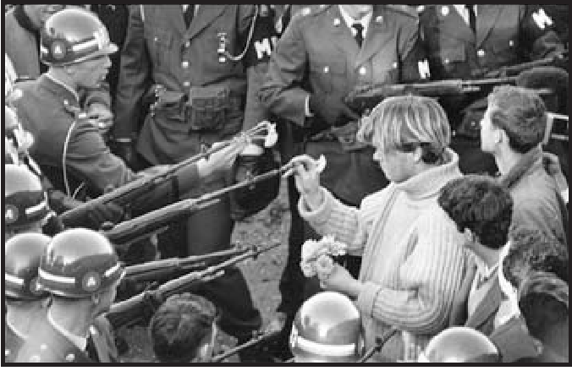
7. This photo of a young man inserting a flower into the barrel of a rifle was taken outside the Pentagon in October 1967.
What is the main reason this photo, entitled “Flower Power”, is widely considered to be an iconic image of the period?
It exemplifies the historical transition from conservative to liberal political values.
It expresses youth’s strong rejection of the militant practices of the older generation.
It represents the dominant influence of democratic action against totalitarian tactics.
It symbolized the tension between nonviolent civil disobedience and the threat of force.

Slide 15
7. This photo of a young man inserting a flower into the barrel of a rifle was taken outside the Pentagon in October 1967.
What is the main reason this photo, entitled “Flower Power”, is widely considered to be an iconic image of the period?
It exemplifies the historical transition from conservative to liberal political values.
It expresses youth’s strong rejection of the militant practices of the older generation.
It represents the dominant influence of democratic action against totalitarian tactics.
It symbolized the tension between nonviolent civil disobedience and the threat of force.

Slide 16
8. Which situation resulted in President Carter asking Americans to undertake “the moral equivalent of war” to help the country develop renewable energy sources?
Acid rain was poisoning rivers and threatening the health of all citizens.
Domestic oil companies were producing less, so more oil was being purchased overseas.
A natural gas company illegally dumped toxic materials near a residential neighborhood.
Safety equipment failed at a nuclear power plan and radiation was released outside the plant.

Slide 17
8. Which situation resulted in President Carter asking Americans to undertake “the moral equivalent of war” to help the country develop renewable energy sources?
Acid rain was poisoning rivers and threatening the health of all citizens.
Domestic oil companies were producing less, so more oil was being purchased overseas.
A natural gas company illegally dumped toxic materials near a residential neighborhood.
Safety equipment failed at a nuclear power plan and radiation was released outside the plant.

Slide 18
9. Despite gaining strong initial support and eventual approval by 35 states, the Equal Rights Amendment (ERA) failed to pass. Which statement about the defeat of the ERA is most accurate?
Social conservatives affiliated with several Christian denominations led opposition to the ERA and emerged as a powerful political force.
The failure of the ERA resulted from a widespread perception among most feminists that abortion is acceptable.
Bitter partisan disputes about women serving in the military in combat situations made compromise on the ERA impossible.
Large and powerful labor unions strongly opposed the ERA because they feared the loss of high-paying jobs to women.

Slide 19
9. Despite gaining strong initial support and eventual approval by 35 states, the Equal Rights Amendment (ERA) failed to pass. Which statement about the defeat of the ERA is most accurate?
Social conservatives affiliated with several Christian denominations led opposition to the ERA and emerged as a powerful political force.
The failure of the ERA resulted from a widespread perception among most feminists that abortion is acceptable.
Bitter partisan disputes about women serving in the military in combat situations made compromise on the ERA impossible.
Large and powerful labor unions strongly opposed the ERA because they feared the loss of high-paying jobs to women.

Slide 20
10. Which factor was most significant in President Carter’s 1980 election loss to Ronald Reagan?
Liberal Democrats were disappointed in President Carter’s failure to maintain the Great Society programs.
The incident at the Three Mile Island nuclear plant cause widespread public disapproval of President Carter.
Americans lost respect for President Carter because his leadership style was too passive.
Rising unemployment and President Carter’s failure to resolve the lengthy hostage crisis in Iran undermined public confidence.

Slide 21
10. Which factor was most significant in President Carter’s 1980 election loss to Ronald Reagan?
Liberal Democrats were disappointed in President Carter’s failure to maintain the Great Society programs.
The incident at the Three Mile Island nuclear plant cause widespread public disapproval of President Carter.
Americans lost respect for President Carter because his leadership style was too passive.
Rising unemployment and President Carter’s failure to resolve the lengthy hostage crisis in Iran undermined public confidence.

Slide 22
11. Which statement is most consistent with the foreign policy position of President Reagan?
The central mission of U.S. efforts abroad should be increasing humanitarian aid and technical assistance to developing countries.
The Revolution Sandanista will restore the peoples’ political power and provide a more equitable economic system.
The path to peace lies in America’s strength and willingness to assist anticommunist forces throughout the world.
The U.S. should focus its efforts on domestic matters and not intervene in the affairs of other nations.

Slide 23
11. Which statement is most consistent with the foreign policy position of President Reagan?
The central mission of U.S. efforts abroad should be increasing humanitarian aid and technical assistance to developing countries.
The Revolution Sandanista will restore the peoples’ political power and provide a more equitable economic system.
The path to peace lies in America’s strength and willingness to assist anticommunist forces throughout the world.
The U.S. should focus its efforts on domestic matters and not intervene in the affairs of other nations.

Slide 24
12. Which summary of the impact of new technologies on the American workplace is most accurate?
Information technologies have created a limited number of new jobs because the nature of the work is so sophisticated.
Innovative high-tech companies have avoided antitrust lawsuits because their technologies are vital to national security.
Cyber-technology has actually lengthened the workweek rather than shortening it.
Federal intervention is necessary to prohibit the outsourcing of information technology jobs.

Slide 25
12. Which summary of the impact of new technologies on the American workplace is most accurate?
Information technologies have created a limited number of new jobs because the nature of the work is so sophisticated.
Innovative high-tech companies have avoided antitrust lawsuits because their technologies are vital to national security.
Cyber-technology has actually lengthened the workweek rather than shortening it.
Federal intervention is necessary to prohibit the outsourcing of information technology jobs.

Slide 26
13. Why was there strong opposition in the United States to the North American Free Trade Agreement and the General Agreement on Tariffs and Trade?
The agreements ignored the human rights violations of the People’s Republic of China and the countries of the former Soviet Union bloc.
The agreements failed to address the issue of child labor and the problem of child slavery in the treaty nations.
The agreements created the potential for job losses, cuts in wages, and environmental issues.
The agreements failed to anticipate immigration problems and their impact on the social services system.

Slide 27
13. Why was there strong opposition in the United States to the North American Free Trade Agreement and the General Agreement on Tariffs and Trade?
The agreements ignored the human rights violations of the People’s Republic of China and the countries of the former Soviet Union bloc.
The agreements failed to address the issue of child labor and the problem of child slavery in the treaty nations.
The agreements created the potential for job losses, cuts in wages, and environmental issues.
The agreements failed to anticipate immigration problems and their impact on the social services system.

Slide 28
14. Which modern-day development has had an impact most similar to that of nineteenth-century Industrial Revolution?
The immigration of Mexican workers
The development of information technology
The expansion of the service sector of the economy
The growth of evangelical political influence

Slide 29
14. Which modern-day development has had an impact most similar to that of nineteenth-century Industrial Revolution?
The immigration of Mexican workers
The development of information technology
The expansion of the service sector of the economy
The growth of evangelical political influence

Slide 30
15. The U.S. military invaded Afghanistan is 2001 to remove the Taliban government for its support of al Qaeda terrorists. Many Taliban members had been U.S. allies in the 1980s.
Why did the United States give aid and support to these individuals in the 1980s?
They exported large amounts of oil to the U.S.
They were attempting to establish democratic reforms.
They provided the U.S. with valuable military information about Iran.
They were fighting a Soviet invasion of their country.

Slide 31
15. The U.S. military invaded Afghanistan is 2001 to remove the Taliban government for its support of al Qaeda terrorists. Many Taliban members had been U.S. allies in the 1980s.
Why did the United States give aid and support to these individuals in the 1980s?
They exported large amounts of oil to the U.S.
They were attempting to establish democratic reforms.
They provided the U.S. with valuable military information about Iran.
They were fighting a Soviet invasion of their country.

Slide 32
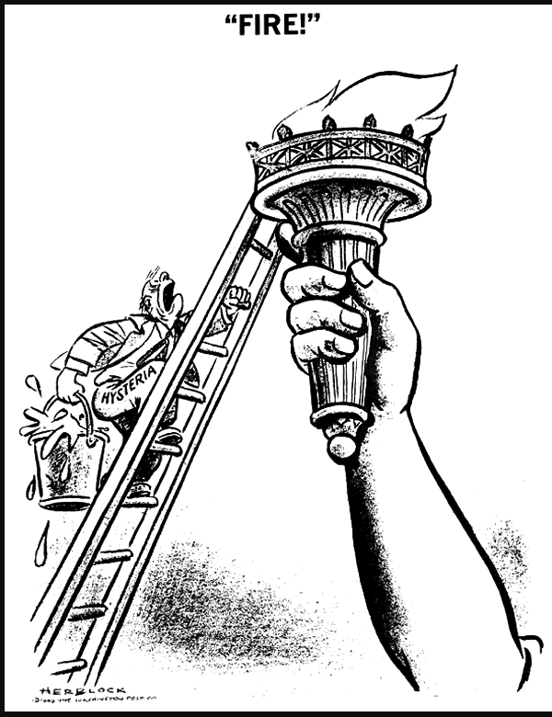
16. Examine this 1949 cartoon. What subsequent development could have inspired the same cartoon?
The impeachment of President Clinton
The passage of the Patriot Act
The acceleration of global warming
The prolonged war in Iraq

Slide 33
16. Examine this 1949 cartoon. What subsequent development could have inspired the same cartoon?
The impeachment of President Clinton
The passage of the Patriot Act
The acceleration of global warming
The prolonged war in Iraq

Slide 34
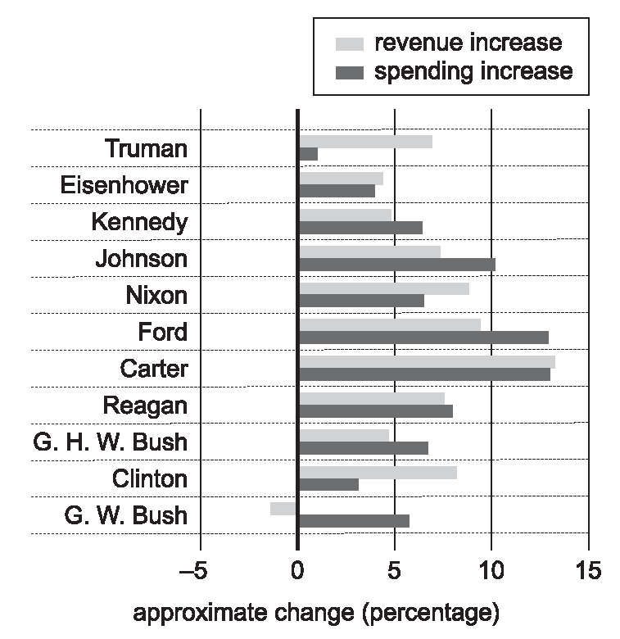
17. This chart depicts federal government revenue intake and spending during the administrations of Presidents Harry Truman through George W. Bush.
Based on this chart, which administration was responsible for the most significant record of deficit spending?
John Kennedy
Lyndon Johnson
George H.W. Bush
George W. Bush

Slide 35
17. This chart depicts federal government revenue intake and spending during the administrations of Presidents Harry Truman through George W. Bush.
Based on this chart, which administration was responsible for the most significant record of deficit spending?
John Kennedy
Lyndon Johnson
George H.W. Bush
George W. Bush

Slide 36
18. Which term best describes the economic philosophy of President George W. Bush?
Centralization
Decentralization
Deregulation
Laissez-faire

Slide 37
18. Which term best describes the economic philosophy of President George W. Bush?
Centralization
Decentralization
Deregulation
Laissez-faire

