Slide 1
The Middle Ages

Slide 2
Middle Ages Art
Art during the Middle Ages saw many changes and the emergence of the early Renaissance period. Byzantine Art was the name given to the style of art used in very early Middle Ages Art. This period was also known as the Dark Ages ( 410 AD - 1066 AD ). The Dark Ages were followed by the Medieval era of the Middle Ages (1066 - 1485)

Slide 3
Notes:Middle Ages Art - Byzantine Art
Pietistic painting (religious art)
Artists were members of religious houses such as monasteries
There were no sculptures as these were looked upon as a form of idolatry
Sombre tones
Byzantine Art was totally flat - one dimensional. There was no perspective
There were no shadows
Figures in Byzantine Art were generally depicted front-facing
Byzantine Art featured long, narrow and solemn faces
There was no attempt to portray realism in sombre Byzantine Art

Slide 4
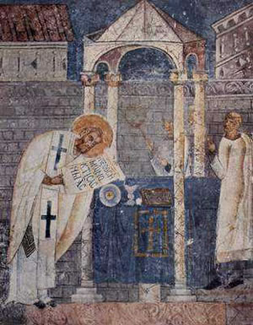

Slide 5
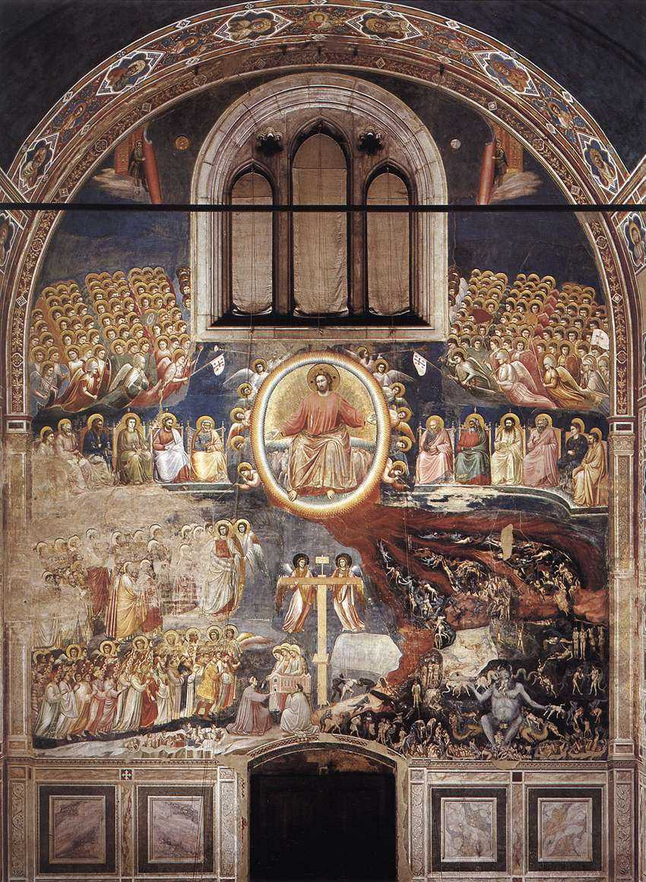

Slide 6
Medieval Gothic Art - Advances of Art in the Middle Ages
Brighter colors
Sculptures
Metal work in the form of bronze art
Middle Ages art in the form of stained glass windows
Move towards realism
The development of perspective and proportion in Middle Ages art
The use of shadows and light
New ideals of naturalism
Creation of a sense of pictorial space
The use of symmetry in Middle Ages art
Changes in subject matter including the depiction of animals and mythological scenes

Slide 7
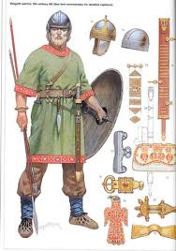
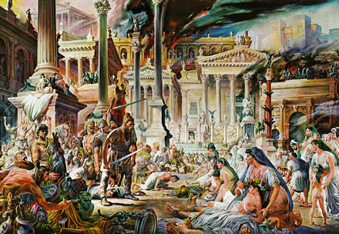
“Goth”

Slide 8
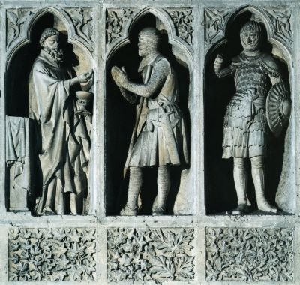

Slide 9
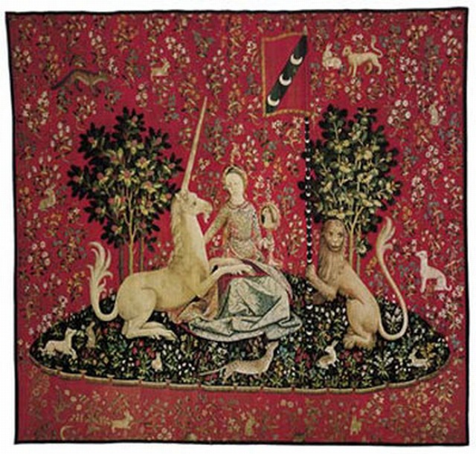

Slide 10
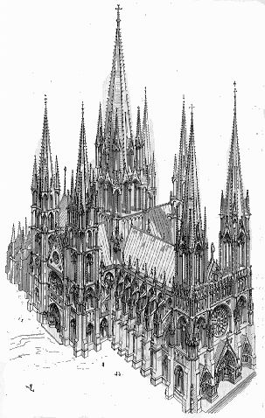

Slide 11
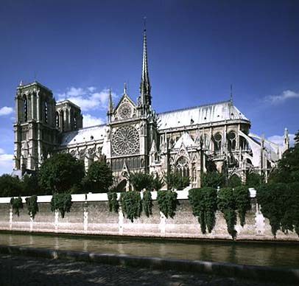

Slide 12
Middle Ages Art by Type
Middle Ages art increased from the type of art depicted in Pietistic painting (religious art) in the form of illuminated manuscripts, mosaics and fresco paintings in churches. Middle Ages art included the following art by type:
Ceramic art
Mosaic
Sculpture
Engraving
Stained Glass art
Heraldry
Illuminated manuscript
Metalwork especially bronze art
Silversmith and Goldsmith and new forms of jewelry
Painting
Fresco

Slide 13
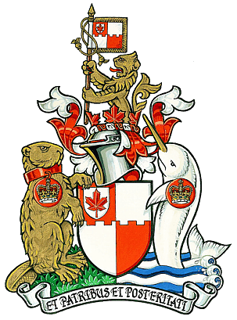
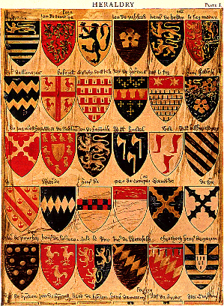
Heraldry

Slide 14
Medieval Music
In the eleventh and twelfth centuries Troubadours, Trouveres and Minstrels were the poets and musicians who influenced Medieval Music. The troubadours and minstrels sang songs of courtly love and romance. Noble ladies of the Medieval period were famous for their patronage of Medieval Music. Eleanor of Aquitaine married King Henry II of England in 1152 and brought her love of music and the troubadours to the English court transferring the tradition to England.

Slide 15
The Troubadours
The Troubadours were originally travelling musicians. The early Troubadours travelled from one village to the next and many also travelled abroad. The role of the Troubadours changed to part of an elite society of royalty and nobles. The themes of the songs sung by the Troubadours mainly dealt with Chivalry and Courtly love - romantic ballads. In Germany, the troubadours became Minnesingers, or singers of love songs. The German minnesingers differed from the troubadours in that they accompanied their songs on the viol.

Slide 16
The Trouveres
The Trouveres were troubadours of nobler birth with finer imagination, including kings and nobles. They were a school of poets who flourished in Northern France and Europe from the 11th to the 14th century.

