Slide 1
Chapter 13

Slide 2
Context
Medieval theatre came between Roman theatre and the Renaissance
Considered to be a “lower” period of theatre between two higher ones
Feudal system Life of the peasant
Christian Church hierarchy began to weaken

Slide 3
Early Medieval Drama and Theatre
What factors in the society pulled theatre toward its central position in the Middle Ages?
Plays of Hroswitha
Liturgical manual of Ethelwold

Slide 4
Hroswitha
Wrote 7 plays, the first in existence since the early days of Rome
Based on comedies of Terence
Intended to celebrate chaste maidens
She lived next to the Benedictines in what is now modern Germany
  First known female playwright
  First known as post-Roman playwright
  Intellectual community
Accomplishments often overshadowed

Slide 5
Ethelwood
Bishop of Winchester (also Benedictine)
Wrote Regularis Concordia- monastic guidebook, describing how liturgical services were to be performed
  Music
  Calendar
  Vestments
  Art
  Architecture
  Liturgy

Slide 6
Medieval Conventions
What were the major conventions of the Middle Ages? How did each reflect the culture of which it was a part?
  Simultaneous-several different locations were present
  Emblematic-costumes and properties were signs and symbols communicating meaning
  Environmental-performed in available space, rather than a structure built for acting

Slide 7
Other Dramatic Evolutions
Quem Quaeritis-liturgical dramas performed in the church as part of the liturgy
Latin music drama-plays that were chanted, sung and acted by clergy, choirboys, monks and other scholars
  Longer and varying complexity compared to Quem Quaeritis
  Biblical
Produced by the church
Costumes based on church vestments
At first monastic communities were the audience and then general audiences attended

Slide 8
Culture and Theatre
Commercial Theory c. 1200
  Merchants began to emerge from the feudal system; monopolies and profit-makers replaced the hierarchy of peasants and lords
  Reformation in the church because of erosion of faith matters

Slide 9
Religious Drama outside the Church
In addition to the Latin music drama, drama outside the church
Performed outdoors
Spoken
Vernacular was used
Laymen involvement
Far-ranging themes; not just liturgical sources
Corpus Christi plays performed in the spring and summer

Slide 10
Religious Plays
The plays that remained in the “religious” category
  Told of the events of Christ’ life and Old Testament stories; called mystery plays
  Lives of saints (historical or legendary); called miracle plays
  Didactic allegories (teaching metaphors); called morality plays

Slide 11
Shared Characteristics
Teach or reinforce belief in church doctrine
Formulated as melodramas or divine comedies-ethical system was clear-good rewarded and evil punished
Driving force of action was God and his plan rather than actions of dramatic agents (motivation); appears more episodic in nature
  Strength of sin, power and compassion of God, punishment of unrepentant sinners
Cycle plays or cosmic dramas-showed history and took days or weeks to perform (serialized)

Slide 12
Staging Religious Plays
Guilds and confraternities- helped to produce plays
All male members (in France women were sometimes permitted to perform)
No written history for 1400-1500 about acting
Conventions remained the same
  Fixed Staging- used throughout Europe
  Movable Staging-most often used in Spain and England

Slide 13
Fixed stages used mansions or scaffolds- see page 205 for arrangement
Movable stages were called pageants and used pageant wagons—much like a parade.
Spectacle became important to presentation
  Master of secrets—the men who oversaw the special effects
Special Effects: Flying, traps, fire
Costumes continued to be emblematic
Masks were rare, restricted to devils

Slide 14
Secular Drama
Outgrowth of religious drama or developed independently
Street pageants and entries-used during special occasions; part of processions
Roman plays-studying in schools and colleges
Farces-poked fun at domestic tribulations, infidelity
Morality plays-featured classic gods and heroes; fire for Reformation
Professionals emerged by the end of this period c. 1450
Theatre became something people paid other people to do.

Slide 15
What changes began to coalesce toward the end of the Middle Ages that seemed to pull theatre in a some what different direction?
What similarities can you find between the theatre of the Middle Ages and that of the ancient world? what major differences?

Slide 16
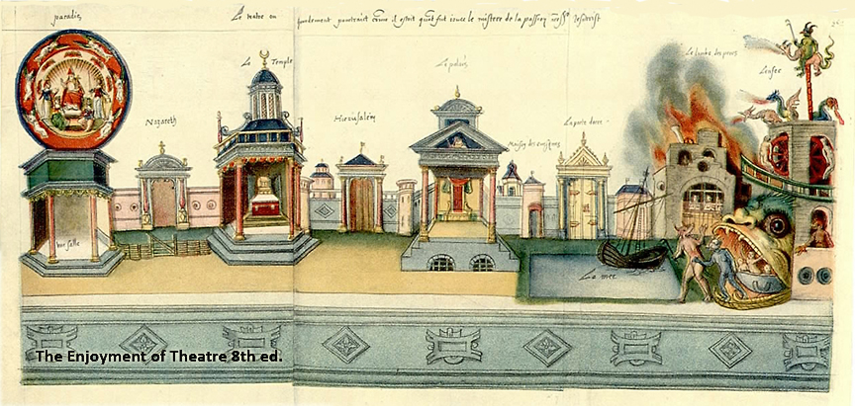
Describe this medieval stage. Why is this arrangement call simultaneous staging? Where is the platea?

Slide 17
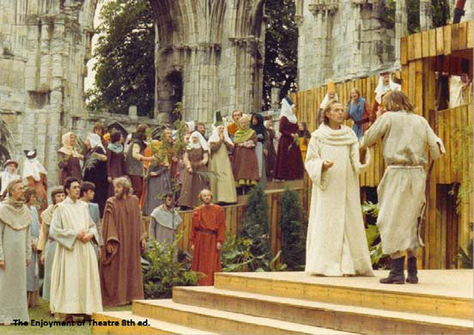
How is this arrangement different from the previous image?

Slide 18
1. Acting during the Middle Ages was mostly professional.
2. Toward the end of the Middle Ages, theatre moved in the direction of secularization and professionalism.
3. In medieval staging, widely separated places could be presented at the same time in full view of the audience.

Slide 19
4. Hroswitha is important in part because her plays demonstrate a link between Rome and medieval Europe.
5. Bishop Ethelwold is important in part because he regularized Benedictine liturgy and, in so doing, included the Quem Quaeritis.
6. Religious and civic theatre of the Middle Ages was usually staged outdoors.

