Slide 1
The Enlightenment Spreads
Chapter 22, Section 3

Slide 2
Baroque Music
Representative Composers
  Antonio Vivaldi
  Johann Sebastian Bach
  George Friedrich Handel

Slide 3
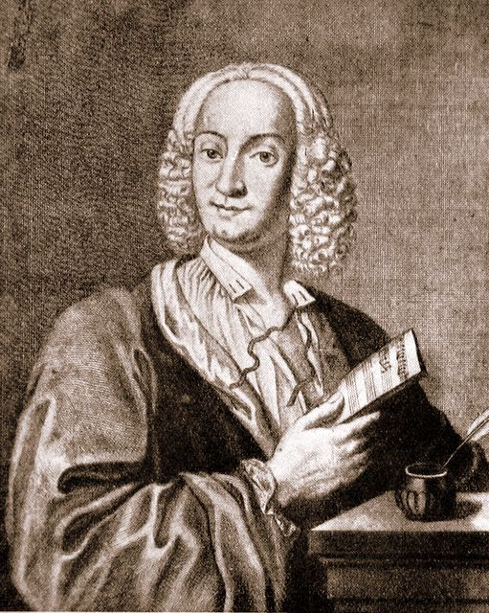
Antonio Vivaldi (1678-1741)
Representative Works
  Most famous work Le quattro stagioni (The Four Seasons) written in 1723.
  46 operas
  76 sonatas
  Chamber music
  Sacred music

Slide 4
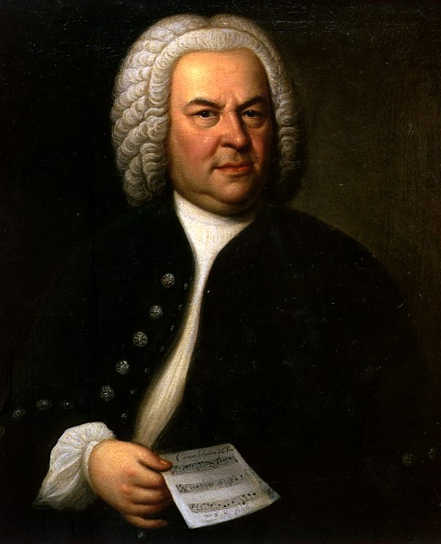
Johann Sebastian Bach (1685-1750)
Representative Works
  cantatas
  chorales
  organ works
  lute music
  chamber music
  canons and fugues
Famous piece: “Jesu Joy of Man’s Desiring”

Slide 5
Classical Music
Representative Composers
  Joseph Haydn
  Wolfgang Amadeus Mozart
  Ludwig van Beethoven

Slide 6
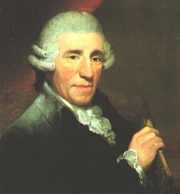
Joseph Haydn (1732-1809)
Known as “Father of the Symphony” and “Father of the String Quartet”
Representative Works
  104 Symphonies
  numerous concertos for various instruments
  15 operas
  other music

Slide 7
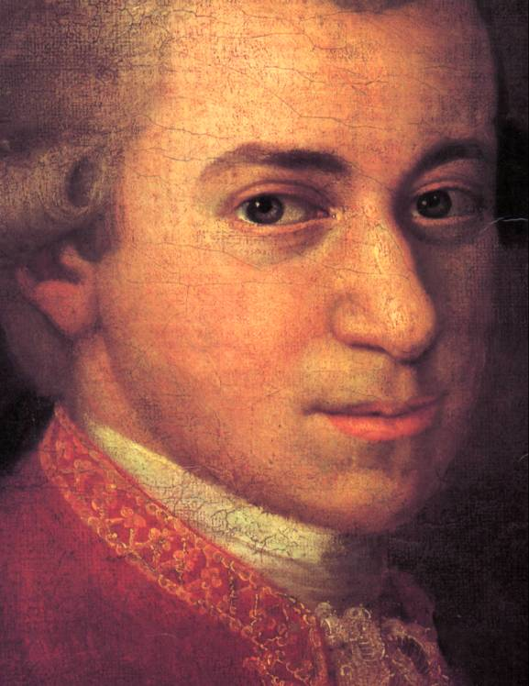
Wolfgang Amadeus Mozart (1756-1791)
Representative works
  23 operas
  numerous symphonies
    “Toy Symphony”
  concertos
    “Flute concerto no. 2 in D Major, K 314”
  piano music
  chamber music
  sacred music
    masses

Slide 8
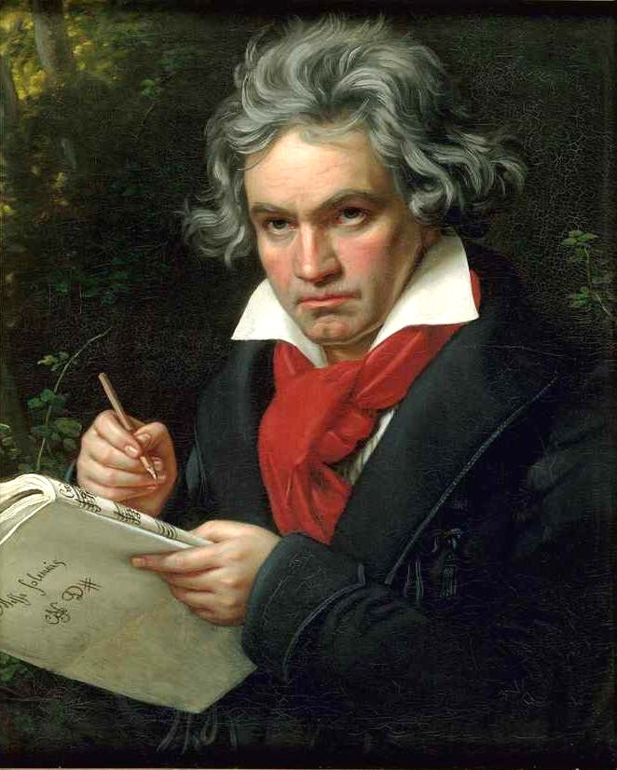
Ludwig van Beethoven
Representative Works
  Symphonies (5th and 9th probably the most famous)
  Piano music
    “Fur Elise”
  Vocal music
    Operas
    Choral music

Slide 9
Enlightened Despots
Frederick II (the Great) of Prussia
Joseph II of Austria
Catherine II (the Great) of Russia

Slide 10
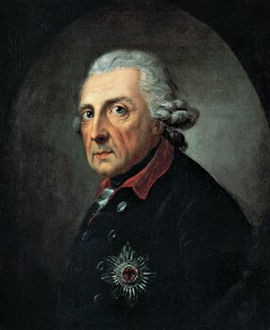
Frederick II (the Great) of Prussia
Ruled Prussia from 1740 to 1786; granted religious freedoms, reduced censorship, improved education

Slide 11
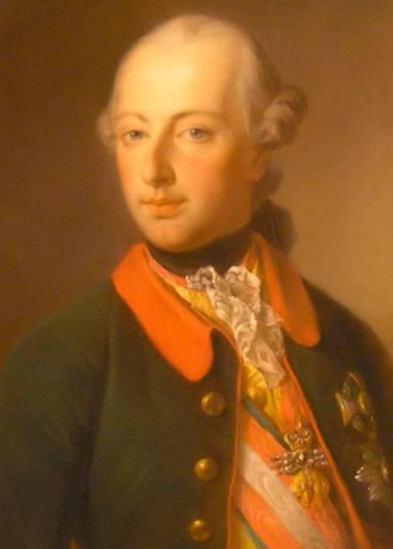
Joseph II of Austria
Religion
  Joseph II had the most progressive policy of religion toleration in all of Europe. He granted toleration toward Jews as well as Protestants. His anti-clerical and liberal innovations provoked a visit from the Pope Pius VI in 1782. Joseph showed himself a good Catholic, but was not persuaded to change his liberal positions on religion.
The Arts
  He was known as the “musical king.” He was a huge patron of composers. He is featured prominently in the movie Amadeus, the fictionalized biography of Mozart.

Slide 12
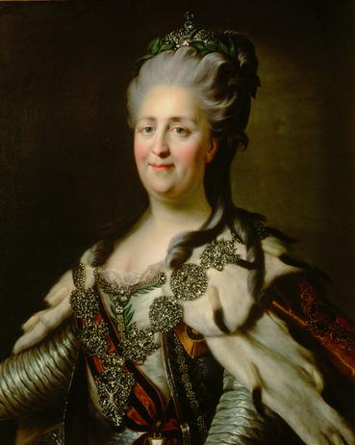
Catherine II (the Great) of Russia
Ruled Russia from 1762 to 1796; put in place limited reforms; vastly enlarged the Russian empire

Slide 13
Diderot’s Encyclopedia
Diderot began to publish a series of books in 1751 that were compilations of articles from leading scholars. Even though the French government and the Catholic Church censored the Encyclopedia, it was responsible for spreading Enlightenment ideas all over Europe.

Slide 14
Neoclassical Style
Neoclassical art began to replace baroque art during the late 1700s. Neoclassical art followed a simple and elegant style that drew on ideas from classical Greece and Rome.

Slide 15
Changes in music during the Enlightenment
Classical music, with a new, lighter style, emerged during the Enlightenment. Haydn, Mozart, and Beethoven were three classical composers from Austria.

Slide 16
Changes in literature during the Enlightenment
Eighteenth century writers began writing novels, lengthy works of prose fiction. Pamela, by Samuel Richardson, is often considered the first English novel.

Slide 17
Enlightened despots
Enlightened despots supported the ideas of the philosophes and made enlightenment reforms. Europe’s most important enlightened despots included Frederick II of Prussia, Joseph II of Austria, and Catherine the Great of Russia.

Slide 18
Frederick II
Ruled Prussia from 1740 to 1786; granted religious freedoms, reduced censorship, improved education

Slide 19
Catherine the Great
Ruled Russia from 1762 to 1796; put in place limited reforms; vastly enlarged the Russian empire

