Slide 1
Grade Reports
Feb. 2nd, 2015

Slide 2
SID.6: Line of Best Fit
Feb. 2nd, 2015

Slide 3

Example 1: The local ice cream shop keeps track of how much ice cream they sell versus the noon temperature on that day. Here are their figures for the last 12 days:
Temperature °C | Ice Cream Sales
14.2° | $215
16.4° | $325
11.9° | $185
15.2° | $332
18.5° | $406
22.1° | $522
19.4° | $412
25.1° | $614
23.4° | $544
18.1° | $421
22.6° | $445
17.2° | $408
  b) Describe the relationship in the context of the problem.
c) What function does the scatter plot resemble?

Slide 4
best represents
Line of Best Fit: the line that _____________________ the data.
How to create a line of best fit: try to have the line as close as possible to all the points and as many points above the line as below!
d) Draw the line of best fit for the above situation. What is the equation?

Slide 6
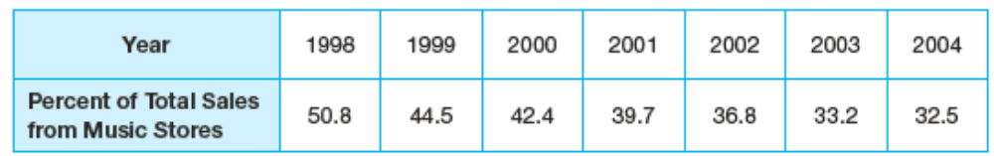
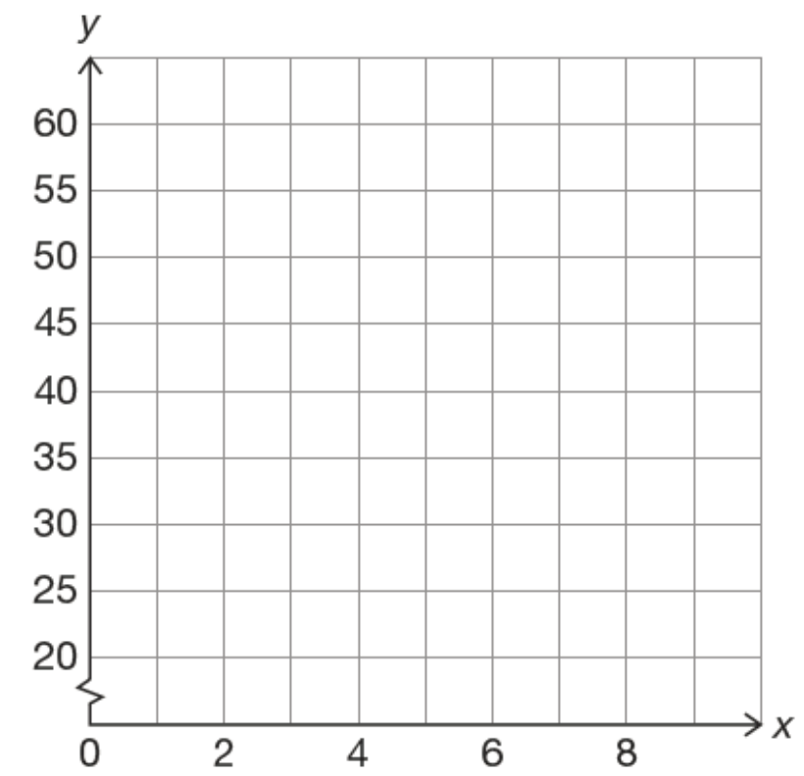
Example 2: Consider the table below displaying the percentage of recorded music
sales coming from music stores from 1998 to 2004.
Let’s create a scatter plot for this data,

Slide 7
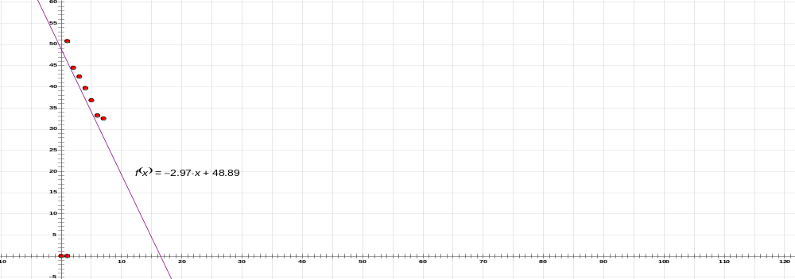
For our scatter plot in example 2, the linear function y = -2.97x + 48.89 represents the linear
function that best models our data. The graph below shows the scatter plot and function plotted
together.
What does this equation mean in context of this problem?
What is the slope of the line? What does it mean in the
context of the problem?
What is the y-intercept? What does it mean in the context
of the problem?
What percentage of total sales came from music stores
in 2008?

Slide 8
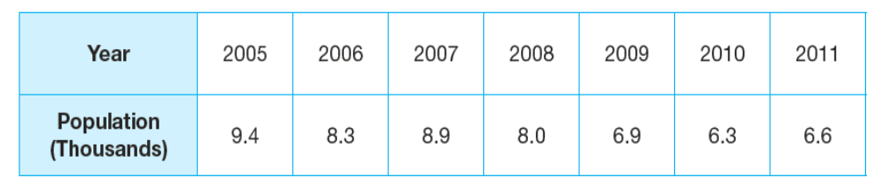

Example 3: The amount of antibiotic that remains in your body over a period of time varies from one
drug to the next. The table given shows the amount of Antibiotic X that remains in your body over a period of
two days.
a). Create a scatter plot for the data.
Create the line of best fit for the data using the instructions from example 1.
c) The exact line of best fit is
Use this function to determine the population in 2015.
d) What year will the population be below 3,000?

Slide 9
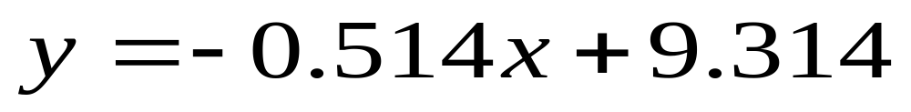
e) What does the number -0.514 represent? What does it mean in the context of the problem?
f) What does the number 9.314 represent? What does it mean in the context of the problem?

