Slide 1
Welcome to Math Night for Parents of 4th Grade Students
Many, Many, Many Multiplication Methods

Slide 2
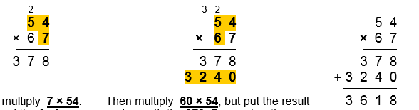
So many ways to multiply
This is how most of us learned to multiply:
7
15
Now, just add the bottom 2 rows of numbers, regrouping as needed.
Erase or cross off the numbers you carried.
12
9
6 x 5 = 30
6 x 4 = 24
13
30 + 2 = 32
1
8
Write a zero in the ones place.
7 x 4 = 28
Write the 8 in the ones place.
2
10
Write the 4 in the tens place.
3
11
Carry the 2 to the tens place.
Carry the 2 to the hundreds place.
4
5
7 x 5 = 35
35 + 2 = 37
14
Write 32 in the hundreds & thousands places.
6
Write 37 in the hundreds and tens place.

Slide 3
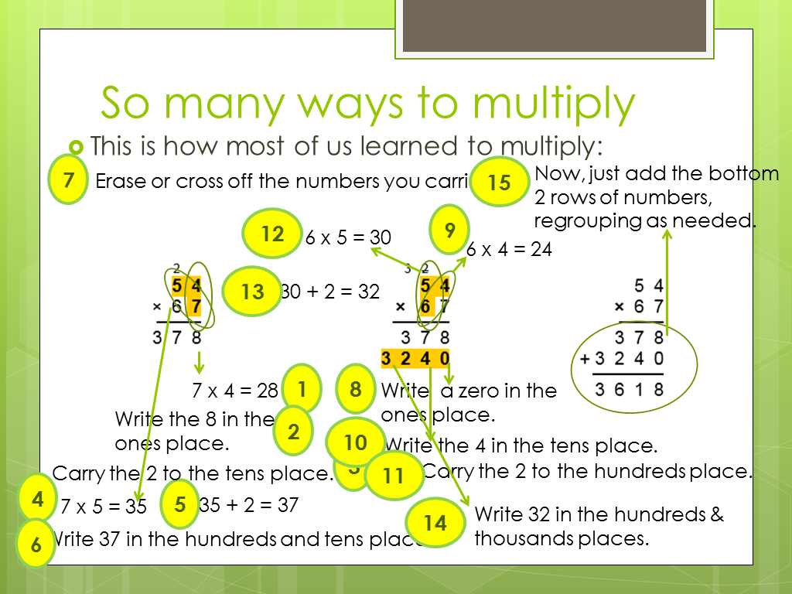
Traditional Algorithm
Your child will learn the traditional algorithm by the
end of 5th grade.

Slide 4
Vocabulary Review
factors
6 x 4 = 24
product
16 x 4 = 10 x 4 = 40
+ 6 x 4 = 24
partial products

Slide 5
So many ways to multiply
Use a Place Value Chart to Multiply by 10

Slide 6
Place Value Chart
Thousands | Hundreds | Tens | Ones
3
X 10
How does the value of a digit change as it moves from the ones place to the tens place?

Slide 7
Place Value Chart
Thousands | Hundreds | Tens | Ones
3
0
X 10
How does the value of a digit change as it moves from the ones place to the tens place?

Slide 8
Place Value Chart
Thousands | Hundreds | Tens | Ones
3
X 10
How does the value of a digit (number 0-9) change as it moves from the tens place to the hundreds place?

Slide 9
Place Value Chart
Thousands | Hundreds | Tens | Ones
3
0
0
X 10
X 10
Using a place value chart, we can multiply by 10, 100, etc.
How many equations can we write from this demonstration?
3 x 10 = 30 30 x 10 = 300 3 x 10 x 10 = 300 3 x 100 = 300

Slide 10
Place Value Chart
Thousands | Hundreds | Tens | Ones
We can also use the place value chart (and the Associative Property of Multiplication) to multiply by multiples of 10 (20, 30, 40, 50, 200, 300, 400, etc.).
For example, 3 x 40 =

Slide 11
Place Value Chart
Decompose 40 to a multiple of 10.
3 x 40 =
3 x 4 x 10 =
Solve 3 x 4.
3 x 4 x 10 =
Think of 12 on the place value chart.
12 x 10 =
To multiply by 10, slide over one place on the place value chart.
120
Thousands | Hundreds | Tens | Ones

Slide 12
So many ways to multiply
Use a Place Value Chart to Multiply by 10
Base Ten Blocks

Slide 13
Base Ten Blocks
1,000 100 10 1
block flat rod unit
or cube

Slide 14
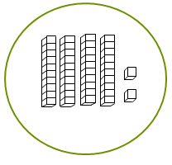
Base Ten Blocks
Concrete manipulatives can be used to physically show the multiplication problem.
For example: 3 groups of 42

Slide 15
Base Ten Blocks
Count how many are in the groups altogether.
Count the rods (10 units in each)
Count the units.
120 + 6 = 126
3
1
2
4
5
6
7
8
1
2
3
4
5
6
6 x 1 = 6
3 x 42 = 126
9
10
11
12
12 x 10 = 120

Slide 16
So many ways to multiply
Use a Place Value Chart to Multiply by 10
Base Ten Blocks
Area Model Using Base Ten Blocks

Slide 17
Area Model Using Base Ten Blocks
Instead of using the actual base 10 blocks, we’ll draw symbols for them.
100 flat 10 rod unit/cube

Slide 18
Area Model Using Base Ten Blocks
Let’s use the same problem: 3 x 42
42
3
First, draw the frame for the problem.

Slide 19
Area Model Using Base Ten Blocks
Next, fill in the area of the frame.
42
3
Now, count the 10 rods and
units in the area.
12 x 10 = 120
6 x 1 = 6
Add the partial products.
120 + 6 = 126
3 x 42 = 126

Slide 20
To see this model demonstrated with other numbers, click on:
http://video.carrollk12.org/view/EM_HARFIELD_CONCRETE_10242013 and fast forward to 1:23 – using base ten blocks to multiply multi digit numbers .

Slide 21
So many ways to multiply
Use a Place Value Chart to Multiply by 10
Base Ten Blocks
Area Model Using Base Ten Blocks
Area Model

Slide 22
Area Model
Let’s use the same problem: 3 x 42
First, draw the frame for the problem.
3 x 40 = 120
3 x 2 = 6
Next, write the equations in each area.
Add the partial products: 120 + 6 = 126.
3 x 42 = 126

Slide 23
Area Model
Here’s a 2 digit times 2 digit example:
43 x 29
40 + 3
20
+
9
20 x 3 = 60
20 x 40 = 800
9 x 40 = 360
9 x 3 = 27
Add the partial products: 800 + 60 = 860
360 + 27 = 387
1,247
43 x 29 = 1,247

Slide 24
Area Model
Let’s try it!
Draw the frame
Write the equations in each area
Add the partial products

Slide 25
So many ways to multiply
Use a Place Value Chart to Multiply by 10
Base Ten Blocks
Area Model Using Base Ten Blocks
Area Model
Partial Products

Slide 26
Partial Products
Break apart one factor to make the multiplication problems easier to solve.
Here’s a simple example using an array.

Slide 27
5 rows of 7 blocks =
5 x 7
7
5

Slide 28
If I don’t know my 7’s tables, I can use the Distributive Property to break apart the factor 7 into two numbers that are easier for me to multiply.
= 35
5 x 7
5
2
5 x 5 = 25
5 x 2 = 10
5
5 x 7 = 35

Slide 29
Partial Products
Here’s an example using numbers only.
68 x 7 =
(60 + 8) x 7 =
(60 x 7 ) + (8 x 7) =
420 + 56 = 476

Slide 30
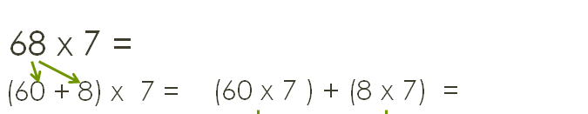
Partial Products
When we are using numbers only, we can always refer back to the pictures of the area model in our minds.
60 + 8
7
60 x 7 = 420
8 x 7 = 56
420 + 56 = 476

Slide 31
Partial Products
Are you ready to try?

Slide 32
Partial Products
Break apart both factors to make the multiplication problems easier to solve.
43 x 29
40 x 20 = 800 40 x 9 = 360
3 x 20 = 60 3 x 9 = 27
Add the partial products: 800 + 360 + 60 + 27 = 1247
43 x 29 = 1247

Slide 33
Partial Products
Again, we can think back to our area model to help us visualize what we are doing.
40 + 3
20
+
9
20 x 3 = 60
20 x 40 = 800
9 x 40 = 360
9 x 3 = 27
Add the partial products: 800 + 60 = 860
360 + 27 = 387
1,247
43 x 29 = 1,247

Slide 34
Partial Products
Are you ready to try breaking apart both factors?

Slide 35
So many ways to multiply
Use a Place Value Chart to Multiply by 10
Base Ten Blocks
Area Model Using Base Ten Blocks
Area Model
Partial Products
Using Friendly Numbers (Compensation)

Slide 36
Friendly Numbers
Change one factor to a friendly number (a number that is easy to work with), and then make an adjustment at the end.

Slide 37
Friendly Numbers
For example: 38 x 7
Thirty-eight is not easy to work with, so let’s change it to a number that is easier to work with.
40 is easier to work with, and it’s close to 38.
40 x 7 = 280
Next, make the adjustment.
Since 40 groups of 7 is 2 more groups of 7
than 38 groups of 7, we need to take away 2 groups of 7.
2 x 7 = 14
280 – 14 = 266
Our final answer is 38 x 7 = 266.

Slide 38
So many ways to multiply
Use a Place Value Chart to Multiply by 10
Base Ten Blocks
Area Model Using Base Ten Blocks
Area Model
Partial Products
Using Friendly Numbers (Compensation)
Distributive Property

Slide 39
Distributive Property
Phew. We’ve already learned this!
All, or nearly all, of the methods we learned tonight use the distributive property – breaking apart one or both factors to find partial products.

Slide 40
So many ways to multiply
Use a Place Value Chart to Multiply by 10
Base Ten Blocks
Area Model Using Base Ten Blocks
Area Model
Partial Products
Using Friendly Numbers (Compensation)
Distributive Property
Algorithm

Slide 41
Traditional Algorithm
Your child will learn the traditional algorithm by the
end of 5th grade.

Slide 42
Any Questions?
Please feel free to ask for help any time.
We can always be reached by email.
Thank you so much for attending our Math Night. We hope it will be helpful to you and your child.
If you have any suggestions to improve our presentation, please send them our way!

