Slide 1
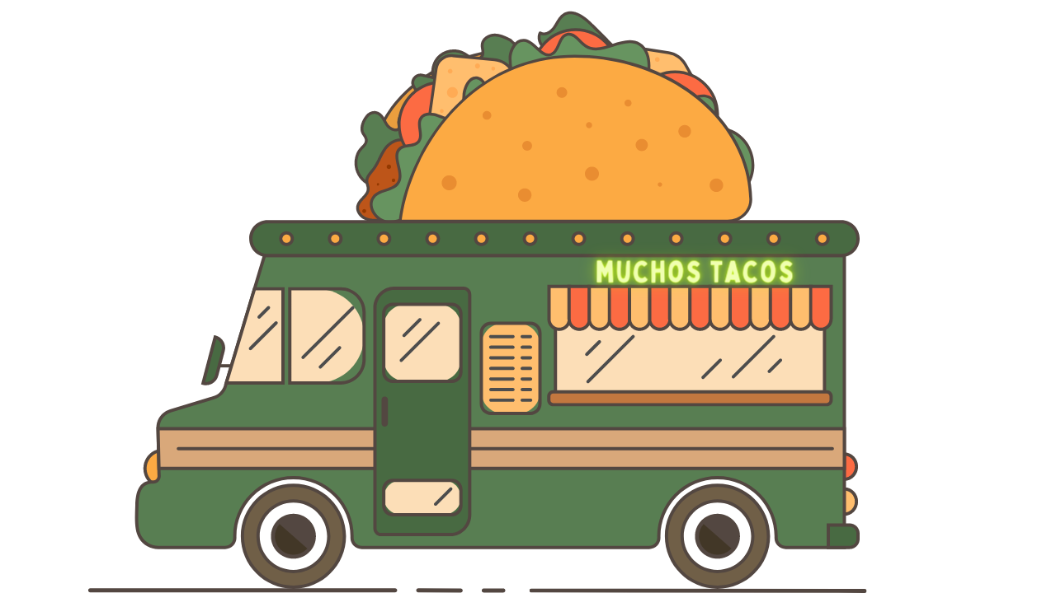

“SERVICE!”
@mrjames_mh

Slide 2
Context.
“We are going to launch Muchos Tacos today! I hope the public are hungry.
You’ll need to take the orders and work out what to charge each customer.
Keep a track of the total income…you might need it later ;)”
@mrjames_mh

Slide 3
Teacher notes.
The sequence is designed to draw attention to relationships. There are opportunities to use doubling, as well as the Over Strategy (e.g. 3 x 1.99 = (3 x 2) - (3 x 0.01).
At the end of the sequence, there is a problem talk so that everyone can come together and be exposed to efficient strategies.
At the very end, there is a selection of “check your understanding” questions to be done individually. Answers provided.
@mrjames_mh

Slide 4
Menu
Chicken tacos: $4.95
Beef tacos: $3.99
The Big Mix! $6.50
Chilli Mayo: $0.49
Muchos Soda: $2.49

Slide 5
a.
“2 orders of Chicken tacos, please.”

Slide 6
b.
“Two sodas, please”

Slide 7
c.
“Four sodas, please”

Slide 8
d.
“Beef tacos with extra chilli mayo”

Slide 9
e.
“2 orders of beef tacos, both with extra chilli mayo”

Slide 10
f.
“Three orders of The Big Mix and one soda”

Slide 11
g.
“Five beef tacos, all with extra chilli mayo.”

Slide 12
h.
“Four chicken tacos, each with a drink”

Slide 13
i.
“Two chicken tacos, two beef tacos, two Big Mix. All with extra chili mayo, all with a drink”

Slide 14
j.
TOTAL INCOME?

Slide 15
k.
50% of the income can be split between each member of your group. How much do you get?

Slide 16
End of sequence.

Slide 17
Problem talk.
“Two orders of beef tacos, please”
“Three orders of chicken tacos, please”
Chicken tacos: $4.95
Beef tacos: $3.99
The Big Mix! $6.50
Chilli Mayo: $0.49
Muchos Soda: $2.49
Notes:
This slide is designed to be a whole-class problem talk. It is animated to reveal the “two orders of beef tacos” first. The space can be used to model efficient ways of calculating this (the way we are looking at is using the Over strategy). Then, to have further practice, the next animation brings up another order: three chicken tacos. Model again, then move onto check your understanding questions slide.

Slide 18
Check your understanding.
Teacher notes:
The difficulty increases from left to right. Students solve each problem in the mini string, then take on the “clunker” at the bottom of the column. These clunkers are related to the string as they can be solved in a similar way, but are novel. This is to try and aid transfer and help students apply strategies without “helper” clues.
It is not necessary for all students to complete all problems. The aim is for each student to be challenged appropriately

Slide 19
Check your understanding - Questions
2 x 2 | 4 x 3 | 5 x 5 | 8 x 12 | 6 x 9
2 x 0.01 | 4 x 0.02 | 5 x .05 | 8 x 0.04 | 6 x 0.02
2 x 1.99 | 4 x 2.98 | 5 x 4.95 | 8 x 11.96 | 6 x 8.98
 |  |  |  | .6 x 8.98
3 x 2.99 | 2 x 1.98 | 4 x 3.95 | 7 x 6.96 | .4 x 4.95
Notes:
Difficulty increases from left to right. Students solve each problem in the mini string, then take on the “clunker” at the bottom of the column. These clunkers are related to the string as they can be solved in a similar way, but are novel. This is to try and aid transfer and help students apply strategies without “helper” clues.

Slide 20
Check your understanding - Answers
2 x 2 = 4 | 4 x 3 = 12 | 5 x 5 = 25 | 8 x 12 = 96 | 6 x 9 = 54
2 x 0.01 = 0.02 | 4 x 0.02 = 0.08 | 5 x .05 = 0.25 | 8 x 0.04 = 0.32 | 6 x 0.02 = 0.12
2 x 1.99 = 3.98 | 4 x 2.98 = 11.92 | 5 x 4.95 = 24.75 | 8 x 11.96 = 95.68 | 6 x 8.98 = 53.88
 |  |  |  | .6 x 8.98 = 5.388
3 x 2.99 = 8.97 | 2 x 1.98 = 3.96 | 4 x 3.95 = 15.80 | 7 x 6.96 = 48.72 | .4 x 4.95 = 1.98
Notes:
Difficulty increases from left to right. Students solve each problem in the mini string, then take on the “clunker” at the bottom of the column. These clunkers are related to the string as they can be solved in a similar way, but are novel. This is to try and aid transfer and help students apply strategies without “helper” clues.

