Slide 1
Ms. Eldridge’s Road to School Counseling
Discovering your passion, talents, interests and their intersections!

Slide 2
Once upon a time...
There was a little girl named Ashley Eldridge. She loved to draw! So, she dreamt of being…
An artist!
As time went on, she realized that she liked to draw for fun. She did not want people to judge her drawings and she liked to keep them. So, she realized art was not her calling.

Slide 3
Not Picasso
Artist
Ms. Eldridge’s grandmother was a nurse. Ms. Eldridge liked helping people and she liked science, so she decided she would be…
An ER Nurse!
After watching a show called Rescue 911, she learned that ER nurses had to see a lot of sad stuff and blood, so she realized that nursing was not her calling.
ER Nurse

Slide 4

Not Florence Nightinggale
All this time, Ms. Eldridge had kept drawing. She really developed a love of drawing elaborate houseboats. Soon, she dreamt of being…
A luxury yacht designer!
She learned that this job is REALLY hard to get, and it involved more than just drawing. So, she realized this was not her calling.
Luxury Yacht Designer

Slide 5

Not a Skipper
Although the luxury yacht designer market was not great, but. Ms. Eldridge also loved drawing intricate homes. She learned that there was a huge market for…
Architects!
Then, in 10th grade, she took Geometry. We’ll just say they didn’t get along, and she knew architects had to do lots of Geometry. She realized, that architecture was not her calling.
Architect

Slide 6

Not Bobby McAlpine
Ms. Eldridge was still doing REALLY well in science, and she loved helping people. Ms. Eldridge wanted to combine this passion and talent. So when a friend’s mom told her about her job as a…
Physical Therapist
She thought it was a great idea!
Physical Therapist

Slide 7
Ruh Roh!
Ms. Eldridge went to Wake Forest, planning to be a Physical Therapist. Once there, she learned that a requirement is completion of an Anatomy class and its lab. The lab involves a dissection of a human body...Ms. Eldridge was NOT feeling this! She realized this was NOT her calling.
So, there she is...freaking out...because she her parents were spending all this money for her to go to college and she had NO idea what to do when she grew up!

Slide 8
A Future Counselor goes to Counseling
A friend suggested that she go to the College and Career Counseling Center at Wake. When she visited, they invited her to take 3 self-assessments that would identify...
Ms. Eldridge’s Strengths
Ms. Eldridge’s Interests
Careers that Might be Well-Matched to Ms. Eldridge
The results came back...and...

Slide 9
EUREKA!
The results were listed from greatest match to least likely match…
Elementary School Counselor
Elementary School Speech Teacher
Elementary School Classroom Teacher
Elementary School Special Ed. Teacher
Elementary School Gym Teacher
Middle School Counselor....
Fill in the other from elementary school with middle school!

Slide 10
Physical Therapist
3rd Grade Teacher

Slide 11
Discovering the Perfect fit in london!
Ms. Eldridge decided she would be a school teacher, like her mom. Although she’d never wanted to be a teacher, it made sense. She liked helping. She liked kids. She liked having summers off. She liked that Wake Forest had a great education program.
Then, she studied abroad in London, England. There, she worked as a teacher assistant under a...
School Counselor!

Slide 12
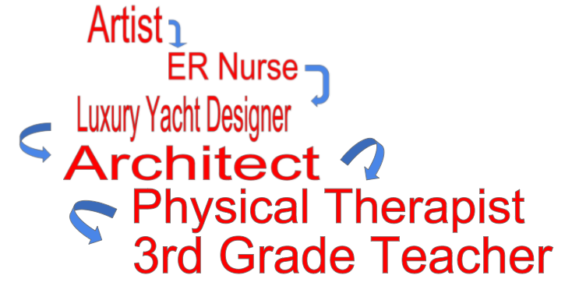
Happily Ever After
Once Ms. Eldridge saw how the school counselor got to know ALL the kids and teachers, how she got to do different things each day, and that there was a perfect balance between teaching and counseling, she thought…
THAT’S IT! School counseling is the job for me!
SCHOOL COUNSELING

Slide 13
DISCUSS: Why did Ms. Eldridge share this story with you?

