Slide 1

Mr. Gautney - Social Science

Slide 2


Slide 3
MORE ABOUT ME …
Hello everyone, my name is Caleb Gautney. I am a life-long resident of the North Alabama region graduating from Brooks High School in Killen, AL in 2005 and receiving my undergraduate degree from the University of North Alabama in 2010. Since that time, I have become a husband and father. My wife and I have the most beautiful daughter who will be starting 1st grade this year. My family and I live for the Lord and cheer for the Tide as I tell most people. We love anything outdoors and good fellowship with friends and family.
My teaching experiences have included time spent in both the public and private sector. I have also worked with at-risk youth in Specialized Treatment Centers for the State of Alabama. These combined experiences have shaped my education philosophy in ensuring the education of the whole child; a critical component in an ever changing world. My greatest joy in life has always been helping others and seeing others succeed. Based on my passion and past experiences, I know this is going to be a fantastic year. And although this year in particular will not start the way in which we are accustomed, I know we will successfully make it through this year together and be better for it.

Slide 4
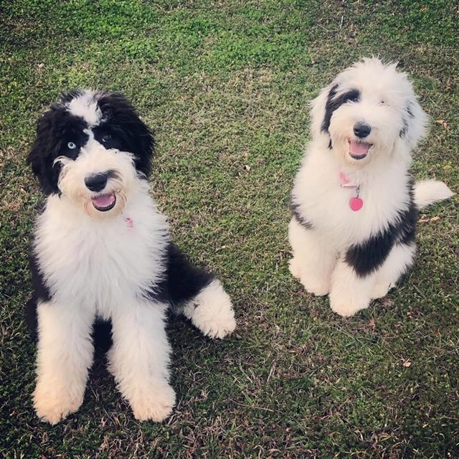
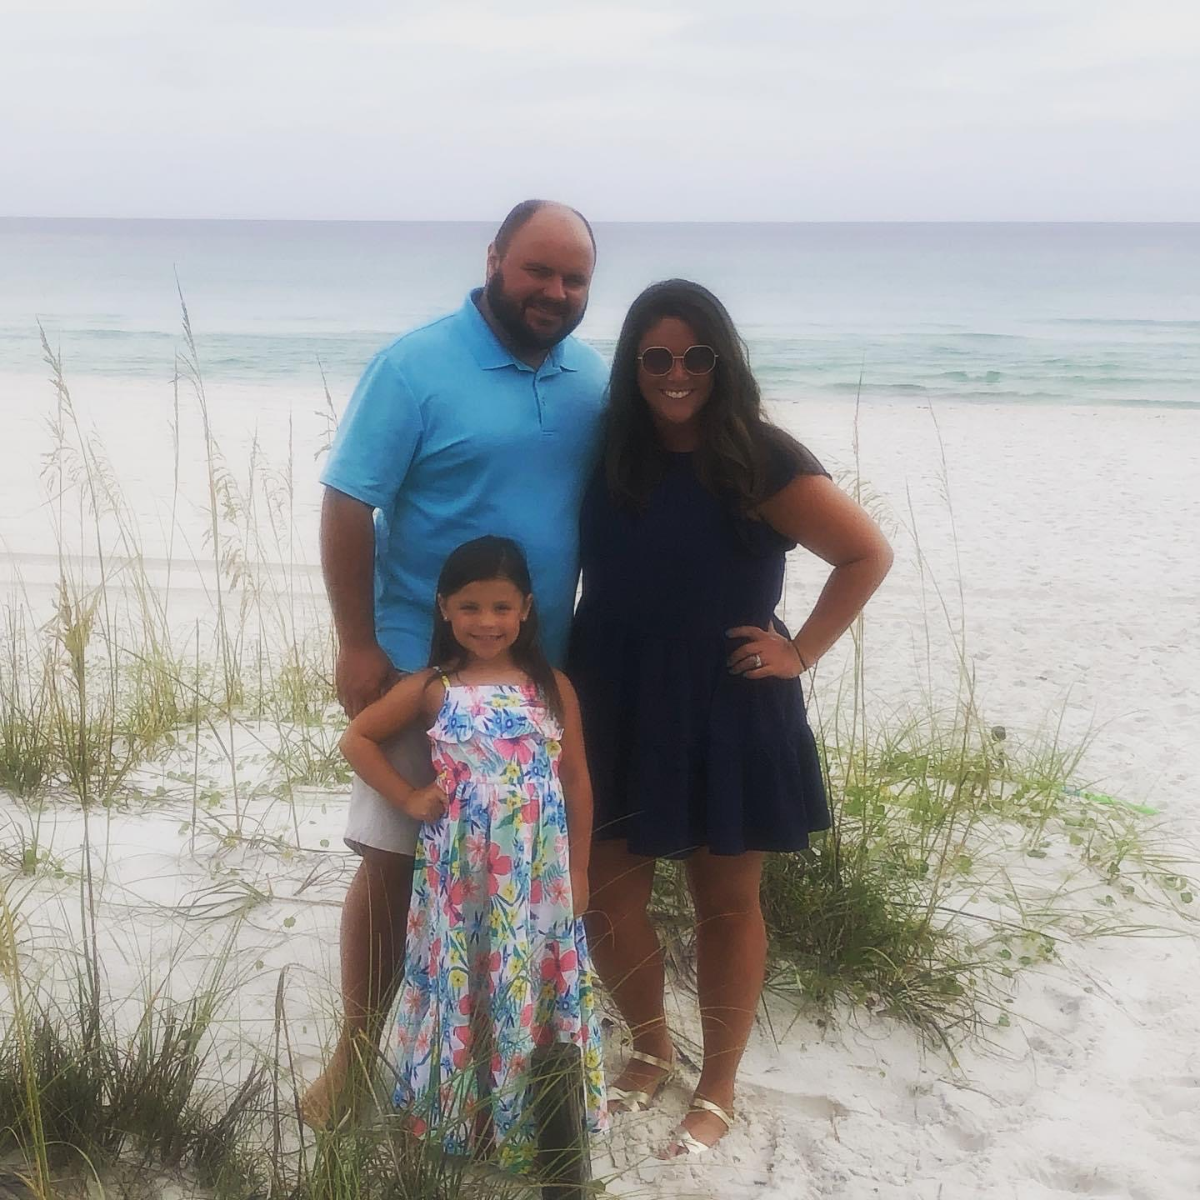
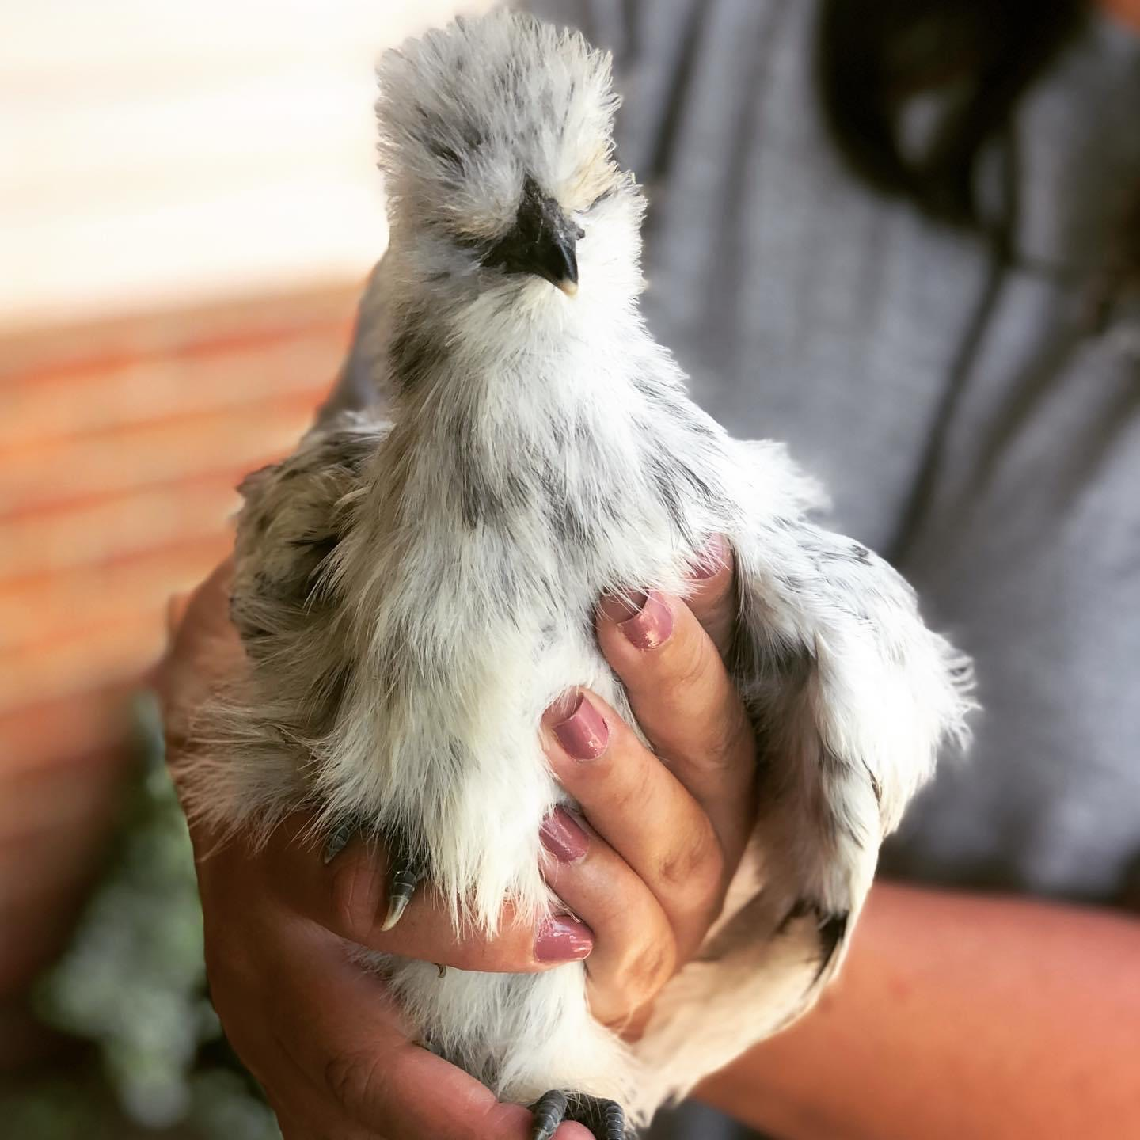
MEET THE FAMILY

Slide 5
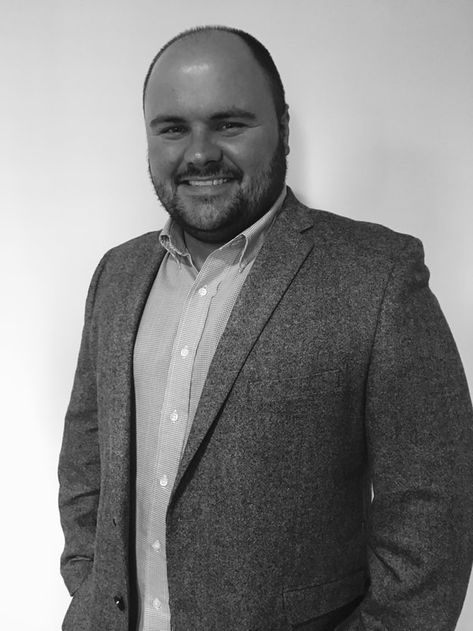
MY MISSION …
https://www.madisoncity.k12.al.us/Domain/1941
My mission is to make a positive impression on the lives of my students and colleagues, while also making a significant contribution in the field of education.

Slide 6
SCHEDULE
S
Y
L
L
A
B
U
S
https://docs.google.com/document/d/1G-ZUoukbY07GuFrayMn2mO3euvYVwsSf2paQ1d2SLVQ/edit?usp=sharing
FALL 2020 | SPRING 2021
8:12-9:32 - Government/Economics | 8:12-9:32 - Government/Economics
9:34-11:26 - Modern U.S. History | 9:34-11:26 - Modern U.S. History
11:28-12:28 - Q&A time for students. Available via phone (256-216-5313 ext. 95150) or email (cpgautney@madisoncity.k12.al.us) | 11:28-12:28 - Q&A time for students. Available via phone (256-216-5313 ext. 95150) or email (cpgautney@madisoncity.k12.al.us)
12:30-1:40 - Early U.S. History | 12:30-1:40 - Early U.S. History
1:42-2:52 - Planning | 1:42-2:52 - Planning
2:54-3:28 - Edgenuity | 2:54-3:28 - Edgenuity

Slide 7
CONTACT INFORMATION
EMAIL: cpgautney@madisoncity.k12.al.us
PHONE: 256-216-5313 ext. 95150

Slide 8
Closing thoughts …
Although this year will not start the way in which we are accustomed, I know we will successfully make it through this year together and be better for it.
Learning Experience (definition): What we do with each day we are given.

